Slide 1
Analysis of Union Budget 2019-20
Moderators
CA. T.V. Mohandas Pai
and
CA. S. Krishnan
Contributors:
Mayank M, Sivaram R, Ravi Sidula, Sravani N, Tarique K
SIRC of ICAI

Slide 2
India at a glance
India at a glance
Population | 1.37 bn | June 2019 (E)
Population Growth Rate | 1.1% | June 2019 (E)
Life Expectancy: Male | 67.8 yrs | 2018 (E)
Life Expectancy: Female | 70.5 yrs | 2018 (E)
Literacy | 79% | 2018 (E)
GDP (at current prices) | US$ 2,736 bn | 2019 (E)
Real GDP growth | 7.4% | 2019 (E)
GDP (in PPP) 3rd Largest Economy | US $11,413 bn | 2019 (E)
Per capita Income | US $2,054 | 2019 (E)
Exports | US $ 331 bn | 2019 (E)
Imports | US $ 513 bn | 2019 (E)
Foreign Exchange Reserves | US $ 426 bn | June 2019 (E)
Government External Borrowings | US $ 105 bn | 2019 (E)
External Debt (Govt & Non-Govt) | US $ 521 bn | Dec 2018 (E)
Interest to Gross Revenue | 24.0% | 2018 (E)
Gross Debt / GDP ratio | 67.29% | 2019 (E)

Slide 3
India – Key Economic Indicators 2019 vs. 1991
….. 28 years’ snapshot post liberalisation
 | 2019 | 1991 | CAGR
Population (Bn) | 1.37 | 0.89 | 1.6%
Life expectancy (Years) | 69 | 58.8 | 0.6%
Literacy rate | 79% | 52% | 2.1%
GDP Growth Rate | 7.4% | 5.3%
GDP (at current prices) – Rs. cr | 190.08 lakhs | 5.32 lakhs | 14.2%
GDP (at current prices) - US$ Bn | 2,736 | 275 | 8.9%
Per capita income - US$ | 2,054 | 310 | 7.0%
Exports - US$ Bn 2018* (E) | 331 | 18 | 11.0%
Imports - US$ Bn 2018* (E) | 513 | 24 | 11.6%
Share in world trade (exports + imports) | 4% | 1%
Foreign Currency Reserves - US $ Bn | 426 | 5.8 | 17.2%
Exchange Rate (US $) | 69.55 | 17.9 | 5.2%
Savings Rate 2018* | 30.5% | 22.9%
Investment Rate 2018* | 32.3% | 22.5%

Slide 4
India’s GDP Growth % - Last 12 Years
GDP expected to grow approximately @ 7 to 7.5% in 2019-20

Slide 5
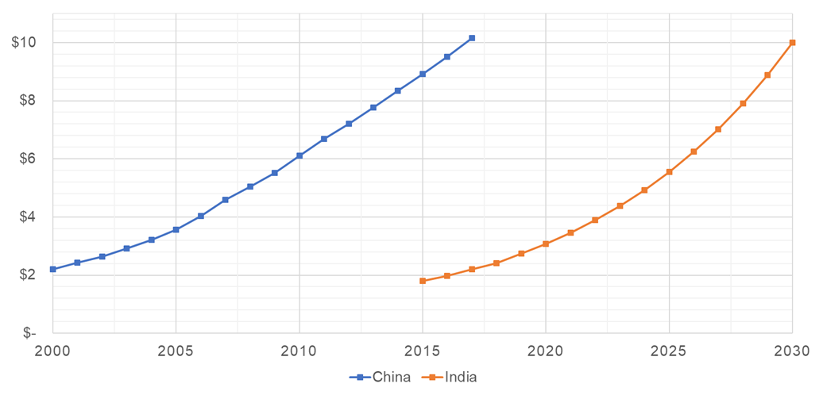
India – GDP Projection
We are where China was in 2002
TRILLIONS
India needs to grow at 9% CAGR net of inflation (~3.5%) to build a USD 10T economy by 2030
China’s GDP grew at an average of 9.9% p.a. from 1979 to 2011

Slide 6
The World is Changing …
Regions | GDP 2018 $ Trilliion | GDP 2025 $ Trilliion | GDP 2030 $ Trilliion | CAGR 2018-2031
US | 20.5 | 24.0 | 26.9 | 2.3%
EU16 | 17.9 | 19.7 | 21.1 | 1.4%
Japan | 4.5 | 4.7 | 4.8 | 0.5%
Others | 9.6 | 9.9 | 9.9 | 2.3%
Total OECD | 52.5 | 58.3 | 62.8 | 1.5%
China | 13.3 | 20.1 | 26.9 | 6.0%
India | 2.6 | 4.7 | 7.2 | 8.8%
Others | 17.3 | 25.3 | 33.0 | 5.5%
Total: RoW | 33.3 | 50.0 | 67.0 | 6.0%
Total Global | 86.6 | 108.3 | 129.8 | 3.5%
Source: OECD, analyst estimates

Slide 7
India & China – at a glance
……………..China has grown faster
 | Estimates as of | India | China
Population | 2019 (E) | 1.37 bn | 1.42 bn
Population Growth Rate | 2019 (E) | 1.1% | 0.35%
Life Expectancy: Male | 2019 (E) | 67.6 yrs | 75 yrs
Life Expectancy: Female | 2019 (E) | 70.1 yrs | 78 yrs
Literacy | 2019 (E) | 79.0% | 96.4%
GDP (at current prices) | 2019 (E) | US$ 2,736 bn | US $ 14,172 bn
Real GDP growth | 2019 (E) | 7.4% | 6.9%
GDP (in PPP) | 2019 (E) | US $ 11,413 bn | US $ 27,449 bn
Per capita Income | 2019 (E) | US $ 2,054 | US $ 10,099
Exports | 2019 (E) | US $ 331 bn | US $ 2,488 bn
Imports | 2019 (E) | US $ 513 bn | US $ 2,119 bn
Foreign Currency Reserves | June 2019 (E) | US $ 426 bn | US $3,101 bn
External Debt | Dec 2018 (E) | US $ 521 bn | US $ 1,965 bn
Gross Debt / GDP ratio | 2019 (E) | 67.29% | 249%

Slide 8
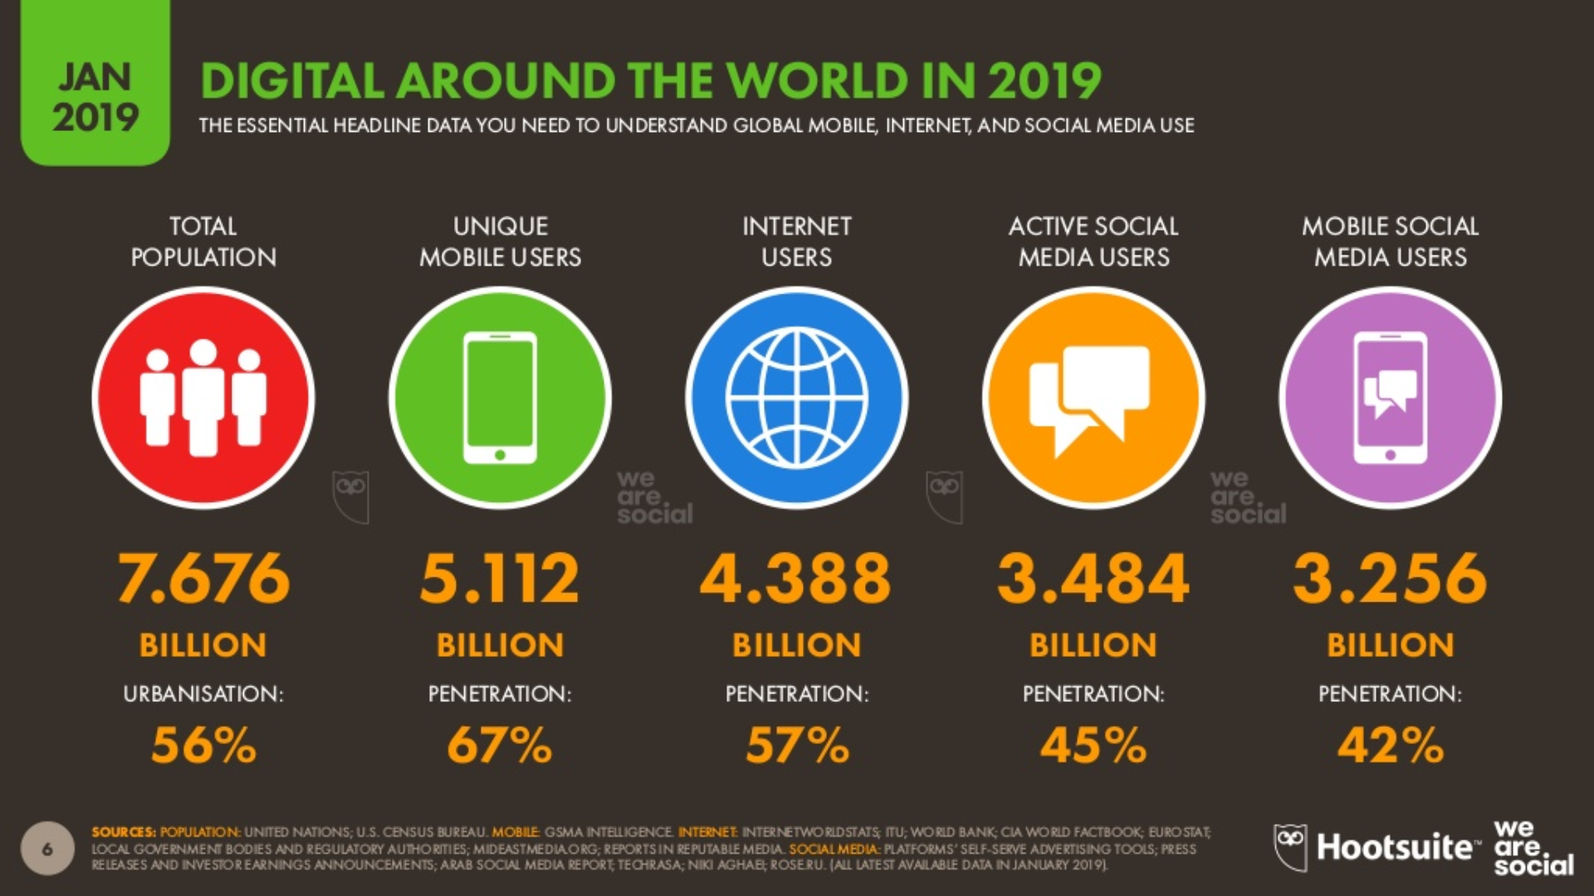
Digitization has transformed the world…
Source: We Are Social

Slide 9
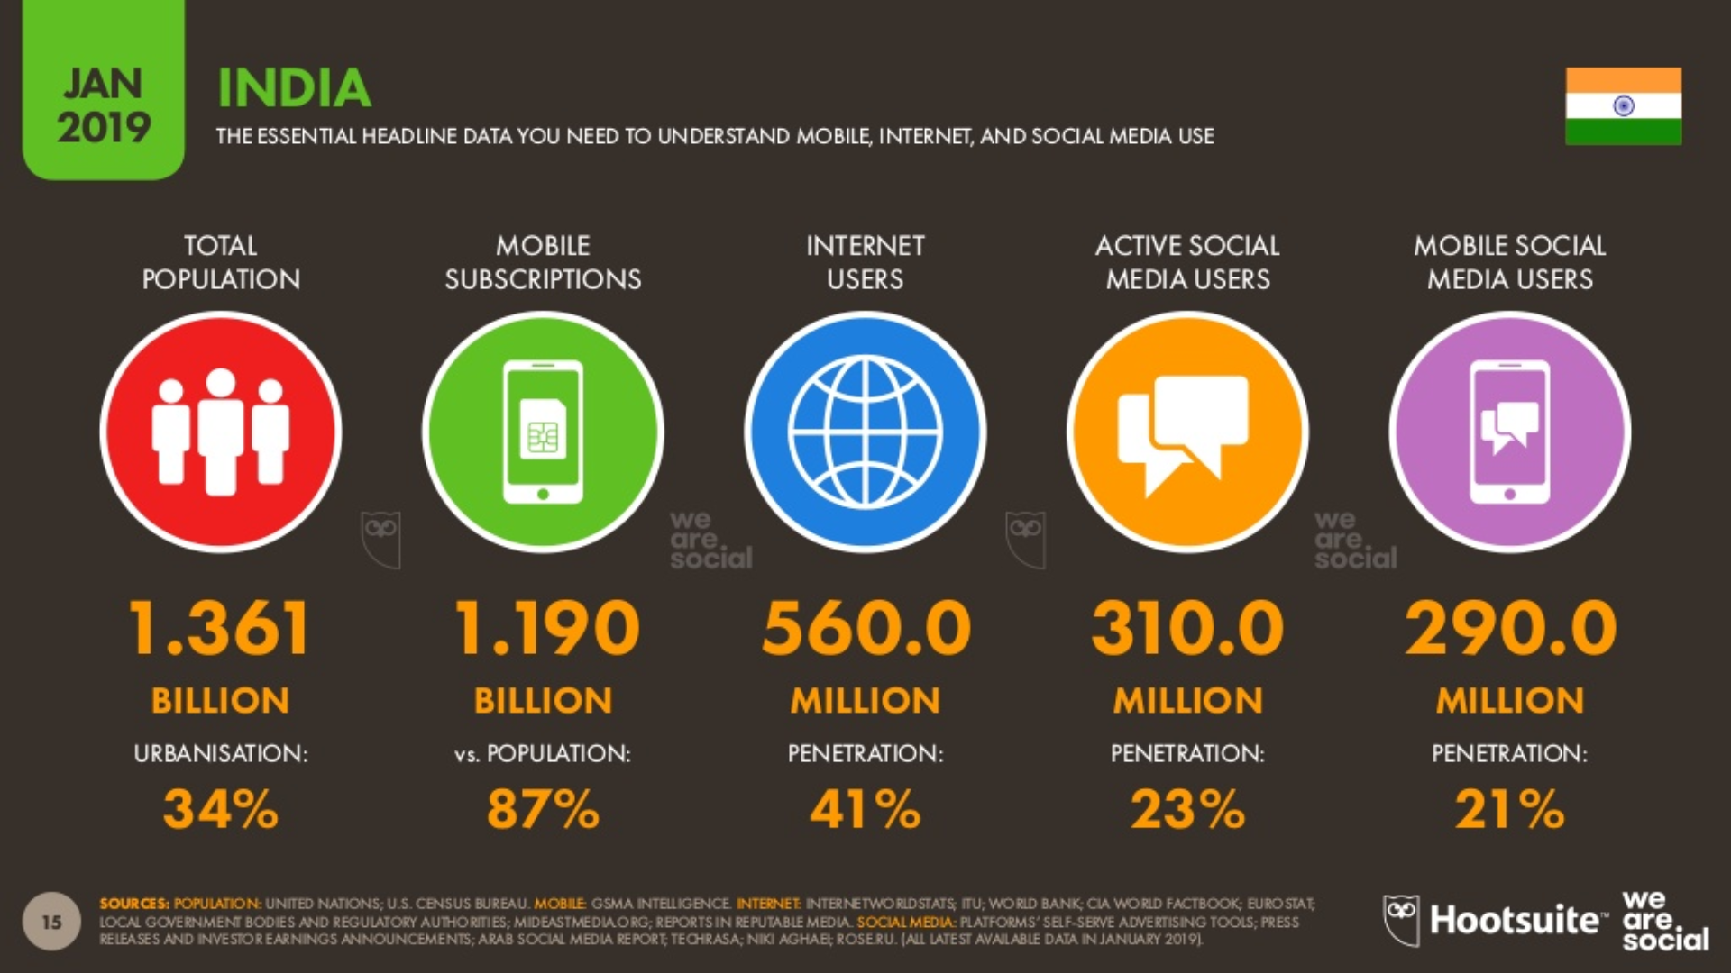
…and India has benefited tremendously
Source: We Are Social

Slide 10
Video 1
Vision for the decade
FM Speech – Para 6 & 7 & Para 8 & 9
Our economy was at approximately US$ 1.85 trillion when we formed the Government in 2014. Within 5 years it has reached US$ 2.7 trillion. Hence, it is well within our capacity to reach the US$ 5 trillion in the next few years. In the interim Budget of 2019-20 presented in February 2019, we gave ourselves a Vision for the Decade. I flag here the ten points of our Vision laid before us:

Slide 11
Vision for the decade
SIRC of ICAI
Are we investing enough to grow the economy?
Does the budget promote the investments needed?
Are the structural reforms in the budget adequate to reach 5T$ by 2025?
What are the major constraints that could impede us?

Slide 12
Video 2
Agriculture and Rural Economy
FM Speech – Para 48
“We will invest widely in agricultural infrastructure. We will support private entrepreneurships in driving value-addition to farmers’ produce from the field and for those from allied activities, like Bamboo and timber from the hedges and for generating renewable energy. Annadata can also be Urjadata. Dairying through cooperatives shall also be encouraged by creating infrastructure for cattle feed manufacturing, milk procurement, processing & marketing. I place my appreciation for our farmers who have made India self-sufficient in pulses. I am sure they will repeat such a success even in the production of oilseeds. Our import bill shall be reduced by their Seva.”

Slide 13








Strong Agricultural Base
Food Grains
Milk
Cotton
Horticulture
Sugar
Spices
Cropland
Livestock
Production (Mn tonnes)
Production (Mn tonnes)
Production (Mn bales)
Production (Mn tonnes)
Production (Mn tonnes)
Exports
(in USD Bn)
Population (Mn)
(Mn hectares)
281
(2nd largest )
176
(Largest)
33
(Largest)
315
(2nd largest)
35.5
(2nd largest)
2.8
(Largest)
179.8
(Largest)
512
(Largest)
INDIA
Major producer of agrochemicals, tea, cashew, jute, oilseeds, etc.
Largest exporter of cereal products, cotton, bovine meat, sugar, etc.
All 15 major climates in the world; 46 of the 60 soil types in the world
Largest manufacturers of farm equipment
Proximity to food importing nations
Consumer spending to reach USD 3.6 Tn by 2020

Slide 14
Agriculture and Rural economy
SIRC of ICAI
Pradhan Mantri Awas Yojana – Gramin (PMAY-G) aims to achieve objective of “Housing for All” by 2022. 1.54 cr rural homes have been completed in last 5 years.
In 2nd phase of PMAY-G, during 2019-20 to 2021-22, 1.95 cr houses are proposed to be provided to the eligible beneficiaries.
Pradhan Mantri Gram Sadak Yojana (PMGSY) has brought socio economic gains in rural areas and all weather connectivity provided to over 97% of such habitations.
PMGSY-III is envisaged to upgrade 1,25,000kms of road length over the next five years, with an estimated cost of Rs. 80,250 crore.
‘Scheme of Fund for Upgradation and Regeneration of Traditional Industries’ (SFURTI) aims to set up more Common Facility Centres to facilitate cluster based development for traditional industries be more productive, profitable and capable for generating sustained employment opportunities.
To invest widely in agricultural infrastructure. To enable private entrepreneurships in driving value-addition to farmers’ produce from the field and for those from allied activities, like Bamboo and timber from the hedges and for generating renewable energy.
To form 10,000 new Farmer Producer Organizations, to ensure economies of scale for farmers over the next five years.

Slide 15
Agriculture and Rural economy
SIRC of ICAI
To work with State Governments to allow farmers to benefit from e-NAM. The Agriculture Produce Marketing Cooperatives (APMC) Act should not hamper farmers from getting a fair price for their produce. Ease of doing business and ease of living both should apply to farmers too.
To go back to basics on one count: Zero Budget Farming. We need to replicate this innovative model through which, in a few States farmers are already being trained in this practice. Steps such as this can help in doubling our farmers’ income in time for our 75th year of Independence.
Constitution of the Jal Shakti Mantralaya, integrating the Ministry of Water Resources, River Development and Ganga Rejuvenation and Ministry of Drinking Water and Sanitation.
This new Mantralaya will look at the management of our water resources and water supply in an integrated and holistic manner, and will work with States to ensure Har Ghar Jal (piped water supply) to all rural households by 2024 under the Jal Jeevan Mission.
This Mission, will focus on integrated demand and supply side management of water at the local level, for reuse in agriculture.

Slide 16
Agriculture and Rural economy
SIRC of ICAI
Has the FM done enough this year to enable the farmers to double their income in 5 years?
Are these measures comprehensive to improve agriculture productivity?
Will the situation in the rural sector improve?
Will this address rural distress?
Are any other measures required to improve the rural sector?

Slide 17
Video 3
Infrastructure
FM Speech – Para 12 & 30
“12. Connectivity is the lifeblood of an economy. The Government has given a massive push to all forms of physical connectivity through Pradhan Mantri Gram Sadak Yojana, industrial corridors, dedicated freight corridors, Bhartamala and Sagarmala projects, Jal Marg Vikas and UDAN Schemes. While the industrial corridors would improve infrastructure availability for greater industrial investment in the catchment regions, the dedicated freight corridors would mitigate the congestion of our railway network benefitting the common man. The ambitious programme of Bharatmala would help develop national road corridors and highways, while Sagarmala would enhance port connectivity, modernization and port-linked industrialization…..
30. We recognize that investment-driven growth requires access to low cost capital. It is estimated that India requires investments averaging 20 lakh crores every year (USD 300 billion a year). A number of measures are proposed to enhance the sources of capital for infrastructure financing:”

Slide 18
Infrastructure
SIRC of ICAI
Investment-driven growth requires access to low cost capital. Estimated that India requires investments averaging Rs. 20 lakh crores every year ($300 Bn a year). Number of measures proposed to enhance sources of capital for infra financing:
  A Credit Guarantee Enhancement Corporation will be set up in 2019-20.
  An action plan to deepen the market for long term bonds including for deepening markets for corporate bond repos, credit default swaps etc., with specific focus on infrastructure sector, will be put in place.
  It is proposed to permit investments made by FIIs/FPIs in debt securities issued by Infrastructure Debt Fund – Non-Bank Finance Companies (IDF-NBFCs) to be transferred/sold to any domestic investor within the specified lock-in period.
Corporate Debt markets are crucial for the infrastructure sector. To deepen the Corporate tri-party repo market in Corporate Debt securities, Government will work with RBI/SEBI to enable stock exchanges to allow AA rated bonds as collaterals.
User-friendliness of trading platforms for corporate bonds will be reviewed, including issues arising out of capping of International Securities Identification Number (ISIN).

Slide 19
Infrastructure
SIRC of ICAI
To develop inland waterways in order to shift a significant portion of inland cargo movement from road and rail. Use of rivers for cargo transportation, which will also help to decongest roads and railways.
Railway Infrastructure would need an estimated investment of Rs. 50 lakh crores between 2018-2030. Capital expenditure outlays of Railways around Rs. 1.5 to 1.6 lakh cr p.a. Proposed to use Public-Private Partnership for faster development and track completion, rolling stock manufacturing and delivery of passenger freight services.
As the world’s 3rd largest domestic aviation market, India to enter into aircraft financing and leasing activities from Indian shores to enable development of a self-reliant aviation industry, creating aspirational jobs in aviation finance and leveraging the business opportunities available in India’s financial Special Economic Zones (SEZs), namely, International Financial Services Centre (IFSC). Government to implement the essential elements of the regulatory roadmap for making India a hub for such activities.
To take connectivity infrastructure to the next level, propose to make available a blueprint this year for developing gas grids, water grids, i-ways, and regional airports.
A package of power sector tariff and structural reforms to be announced soon.
Several reform measures to be taken up to promote rental housing. Current Rental Laws are archaic as they do not address the relationship between the Lessor and the Lessee realistically and fairly. A Model Tenancy Law will also be finalized and circulated to the States.

Slide 20








Strong Industrial & Infrastructural Base
Coal
Iron Ore
Aviation
Railway
Roadway
Ports
Electricity
Textile
Production (Mn MT)
Production (Mn tonnes)
Passenger Traffic (Mn)
Network (‘000 Kms)
Network
(Mn Kms)
Cargo Traffic
(Bn MT)
Production
(Bn Units)
Production
(Bn$)
739.4
(2nd largest)
67.4
(4th largest)
5.6
(3rd largest)
1.2
(2.5 by 2020)
67.5
(2nd largest)
INDIA
220
(4th largest )
345
(7th largest )
1260
(3rd largest)
Exports stood at USD 331 billion in 2018-19, growing at 10%
Ranked 35th in Logistics Performance Index (LPI) 2016 (up 19 ranks)
Air passenger traffic is growing at 16.5%, to become 3rd largest by 2024
Automobile production is growing at 14.8% and exports at 16.1%
Produces 95 minerals - 4 fuel-related, 10 metallic, 23 non-metallic, 3 atomic, and 55 others

Slide 21








Strong Industrial & Infrastructure Base
Steel
Cement
Two
Wheeler
Four
Wheeler
Construction
ITeS
Electricity
Production
Wireless
Phone
Production in Mn tonnes
Capacity in Mn tonnes
Production in Mn Units
Production in Mn Units
Bn Sq. ft.
Revenue in Bn$
TWh
Subscribers in Mn
107
(2nd largest)
24.5
(Largest )
1,162
(2nd largest )
INDIA
502
(2nd largest)
5.1
(5th largest )
181
(4th largest )
1,260
(5th largest)
1
(6th largest)
JAPAN
104
55
-
9.7
-
-
1,020
173
USA
87
120
-
11.3
-
1,600
4,280
392

Slide 22
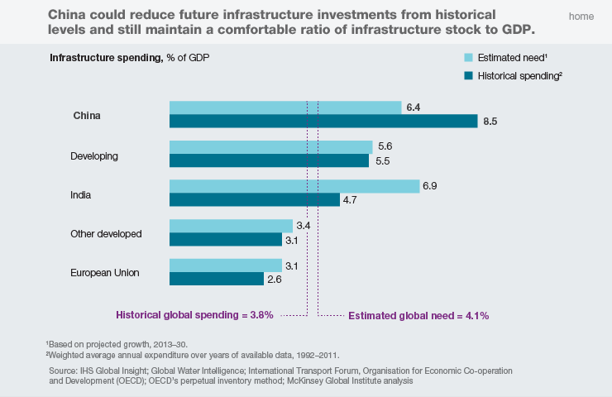
Infrastructure Investment
… India is spending much below its need and China, way above

Slide 23
Infrastructure
SIRC of ICAI
Is the budgetary expenditure on infrastructure adequate to meet India’s infrastructure requirements?
How do we access long term low cost capital to fund infrastructure?
Does the private sector have the capacity to invest in Infra?
Is the allocation of Rs 100 lakh crore over 5 years feasible?

Slide 24
Video 4
Capital Markets
FM Speech – Para 32 & 33
“32. It is right time to consider increasing minimum public shareholding in the listed companies. I have asked SEBI to consider raising the current threshold of 25% to 35%.
33. As a key source of capital to the Indian economy, it is important to ensure a harmonized and hassle free investment experience for Foreign Portfolio Investors. Hence, it is proposed to rationalize and streamline the existing Know Your Customer (KYC) norms for FPIs to make it more investor friendly without compromising the integrity of cross-border capital flows.”

Slide 25
Capital Markets
SIRC of ICAI
To consider increasing minimum public shareholding in the listed companies from the current threshold of 25% to 35%.
To bring inter-operability of RBI depositories and SEBI depositories to enable seamless transfer of treasury bills and government securities.
In order to make India a more attractive FDI destination:
a. 100% Foreign Direct Investment (FDI) will be permitted for insurance intermediaries.
b. Local sourcing norms will be eased for FDI in Single Brand Retail sector.
c. Government to examine suggestions of further opening up of FDI in aviation, media (animation, AVGC) and insurance sectors in consultation with all stakeholders.
To increase the statutory limit for FPI investment in a company from 24% to sectoral foreign investment limit, with option given to the concerned corporates to limit it to a lower threshold.
FPIs will be permitted to subscribe to listed debt securities issued by ReITs and InvITs.
To merge the NRI-Portfolio Investment Scheme Route with the Foreign Portfolio Investment Route.

Slide 26
Capital Markets
SIRC of ICAI
To rationalize and streamline the existing Know Your Customer (KYC) norms for FPIs to make it more investor friendly without compromising the integrity of cross-border capital flows.
To set up a social stock exchange under the regulatory ambit of SEBI for listing social enterprises and voluntary organizations working for the realization of a social welfare objective so that they can raise capital as equity, debt or as units like a mutual fund.
Securities Transaction Tax (STT) to be levied only on the difference between settlement and strike price in case of exercise of options.

Slide 27
Capital Markets
SIRC of ICAI
Did the 10% long term capital gain on equity investments introduced last year negatively affect the capital market?
What is the impact of increasing minimum public shareholding in the listed companies to 35%?
What is the impact of introducing buy-back tax on listed securities?

Slide 28
Video 5
Banking and Financial Sector
FM Speech – Para 88 & 89
“88. Financial gains from cleaning of the banking system are now amply visible. NPAs of commercial banks have reduced by over 1 lakh crore over the last year, record recovery of over 4 lakh crore due to IBC and other measures has been effected over the last four years, provision coverage ratio is now at its highest in 7 years, and domestic credit growth has risen to 13.8%. Government has smoothly carried out consolidation, reducing the number of Public Sector Banks by 8. At the same time, as many as 6 PSBs have been enabled to come out of Prompt Corrective Action framework.
89. Having addressed legacy issues, PSBs are now proposed to be further provided 70,000 crore capital to boost credit for a strong impetus to the economy. To further improve ease of living, they will leverage technology, offering online personal loans and doorstep banking, and enabling customers of one PSB to access services across all PSBs…….

Slide 29
Banking and Financial Sector
SIRC of ICAI
To provide Rs. 70,000 crore capital to Public Sector Banks to boost credit for a strong impetus to the economy.
To enable customers of one Public Sector Bank to access services across all Public Sector Banks.
Reforms to be undertaken to strengthen governance in Public Sector Banks.
NBFCs that are fundamentally strong should continue to get funding from banks and
mutual funds without being unduly risk averse.
In order to enable purchase of high-rated pooled assets of financially sound NBFCs, amounting to a total of Rupees one lakh crore during the current financial year, Government will provide one time six months' partial credit guarantee to Public Sector Banks for first loss of up to 10%.
To strengthen the regulatory authority of RBI over NBFCs.
NBFCs providing public placement of debt have to maintain a Debenture Redemption Reserve (DRR) and an additional special reserve as required by RBI. To allow NBFCs to raise funds in public issues, the requirement of creating a DRR will be removed.

Slide 30
Banking and Financial Sector
SIRC of ICAI
For ease of access to credit for MSMEs, Government has introduced providing of loans up to 1 crore for MSMEs within 59 minutes through a dedicated online portal. Under the Interest Subvention Scheme for MSMEs, 350 crore has been allocated for FY 2019-20 for 2% interest subvention for all GST registered MSMEs, on fresh or incremental loans.
Government payments to suppliers and contractors are a major source of cash flow, especially to SMEs and MSMEs. Investment in MSMEs will receive a big boost if these delays in payment are eliminated. Government to create a payment platform for MSMEs to enable filing of bills and payment thereof on the platform itself.

Slide 31
Banking and Financial Sector
SIRC of ICAI
With the infusion of Rs 70,000 crore, will the banking sector have adequate capital to lend again?
Why are banks not passing on the interest rates cuts announced by RBI?
Can public sector banks compete with private sector banks in the future?
Has IBC made a big difference to banking?

Slide 32
Video 6
Start-ups
FM Speech – Para 113 & 114
“113. Start-ups in India are taking firm roots and their continued growth needs to be encouraged. To resolve the so-called ‘angel tax’ issue, the start-ups and their investors who file requisite declarations and provide information in their returns will not be subjected to any kind of scrutiny in respect of valuations of share premiums. The issue of establishing identity of the investor and source of his funds will be resolved by putting in place a mechanism of e-verification. With this, funds raised by start-ups will not require any kind of scrutiny from the Income Tax Department.
114. In addition, special administrative arrangements shall be made by Central Board of Direct Taxes (CBDT) for pending assessments of startups and redressal of their grievances. It will be ensured that no inquiry or verification in such cases can be carried out by the Assessing Officer without obtaining approval of his supervisory officer.”

Slide 33



Startups at a glance
50%
of all active startups are concentrated in Bengaluru, Mumbai and Delhi-NCR
% deals per city
Startups have raised
USD 50Bn since 2014
across 3700+ deals
250+ Accelerators & Incubators
500+ Institutional Investors
2000+ Active Investors
495 Acquisitions
Delhi
15%
Mumbai
Hyderabad
9%
15%
Bengaluru saw 43.3%
of the total deal value in 2018
BLR
20%
Chennai
6%
Startups raised USD 11Bn (excl. Walmart’s investment in Flipkart) across 936 deals in 2018,
against USD 13.7Bn across 820 deals that was invested in 2017
Source: Yourstory, Inc42

Slide 34
Start-ups
SIRC of ICAI
To resolve the so-called ‘angel tax’ issue, the start-ups and their investors who file requisite declarations and provide information in their returns will not be subjected to any kind of scrutiny in respect of valuations of share premiums.
The issue of establishing identity of the investor and source of his funds will be resolved by putting in place a mechanism of e-verification. With this, funds raised by start-ups will not require any kind of scrutiny from the Income Tax Department.
CBDT to make special administrative arrangements to redress grievances of pending assessments of start-ups. CBDT to ensure that no inquiry or verification in such cases can be carried out by the Assessing Officer without obtaining approval of his supervisory officer.
At present, start-ups are not required to justify fair market value of their shares issued to certain investors including Category-I AIFs. This benefit is extended to Category-II AIFs also. Therefore, valuation of shares issued to these funds shall be beyond the scope of income tax scrutiny.
The period of exemption of capital gains arising from sale of residential house for investment in start-ups to be extended by 2 years up to 31.3.2021.

Slide 35
Start-ups
SIRC of ICAI
Do these measures provide complete relief from Angel tax terrorism?
How do we incentivise domestic investors to invest in start-ups?
Can we prevent India from becoming a digital colony?

Slide 36
Trends in Fiscal Deficit
(Rs. cr)

Slide 37
Trends in Revenue and Fiscal Deficit
(% of GDP)

Slide 38
Trends in Inflation (CPI)

Slide 39
Is the Budget Credible?
Rs cr | 2014-15 |  | 2015-16 |  | 2016-17 |  | 2017-18 |  | 2018-19
 | BE | Actual | BE | Actual | BE | Actual | BE | Actual | BE | RE
Receipts | 15,77,029 | 14,42,742 | 16,71,223 | 17,06,908 | 19,53,809 | 19,88,653 | 22,00,336 | 21,37,882 | 23,99,147 | 24,16,034
Tax Receipt | 13,64,524 | 12,44,885 | 14,49,490 | 14,55,648 | 16,30,888 | 17,15,822 | 19,11,579 | 19,15,494 | 22,71,241 | 22,48,175
Non Tax Revenue | 2,12,505 | 1,97,857 | 2,21,733 | 2,51,260 | 3,22,921 | 2,72,831 | 2,88,757 | 1,92,744 | 2,45,089 | 2,54,276
Expenditure | 17,94,892 | 16,63,673 | 17,77,477 | 17,90,783 | 19,78,060 | 19,75,194 | 21,46,735 | 21,41,973 | 24,42,213 | 24,57,235
Subsidies | 2,60,658 | 2,58,258 | 2,43,811 | 2,41,833 | 2,33,835 | 2,04,025 | 2,40,339 | 1,91,210 | 2,64,336 | 2,66,206
GDP growth rate % | 11% |  | 10.40% |  | 10.80% |  | 10% |  | 11.5%
Nominal GDP is expected to grow approximately @ 11.5% in 2019-20

Slide 40
Is the Budget Credible?
 | 2015-16 | 2016-17 | 2017-18 | 2018-19
Budgeted Tax Revenue growth % | 6% | 13% | 17% | 19%
Actual Tax Revenue Growth % | 17% | 18% | 12%
Actual Total Receipts % of BE | 102% | 102% | 97%
Actual Subsidy % of BE | 99% | 87% | 80%

Slide 41
Fiscal Management
SIRC of ICAI
FRBM Committee in FY 2016-17 recommended 3% fiscal deficit for next 3 years.
The former FM had projected fiscal deficit of 3.2% in FY 2017-18. Revised fiscal deficit for FY 2017-18 is 3.5%.
Projected fiscal deficit for FY 2018-19 is 3.3%
Will the slippage in fiscal deficit increase inflation?
Will the FM be able to prudently manage fiscal deficit in FY 2018-19?

Slide 42
Budget at a glance
INR cr
 | 2017-2018 Actuals | 2018-19 (BE) | 2018-19 (RE) | 2019-20 (BE)
Total Receipts* | 21,37,882 | 23,99,147 | 24,16,034 | 27,35,290
Non-Scheme Expenditure | 12,68,740 | 14,27,762 | 14,15,590 | 15,83,945
Scheme Expenditure | 8,73,233 | 10,14,451 | 10,41,645 | 12,02,404
Total Expenditure | 21,41,973 | 24,42,213 | 24,57,235 | 27,86,349
Revenue Deficit | 4,43,600 | 4,16,034 | 4,45,293 | 485,019
Fiscal Deficit | 5,91,062 | 6,24,276 | 6,45,367 | 703,760
Primary Deficit | 62,110 | 48,481 | 62,692 | 43,289
Source: Budget 2019-20
*Excludes draw-down of cash balance

Slide 43
Budget at a glance
INR cr
 | 2017-18 Actuals | 2018-2019 (BE) | 2018-2019 (Actuals) | 2019-20 (BE)
Gross Tax revenue | 19,19,008 | 22,71,242 | 20,80,203 | 24,61,195
Revenue Receipts – A | 14,35,232 | 17,25,738 | 15,63,170 | 19,62,761
Tax Revenue (net to Centre) | 12,42,488 | 14,80,649 | 13,16,951 | 16,49,582
Non-tax revenue | 1,92,744 | 2,45,089 | 2,46,219 | 3,13,179
Capital Receipts - B | 7,06,740 | 7,16,475 | 7,48,252 | 8,23,588
Recoveries of Loans | 15,633 | 12,199 | 17,840 | 14,828
Other Receipts | 1,00,045 | 80,000 | 85,045 | 1,05,001
Borrowings and other Liabilities * | 5,91,062 | 6,24,276 | 6,45,367 | 7,03,760
Total Receipts (A + B) | 21,41,972 | 24,42,213 | 23,11,422 | 27,86,349
Gross Tax to GDP ratio | 11.2% | 11.09% | 11.9% | 11.7%**
Source: Budget 2019-20
*Includes draw-down of cash balance
**Based on projected GDP for BE 2019-20 at INR 2,11,00,607

Slide 44
Tax revenues for the past four years
INR cr
 | 2015-2016 | 2016-2017 | 2017-2018 | 2018-2019
Gross Tax revenue | 14,55,648 | 17,15,822 | 19,19,008 | 20,80,203
Growth in gross tax revenue (%) | 16.93% | 17.87% | 11.84% | 8.3%
Revenue Receipts | 11,95,025 | 13,74,203 | 14,35,232 | 15,63,170
Tax Revenue (net to Centre) | 9,43,765 | 11,01,372 | 12,42,488 | 13,16,951
Non-tax revenue | 2,51,260 | 2,72,831 | 1,92,744 | 2,46,219
Capital Receipts | 5,95,748 | 6,09,886 | 706,740 | 7,48,252
Recoveries of Loans | 20,835 | 17,630 | 15,633 | 17,840
Other Receipts | 42,132 | 47,742 | 100,045 | 85,045
Borrowings and other Liabilities | 5,32,791 | 5,35,619 | 591,062 | 6,45,367
Total Receipts* | 17,90,773 | 19,84,089 | 21,41,972 | 23,11,422
The gross tax revenue for 2019-20 BE is estimated to increase by 18.3% over 2018-19
Source: Budget 2019-20
*Includes draw-down of cash balance

Slide 45
Tax revenue
INR cr
TAX REVENUE RECEIPTS | 2017-18 Actuals | 2018-19 Budget Estimates | 2018-19 Revised Estimates | 2019-20 Budget Estimates
Gross Tax Revenue | 19,19,008 | 22,71,242 | 22,48,175 | 24,61,195
Corporation tax | 571,202 | 6,21,000 | 6,71,000 | 7,66,000
Income tax | 430,772 | 5,29,000 | 5,29,000 | 5,69,000
Wealth tax | 63 | - | - | -
Customs | 129,030 | 1,12,500 | 1,30,038 | 1,55,904
Excise | 258,834 | 2,59,600 | 2,59,612 | 3,00,000
Service tax | 81,228 | - | 9,283 | -
GST | 442,561 | 7,43,900 | 6,43,900 | 6,63,343
Taxes on Union Territories | 4,721 | 5,242 | 5,342 | 6,948
Direct Tax | 10,02,037 | 11,50,000 | 12,00,000 | 13,35,000
Indirect Tax | 916,374 | 11,21,242 | 10,48,175 | 11,26,195
Direct tax to GDP ratio | 5.9% | 6.0% | 6.4% | 6.3%
Indirect tax to GDP ratio | 5.4% | 5.9% | 5.6% | 5.3%

Slide 46
Video 7
Direct tax proposals
FM Speech – Para 110 & 127
“110. So far as corporate tax is concerned, we continue with phased reduction in rates. Currently, the lower rate of 25 % is only applicable to companies having annual turnover up to 250 Crore. I propose to widen this to include all companies having annual turnover up to 400 crore. This will cover 99.3% of the companies. Now only 0.7% of companies will remain outside this rate.
127. Mr Speaker Sir, as I have stated earlier, we have taken several measures in the past to alleviate the tax burden on small and medium income-earners as those having annual income up to 5 lakh are not required to pay any income-tax. We are thankful to the taxpayers who play a major role in nation building by paying their taxes. However, in view of rising income levels, those in the highest income brackets, need to contribute more to the Nation’s development. I, therefore, propose to enhance surcharge on individuals having taxable income from 2 crore to 5 crore and 5 crore and above so that effective tax rates for these two categories will increase by around 3 % and 7 % respectively.”

Slide 47
Direct taxes
SIRC of ICAI
For individuals with taxable income of Rs 2-5 crore, surcharge is increased from 15% to 25%, resulting in an effective tax rate of 39% compared to 35.9%. An increase of about 3%.
For individuals with taxable income of above Rs 5 crore, surcharge is increased from 15% to 37%, an increase of 22%. This results in an effective tax rate of 42.74%., an increase of about 7%.
An additional deduction of up to Rs. 1.5 lakh for interest paid on loans borrowed up to 31.03.2020 for purchase of an affordable self-occupied house valued up to 45 lakh. A first-time buyer purchasing an affordable house will now get an enhanced interest deduction up to Rs. 3.5 lakh.
Additional income tax deduction of Rs. 1.5 lakh on the interest paid on loans taken to purchase electric vehicles. This amounts to a benefit of around 2.5 lakh over the loan period to taxpayers who take loans to purchase electric vehicle.
TDS of 2% on cash withdrawal exceeding 1 crore in a year from a bank account.
For ease and convenience of tax payers, PAN and Aadhaar made interchangeable. Those who do not have PAN can file IT returns by quoting their Aadhaar number and also use it wherever they are required to quote PAN.

Slide 48
Direct taxes
SIRC of ICAI
Pre-filled tax returns will be made available to taxpayers which will contain details of salary income, capital gains from securities, bank interests, and dividends etc. and tax deductions.
A scheme of faceless assessment in electronic mode involving no human interface is being launched this year in a phased manner. To start with, such e-assessments shall be carried out in cases requiring verification of certain specified transactions or discrepancies.
Cases selected for scrutiny shall be allocated to assessment units in a random manner and notices shall be issued electronically by a Central Cell, without disclosing the name, designation or location of the Assessing Officer.
An individual or HUF will be required to apply TDS @ 5% if the annual payment made to a contractor or professional exceeds Rs. 50 lakh.
For TDS on payment made for acquisition of immovable property, consideration shall include other charges in the nature of club membership fee, car parking fee, electricity and water facility fee, maintenance fee, advance fee or any other charges of similar nature which are incidental to the purchase of immovable property.
To ensure that persons who enter into high value transactions also furnish return of income, compulsory return filing for persons who have deposited more than Rs. 1 crore in a current account in a year, or who have spent more than Rs. 2 lakh on foreign travel or more than Rs. 1 lakh on electricity consumption in a year or who fulfils the prescribed conditions.

Slide 49
Corporate taxes
SIRC of ICAI
Income tax rate reduced to 25% for companies with annual turnover up to Rs. 400 crs. This reduced rate will cover 99.3% of the companies.
In order to discourage the practice of avoiding Dividend Distribution Tax (DDT) through buy back of shares by listed companies, it is proposed to provide that listed companies shall also be liable to pay additional tax at 20% in case of buy back of shares, as is the case currently for unlisted companies.
It is proposed to allow pass through of losses in cases of Category I and II AIF similar to pass through of income which is allowed atpresent
In order to boost economic growth and Make in India, the government will launch a scheme to invite global companies through a transparent competitive bidding to set up mega-manufacturing plants in sunrise and advanced technology areas such as Semi-conductor Fabrication (FAB), Solar Photo Voltaic cells, Lithium storage batteries, Solar electric charging infrastructure, Computer Servers, Laptops, etc. and provide them investment linked income tax exemptions under section 35 AD of the Income Tax Act, and other indirect tax benefits.
In order to promote the development of world class financial infrastructure in India, additional tax benefits are proposed in respect of businesses carried on from an IFSC

Slide 50
Worldwide corporate tax rates
The worldwide average statutory corporate income tax rate in 2017, measured across 202 tax jurisdictions, is 22.96%*. When weighted by GDP, the average statutory rate is 29.41%
The worldwide corporate tax rate has declined significantly since 1980, from an average of 38.68% to 22.96%, a 41% reduction over the 37 years surveyed
Europe has the lowest regional average rate at 18.35% (25.58% when weighted by GDP). Conversely, Africa and South America has the highest regional average statutory rate at 28.73% (28.2% weighted by GDP for Africa, 32.98% weighted by GDP for South America). Asia’s regional average statutory rate is 20.05% (26.26% GDP weighted)
Today, most countries have corporate tax rates below 30%. Thirty countries have a statutory corporate tax rate between 30 and 35%*
Countries with large economies in the top twenty tax bracket are India (@ 34.61%, including 12% surcharge and 3% cess) and France (34.43%), which rank near the bottom of the category. India holds the 18th spot, while France holds the 20th spot*
*Source: Tax Foundation. Data compiled from numerous sources including: PwC, KPMG, Deloitte, and the U.S. Department of Agriculture.

Slide 51
Direct taxes
Corporate tax rates across the world
Country Name | Corp. Tax Rate
US (incl states) | 27.00%
France | 33.33%
Germany | 33.00%
Australia | 30.00%
Netherlands | 25.00%
China | 25.00%
Japan | 23.20%
UK | 19.00%
Singapore | 17.00%

Slide 52
Effective Tax Rate of Companies in India
Profit Before Taxes | Number of Companies | Share in PBT (%) | Share in Total Income (%) | Share in Total Corporate Tax Liability (%) | Total Income to PBT | Effective Tax Rate (%)
Less than Zero | 3,62,829 | - | 1.34 | 1.34 | - | -
Zero | 88,214 | - | 14.38 | 6.61 | - | -
Rs 0-1 cr | 3,45,458 | 2.72 | 2.84 | 2.43 | 91.71 | 26.29
Rs 1-10 cr | 35,745 | 7.17 | 7.13 | 6.66 | 87.40 | 27.38
Rs 10-50 cr | 6,670 | 9.44 | 8.62 | 9.31 | 80.29 | 29.09
Rs 50-100 cr | 1,162 | 5.41 | 4.71 | 5.22 | 76.44 | 28.44
Rs 100-500 cr | 1,236 | 16.85 | 14.54 | 16.35 | 75.82 | 28.62
Greater Than 500 cr | 373 | 58.41 | 46.44 | 52.08 | 69.87 | 26.30
All Companies | 8,41,687 | 100.00 | 100.00 | 100.00 | 87.87 | 29.49

Slide 53
Effective Tax Rate of Companies in India
In %
Effective Tax Rate | Number of Companies | Share in Total Profits | Share in Total Income | Share in Total Tax Liability
Less Than Zero and Zero | 3,80,006 | 3.18 | 1.57 | 1.43
0-20 | 8,69,36 | 14.41 | 6.5 | 7.77
20-25 | 41,118 | 27.16 | 16.84 | 21.76
25-30 | 1,58,190 | 16.26 | 18.49 | 16.38
30-33 | 52,822 | 33.39 | 44.62 | 41.75
>33 | 34,401 | 5.61 | 11.98 | 10.91
Indeterminate (PBT = 0) | 88,214 | - | - | -
TOTAL | 8,41,687 | 100 | 100 | 100

Slide 54
Effective Tax Rate of Companies in
In %
Effective Tax Rate | Number of Companies | Share in Total Profits | Share in Total Income | Share in Total Tax Liability
Less Than Zero and Zero | 3,80,006 | 3.18 | 1.57 | 1.43
0-20 | 8,69,36 | 14.41 | 6.5 | 7.77
20-25 | 41,118 | 27.16 | 16.84 | 21.76
25-30 | 1,58,190 | 16.26 | 18.49 | 16.38
30-33 | 52,822 | 33.39 | 44.62 | 41.75
>33 | 34,401 | 5.61 | 11.98 | 10.91
Indeterminate (PBT = 0) | 88,214 | - | - | -
TOTAL | 8,41,687 | 100 | 100 | 100

Slide 55
Effective tax rate of companies in the public and private sectors
Effective tax rate of companies in the
manufacturing and non-manufacturing sectors
In %
Sector | Number of Companies | Share in Total Profits | Share in Total Tax Liability | Effective tax
Manufacturing | 1,30,676 | 38.92 | 36.74 | 27.83
Non-manufacturing | 7,11,011 | 61.08 | 63.26 | 30.55
TOTAL | 8,41,687 | 100 | 100 | 29.49
Sector | Number of Companies | Share in Total Profits | Share in Total Tax Liability | Effective tax
Public | 214 | 16.64 | 15.11 | 28.29
Private | 8,41,4873 | 83.36 | 84.89 | 29.73
TOTAL | 8,41,687 | 100 | 100 | 29.49

Slide 56
Direct Taxes
SIRC of ICAI
Is this Budget disappointing as the FM has not cut the corporate tax rate for all companies as per the road map given in 2015 budget?
The government seems to target only individual taxpayers to increase income tax rates in the absence of increasing the taxpayer base
Have they taken adequate steps to bring tax evaders to book?
What are the steps taken by the Govt. to increase taxpayer base?

Slide 57
Video 8
Indirect tax
FM Speech – Para 129
“129. Now coming to Indirect Tax, we are aware that the landscape has changed significantly with implementation of GST. In every sense, this has been a monumental reform. Centre and States coming together and agreeing to pool in their sovereign power of taxation for common good of the country was unprecedented. 17 taxes and 13 cesses became one tax. Multitude of rates instantly became four. Almost all commodities saw rate reduction. Tens of returns were replaced by one. Taxpayer’s interface with tax departments got reduced. Border checks got eliminated. Goods started moving freely across states, which saved time and energy. A truck started doing two trips in the same time in which it was doing one. Thus, dream of one nation, one tax, one market was realised. The GST Council deserves all the credit for this.”

Slide 58
Indirect Taxes
Government is further simplifying the GST processes. A simplified single monthly return is being rolled out. Taxpayer having annual turnover of less than Rs. 5 crore shall file quarterly return. Free accounting software for return preparation has been made available to small businesses.
A fully automated GST refund module shall be implemented.
Multiple tax ledgers for a taxpayer shall be replaced by one.
GST has just completed 2 years. There are huge pending litigations from pre-GST regime. More than Rs. 3.75 lakh crore is blocked in litigations in service tax and excise.
A Legacy Dispute Resolution Scheme will be introduced that will allow quick closure of these litigations.
Proposed to move to an electronic invoice system wherein invoice details will be captured in a central system at the time of issuance. This will eventually be used to prefill the taxpayer’s returns. There will be no need for a separate e-way bill. Its roll out would begin from January, 2020. Electronic invoice system will significantly reduce the compliance burden.

Slide 59
Indirect Taxes
Increase in Special Additional Excise duty and Road and Infrastructure Cess each by one rupee a litre on petrol and diesel.
Increase in custom duty on gold and other precious metals from 10% to 12.5%.
Provisions are being incorporated in Customs Act for enhanced penalty and prosecution for availing undue concessions and export incentives through unfair practices by bogus entities.
Misuse of duty free scrips and drawback facility involving more than Rs. 50 lakh to be made a cognizable and nonbailable offence.
In order to provide domestic industry a level playing field, basic customs duty is being increased on items such as cashew kernels, PVC, Vinyl flooring, tiles, metal fittings, mountings for furniture, auto parts, certain kinds of synthetic rubbers, marble slabs, optical fibre cable, CCTV camera, IP camera, digital and network video recorders etc.
To further promote domestic manufacturing, customs duty reductions are being proposed on certain raw materials and capital goods.

Slide 60
Indirect Taxes
Exemptions from custom duty on certain electronic items which are now being manufactured in India are being withdrawn
Import of defence equipment that are not being manufactured in India are being exempted from the basic customs duty.
To further incentivise e-mobility, customs duty is being exempted on certain parts of electric vehicles.
Customs duty is also being exempted on capital goods required for manufacture of specified electronic goods.

Slide 61
Indirect Taxes
Is the GST implemented effectively?
Will the GST Buoyancy help in meeting the fiscal deficit target?
Is GST helping in “ease of doing business?

Slide 62
Video 9
Conclusion
FM Speech – Para 10
“10. Respected Speaker Sir, it took over 55 years for the Indian economy to reach 1 trillion dollar but when the country and her people’s hearts are filled with aasha, vishwas and aakansha that is, when hearts are filled with hope, trust and aspirations, we, in 5 years, added 1 trillion dollar. Today we are nearing a 3 trillion dollar level. So when we aspire to reach a 5 trillion dollar level, many wonder if it is possible. If we can appreciate our citizens’ "purusharth” or their “goals of human pursuit” filled with their inherent desire to progress led by the dedicated leadership present in this House, the target is eminently achievable.”

Slide 63
Conclusion
Will the next 5 years be the golden years for India?

Slide 64
THANK YOU

