Slide 1
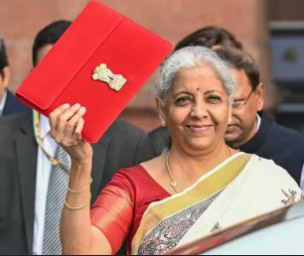
Analysis of Union Budget 2025-26
32nd Awareness Program
F.M. Nirmala Sitharaman creates history with 8th consecutive budget in Parliament.
This takes her closer to the record of 10 budgets that were presented by former Prime Minister Morarji Desai over different time periods. He presented a total of 6 budgets during his tenure as finance minister in 1959-1964, and 4 budgets between 1967-1969

Slide 2
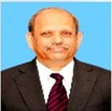
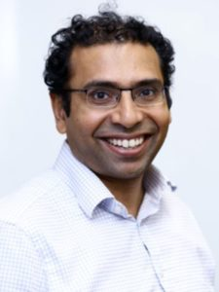
Analysis of Union Budget 2025-26
Panelists
Mr. Saurabh Mukherjea
Founder and Chief Investment Officer of Marcellus
Dr. M. Govinda Rao
Chairman Karnataka Regional Imbalances Redressal Committee
Mr. S. S. Naganand
Senior Advocate

Slide 3
Analysis of Union Budget 2025-26
Contributors:
Krishnan S, Mayank M, Ravi S, Sivaram R, Shweta D, Hari D

Slide 4
India - At a glance
Estimates
Population | 1.41 bn | Dec 2024
Population Growth Rate | 0.88% | Dec 2024
Life Expectancy: Male | 70.7 yrs | 2024
Life Expectancy: Female | 73.9 yrs | 2024
Literacy | 80.3% | 2023
GDP (at current prices) | US$ 3,900 bn | ES 2025
Real GDP growth | 6.4% | ES 2025
GDP (in PPP) 3rd Largest | US $16,020 bn | 2025
Per capita Income | US $2,762 | ES 2024
Exports (goods and services) | US $ 825 bn | MOC 2025
Imports (goods and services) | US $ 909 bn | MOC 2025
Foreign Exchange Reserves | US $ 640 bn | (ES) Dec 2024
Government External Borrowings | US $ 162 bn | MOC Sep 2024
External Debt (Govt & Non-Govt) | US $ 711.8 bn | (ES) Sep 2024
Interest to Gross Revenue | 25% | 2025 BE (Budget)

Slide 5
India – Key Economic Indicators 2025 vs. 1991 ….. 34 years’ snapshot post liberalisation
 | 2025 | 1991 | CAGR
Population (Bn) | 1.41 | 0.89 | 1.4%
Life expectancy (Years) | 72.3 | 59 | 0.6%
Literacy rate | 80.3% | 52% | 1.3%
GDP Growth Rate | 6.4% | 5.3%
GDP (at current prices) – Rs. Lakh Cr | 325 | 5 | 12.9%
GDP (at current prices) - US$ Bn | 3,900 | 275 | 8.1%
Per capita income - US$ | 2,762 | 310 | 6.6%
Exports (G+S) - US$ Bn | 825 | 18 | 11.9%
Imports (G+S) - US$ Bn | 909 | 24 | 11.3%
Share in world trade (exports + imports) | 3% | 1%
Foreign Currency Reserves - US$ Bn | 640 | 6 | 14.8%
Exchange Rate (US $) | 83.6 | 18 | 4.8%
Savings Rate | 30.2% | 22.9%
Investment Rate | 31.4% | 22.5%
Investments | 1 Tr$

Slide 6
India’s GDP Growth % - Last 10 Years
Real GDP & Nominal GDP expected to grow approximately @ 6.3%-6.8% & 10.1% respectively in 2025-26 (ES & Budget)

Slide 7
India – GDP Projection
We are where China was in 2008
India could achieve a projected GDP of $8 Trillion and per capita income of $5,625 by 2030 on account of India’s demographic dividend and a sharp rise in working population. – CBRE
If India wants to build a $10 Trillion economy by 2033, it needs to grow at 12.5% CAGR

Slide 8
GDP Growth Forecast & Inflation
GDP
Inflation
Location | 2025 | 2026
World | 3.3% | 3.3%
Advanced Economies | 1.9% | 1.8%
United States | 2.7% | 2.1%
Euro Area | 1.0% | 1.4%
India* | 6.5% | 6.5%
UK | 1.6% | 1.5%
Japan | 1.1% | 0.8%
Emerging Market Economies | 4.2% | 4.3%
China | 4.6% | 4.5%
2025
4.3%
2.0%
1.9%
2.0%
4.1%
2.1%
2.0%
5.9%
1.7%
2026
3.6%
2.0%
2.1%
2.0%
4.1%
2.0%
2.0%
4.7%
2.0%
IMF Forecast (WEO Jan 2025 Update)

Slide 9
The World is Changing …
GDP in $ trillion
Regions | GDP 2025 | GDP 2029 | GDP 2034 | CAGR 2025-2034
US | 30.3 | 32.6 | 37.9 | 2.5%
EU22 | 19.1 | 19.2 | 21.9 | 1.5%
Japan | 4.4 | 5.1 | 4.8 | 1.0%
OECD Others | 17.0 | 20.1 | 22.2 | 3.0%
Total OECD | 70.8 | 76.9 | 86.7 | 2.3%
China | 19.5 | 24.5 | 27.8 | 4.0%
India | 3.9 | 6.3 | 7.2 | 7.0%
ROW Others | 20.3 | 25.4 | 28.9 | 4.0%
Total: RoW | 43.8 | 56.1 | 63.9 | 4.3%
Total Global | 114.6 | 133.1 | 150.6 | 3.1%
Source: IMF, WEO Database & projections

Slide 10
India & China – at a glance ……………..China has grown faster
 | Estimates as of | India | China
Population | 2024 (E) | 1.41 bn | 1.41 bn
Population Growth Rate | 2024 (E) | 0.8% | -0.54%
Life Expectancy: Male | 2024 (E) | 70.7 yrs | 75.2 yrs
Life Expectancy: Female | 2024 (E) | 73.9 yrs | 81 yrs
Literacy | 2024 (E) | 80.3% | 96.8%
GDP (current) | 2024-25 | US $ 3.90 Tn | US $ 19.53 Tn
GDP growth (Real) | 2024-25 | 6.4% | 4.6%
GDP (in PPP) | 2024 (E) | US $ 16.02 Tn | US $ 39.44 Tn
Per capita Income (current) | 2024-25 (E) | US $ 2,762 | US $ 13,778
Exports (Goods & Services) | 2024-25 (E) | US $ 825 bn | US $ 3.58 Tn
Imports (Goods & Services) | 2024-25 (E) | US $ 909 bn | US $ 2.59 Tn
Foreign Currency Reserves | Dec 2024(E) | US $ 640 bn | US $3.2 Tn
External Debt | Dec 2024(E) | US $ 711.8 bn | US $2.51 Tn
Debt / GDP ratio | 2024 | 87.5% | 93.8%

Slide 11
Video 1
FM Speech – Para 3
First quarter of the 21st Century
As we complete the first quarter of the 21st century, continuing geopolitical headwinds suggest lower global economic growth over the medium term. However, our aspiration for a Viksit Bharat inspires us, and the transformative work we have done during our Government’s first two terms guides us, to march forward resolutely.

Slide 12
First quarter of the 21st Century
Our economy is the fastest-growing among all major global economies
Our development track record of the past 10 years and structural reforms have drawn global attention. It is a shining exception
India has become the fifth largest economy in the first quarter of this Century
Can we realize ‘Viksit Bharat’, as per the vision of PM?

Slide 13
Video 2
FM Speech – Para 6
In this Budget, the proposed development measures span ten broad areas focusing on Garib, Youth, Annadata and Nari.
1) Spurring Agricultural Growth and Productivity;
2) Building Rural Prosperity and Resilience;
3) Taking Everyone Together on an Inclusive Growth path;
4) Boosting Manufacturing and Furthering Make in India;
5) Supporting MSMEs;
6) Enabling Employment-led Development;
7) Investing in people, economy and innovation;
8) Securing Energy Supplies;
9) Promoting Exports; and
10) Nurturing Innovation

Slide 14
Budget priorities
SIRC of ICAI
Viksit Bharat encompasses:
a) zero-poverty;
b) hundred per cent good quality school education;
c) access to high-quality, affordable, and comprehensive healthcare;
d) hundred per cent skilled labour with meaningful employment;
e) seventy per cent women in economic activities; and
f) farmers making our country the ‘food basket of the world’
Do the Budget priorities aid India to become Viksit Bharat?

Slide 15
Video 3
FM Speech – Para 9 & 10
Agriculture as the 1st Engine
9. Now I move to specific proposals, beginning with ‘Agriculture as the 1st Engine’.
Prime Minister Dhan-Dhaanya Krishi Yojana - Developing Agri Districts Programme
10. Motivated by the success of the Aspirational Districts Programme, our Government will undertake a ‘Prime Minister Dhan-Dhaanya Krishi Yojana’ in partnership with states. Through the convergence of existing schemes and specialized measures, the programme will cover 100 districts with low productivity, moderate crop intensity and below-average credit parameters. It aims to (1) enhance agricultural productivity, (2) adopt crop diversification and sustainable agriculture practices, (3) augment post-harvest storage at the panchayat and block level, (4) improve irrigation facilities, and (5) facilitate availability of long-term and short-term credit. This programme is likely to help 1.7 crore farmers.

Slide 16
Strong Agricultural Base
Food Grains
Milk
Cotton
Horticulture
Sugar
Spices
Cropland
Livestock
Production (Mn tonnes)
Production (Mn tonnes)
Production (Mn bales)
Production (Mn tonnes)
Production (Mn tonnes)
Exports
(in USD Bn)
(Mn hectares)
Population (Mn)
332.20
(2nd largest)
239.30
(Largest)
29.5
(2nd Largest)
352.23
(2nd largest)
34
(Largest)
4.25
(Largest)
INDIA
219.2
(Largest)
536.78
(Largest)
Major producer of agrochemicals, tea, cashew, jute, oilseeds, etc.
Largest exporter of cereal products, cotton, bovine meat, sugar, etc.
All 15 major climates in the world; 46 of the 60 soil types in the world
Largest manufacturers of farm equipment
Proximity to food importing nations
Source: PIB, IBEF, Economic Survey 2021-22, Government of India reports

Slide 17
GVO of Agriculture - Crop vs Non Crop
GVO of Agricultural Sub-Sectors at Current Prices – India (INR Lakhs)
Sector | 2015-16 | 2017-18 | 2019-20 | 2021-22 | 2022-23 | CAGR
Crop | 10,14,18,559 | 12,11,78,665 | 13,67,31,549 | 16,55,79,610 | 18,44,01,481 | 8.76%
Fruits & Vegetables | 4,81,40,516 | 5,88,07,715 | 7,07,58,660 | 8,34,79,455 | 9,14,36,601 | 9.23%
Condiments & Spices | 82,24,536 | 97,70,742 | 1,46,92,573 | 2,00,09,728 | 2,15,69,839 | 17.16%
Drugs, Narcotics and Others | 59,40,032 | 63,61,022 | 57,82,359 | 76,40,808 | 82,25,498 | 5.28%
Livestock | 8,33,49,840 | 10,43,07,899 | 12,76,17,159 | 15,74,14,875 | 17,25,06,365 | 10.59%
Forestry and Logging | 2,20,42,136 | 2,59,77,299 | 3,21,97,474 | 3,55,07,431 | 3,87,91,807 | 8.35%
Fishing and Aquaculture | 1,55,69,000 | 2,26,75,938 | 2,75,52,739 | 3,34,13,255 | 3,83,06,937 | 11.06%
Agriculture, Forestry and Fishing | 28,46,84,619 | 34,90,79,280 | 41,53,32,513 | 50,30,45,162 | 55,52,38,528 | 9.73%
Cereals as % of Agri | 15.17% | 15.01% | 15.22% | 14.24% | 14.76%
Crop as % of Agri | 35.62% | 34.71% | 32.92% | 32.92% | 33.21%

Slide 18
Agriculture as the 1st engine
Govt to undertake a ‘Prime Minister Dhan-Dhaanya Krishi Yojana’ in partnership with States. This will cover 100 districts with low productivity, moderate crop intensity and below-average credit parameters. This programme is likely to help 1.7 crore farmers.
A comprehensive multi-sectoral ‘Rural Prosperity and Resilience’ programme to be launched in partnership with states to address under-employment in agriculture through skilling, investment, technology, and invigorating the rural economy.
To implement the National Mission for Edible Oilseeds
To launch a 6-year Mission for Aatmanirbharta in Pulses, National Mission on High Yielding Seeds, 5-year ‘Mission for Cotton Productivity’.
Loan limit for Kisan Credit Cards to be enhanced from Rs. 3 lakhs to 5 lakhs
Comprehensive Programme for Vegetables & Fruits to be launched in partnership with States

Slide 19
Agriculture as the 1st engine
Budget allocations for key agri schemes have declined
No mention of legalized minimum support
Is the budget strategy adequate to improve agriculture productivity?
How can India increase farmer’s income from non-MSP agriculture products?
Can India become the food basket of the world?

Slide 20
Video 4
FM Speech – Para 27 & 28
MSMEs as the 2nd engine
27. Now, I move to MSMEs as the 2nd engine, which encompasses manufacturing and services with a focus on MSMEs numbering 5.7 crore.
Revision in classification criteria for MSMEs
28. Currently, over 1 crore registered MSMEs, employing 7.5 crore people, and generating 36 per cent of our manufacturing, have come together to position India as a global manufacturing hub. With their quality products, these MSMEs are responsible for 45 per cent of our exports. To help them achieve higher efficiencies of scale, technological upgradation and better access to capital, the investment and turnover limits for classification of all MSMEs will be enhanced to 2.5 and 2 times respectively. This will give them the confidence to grow and generate employment for our youth.

Slide 21
MSMEs as the 2nd engine
Revision in classification criteria for MSMEs
Credit guarantee cover to be enhanced:
a) For Micro and Small Enterprises, from Rs. 5 crs to 10 crs, leading to additional credit of Rs. 1.5 lakh crs in the next 5 years;
b) For Startups, from Rs. 10 crore to 20 crore, with guarantee fee being moderated to 1% for loans in 27 focus sectors important for Atmanirbhar Bharat; and
c) For well-run exporter MSMEs, for term loans up to Rs. 20 crs
Customized Credit Cards with a Rs. 5 lakh limit for Micro Enterprises regd on Udyam portal
New Rs. 10,000 crs Fund of Funds for Startups
Rs. 2 cr loan scheme during the next 5 years for First-time Entrepreneurs
To set up a National Manufacturing Mission covering small, medium and large industries for furthering “Make in India”

Slide 22
MSMEs as the 2nd engine
The government is continuing its support to the MSME sector in the second consecutive Budget
Do the Budget initiatives for MSME make it more resilient, competitive and efficient?
Do these measures ensure adequate lending to MSMEs which are starved of credit?
What more needs to be done to make MSMEs grow?

Slide 23
Video 5
FM Speech – Para 39, 41 & 42
Investment as the 3rd engine
39. Now, I move to Investment as the 3rd engine, which encompasses investing in people, investing in the economy and investing in innovation.
A. Investing in People
Atal Tinkering Labs
41. Fifty thousand Atal Tinkering Labs will be set up in Government schools in next 5 years to cultivate the spirit of curiosity and innovation, and foster a scientific temper among young minds.
Broadband Connectivity to Government Secondary Schools and PHCs
42. Broadband connectivity will be provided to all Government secondary schools and primary health centres in rural areas under the Bharatnet project.

Slide 24
Investing in people
A Centre of Excellence in Artificial Intelligence for education will be set up with a total outlay of Rs. 500 crs
50,000 Atal Tinkering Labs to be set up in Government schools in next 5 years to foster a scientific temper in youngsters
Broadband Connectivity to be provided to all Government secondary schools and Primary Health Centres in rural areas
5 National Centres of Excellence for skilling will be set up with global expertise
To implement a scheme for socio-economic upliftment of urban workers
PM SVANidhi scheme for street vendors to revamped with enhanced loans
Social Security Scheme for Welfare of Online Platform Workers
Nutritional support to children, pregnant women and adolescent girls will be enhanced

Slide 25
Education
Schools
Number of Schools | 1,471,891
Number of Teachers | 9,807,600
Number of Students | 248,045,828
Gross Enrolment Rate (GER)
Primary (1-5) | 103.4
Upper Primary (6-8) | 94.7
Elementary (1-8) | 100.1
Secondary (9-10) | 79.6
Higher Secondary (11-12) | 57.6
Higher institutions
Enrolment (Lakh) | 432.68
GER | 28.4%
Male | 28.3%
Female | 28.5%
Graduates (Lakh) | 107.39
No. of Teachers (Lakh) | 15.98
Pupil-Teacher Ratio | 26

Slide 26
Investing in people
Is the government doing enough to develop human capital in the country?
Are we adequately investing in higher education to meet our future needs?
Will India reap demographic dividend?
Are these measures sufficient to generate well paying jobs in our country?

Slide 27
Video 6
FM Speech – Para 52, 53 & 54
B. Investing in the Economy
Public Private Partnership in Infrastructure
52. Each infrastructure-related ministry will come up with a 3-year pipeline of projects that can be implemented in PPP mode. States will also be encouraged to do so and can seek support from the IIPDF (India Infrastructure Project Development Fund) scheme to prepare PPP proposals.
Support to States for Infrastructure
53. An outlay of Rs. 1.5 lakh crore is proposed for the 50-year interest free loans to states for capital expenditure and incentives for reforms.
Asset Monetization Plan 2025-30
54. Building on the success of the first Asset Monetization Plan announced in 2021, the second Plan for 2025-30 will be launched to plough back capital of Rs. 10 lakh crore in new projects. Regulatory and fiscal measures will be fine tuned to support the Plan.

Slide 28
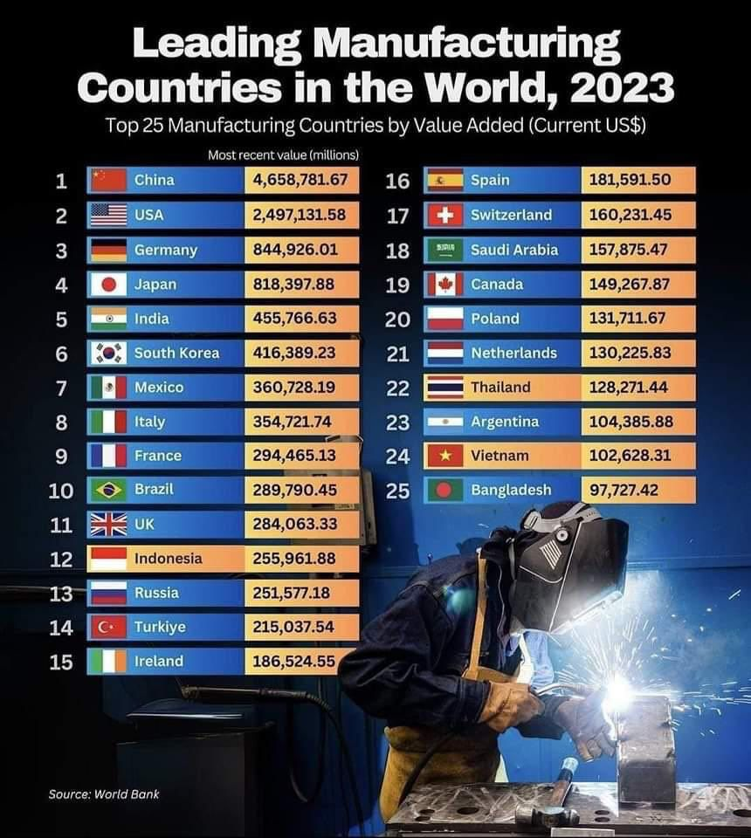
Manufacturing
SIRC of ICAI

Slide 29
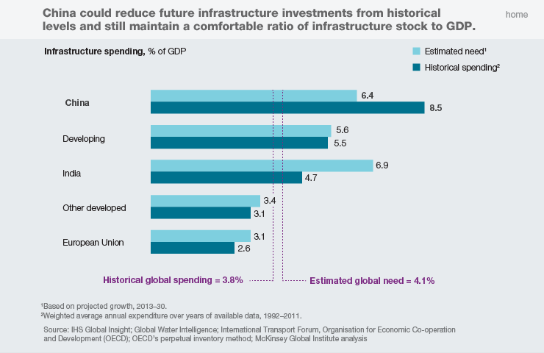
Infrastructure Investment … India is spending much below its need and China, way above

Slide 30
Expenditure outlay over the period of 5 years compared with 2014
Rs. Crore
Sector | 2013-14 | 2021-22 | 2022-23 | 2023-24 | 2024-25 | 2025-26
Railways | 27,072 | 1,35,242 | 1,62,410 | 2,45,791 | 2,55,348 | 2,55,445
Roadways | 25,477 | 1,23,551 | 2,17,089 | 2,75,986 | 2,80,519 | 2,87,333
Aviation | 6,955 | 71, 918 | 9,321 | 2,757 | 2,659 | 2,400

Slide 31
Strong Industrial & Infrastructural Base
Coal
Iron Ore
Aviation
Railway
Roadway
Ports
Renewable Energy
Textile
Production (MT)
Domestic Airline Capacity (Mn)
Network (‘000 Kms)
Cargo Traffic
(million tonnes)
Production (Mn tonnes)
Network
(Mn Kms)
Capacity
(GW)
Production
(Bn Sq. Mt.)
988.32
(2nd largest)
290.5
(3rd largest)
15.5
(3rd largest)
68.58
(4th largest)
6.37
(2nd largest)
209.44
(4th largest)
70.89
(2nd largest)
INDIA
819.3
Exports stood at USD 777 billion in 2023-24
Ranked 38th in Logistics Performance Index (LPI) 2023
Produces 95 minerals - 4 fuel-related, 10 metallic, 23 non-metallic, 3 atomic, and 55 others
Source: Ministry Reports of the Government of India, BEE, TRAI, SIAM, OICA, World Steel Association, BP, Statista

Slide 32
Strong Industrial & Infrastructural Base
Steel
Cement
Two
Wheeler
Four
Wheeler
Construction
ITeS
Electricity
Production
Wireless
Phone
Production in Mn tonnes
Production in Mn tonnes
Production in Mn Units
Light vehicles Production in Mn Units
Bn Sq. ft.
Revenue in Bn$
Bn Units
Subscribers in Mn
148.3
(2nd largest)
423
(2nd largest)
19.54
(Largest)
5.2
(3rd largest)
1.4
(2nd largest)
254
1,739.09
(3rd largest)
1,200
(2nd largest)
INDIA
JAPAN
84.0
53.2
0.63
7.4
-
89.45
1,030
195
USA
79.3
95
-
9.8
-
1,800
4,243
338.3
Source: Ministry Reports of the Government of India, BEE, TRAI, SIAM, OICA, World Steel Association, BP, Statista

Slide 33
Investing in the Economy
An outlay of Rs. 1.5 lakh crs is proposed for the 50-year interest free loans to states for capital expenditure and incentives for reforms
2nd Asset Monetization Plan for 2025-30 will be launched to plough back capital of Rs. 10 lakh crs in new projects
Govt to set up an Urban Challenge Fund of Rs. 1 lakh crs to implement the proposals for ‘Cities as Growth Hubs’, ‘Creative Redevelopment of Cities’ and ‘Water and Sanitation’ announced in the July Budget
To set up a Nuclear Energy Mission for research & development of Small Modular Reactors (SMR) with an outlay of Rs. 20,000 crs. To operationalize at least 5 indigenously developed SMRs by 2033.
Maritime Development Fund with a corpus of Rs. 25,000 crs will be set up for long-term financing of the maritime industry
Each infrastructure-related ministry to propose a 3-year pipeline of projects that can be implemented in PPP mode

Slide 34
Investing in the economy
Shipbuilding Clusters to increase the range, categories and capacity of ships
Modified UDAN scheme to be launched to enhance regional connectivity to 120 new destinations and carry 4 crore passengers in the next 10 years
Special Window for Affordable and Mid-Income Housing (SWAMIH) Fund 2 of Rs. 15,000 crs to be established for expeditious completion of another 1 lakh units.
To incentivize electricity distribution reforms and augmentation of intra-state transmission capacity by states
To develop top 50 tourist destination sites in the country in partnership with states

Slide 35
Investing in the economy
Budget for infrastructure over the last 3 years is less than the rate of inflation
Are we finally focusing on urban centers as engines of growth?
In the last budget, 3.4% of GDP was allocated for capital expenditure.
Is the budgetary allocation this year adequate to meet India’s infrastructure requirements?
How do we access long-term low-cost overseas capital to fund infrastructure?

Slide 36
Video 7
FM Speech – Para 85, 86, 87
Now, I move to Exports as the 4th engine.
Exports as the 4th engine
Export Promotion Mission
86. We will set up an Export Promotion Mission, with sectoral and ministerial targets, driven jointly by the Ministries of Commerce, MSME, and Finance. It will facilitate easy access to export credit, cross-border factoring support, and support to MSMEs to tackle non-tariff measures in overseas markets.
BharatTradeNet
87. A digital public infrastructure, ‘BharatTradeNet’ (BTN) for international trade will be set-up as a unified platform for trade documentation and financing solutions. This will complement the Unified Logistics Interface Platform. The BTN will be aligned with international practices.

Slide 37
Exports as the 4th engine
To set up an Export Promotion Mission, with sectoral and ministerial targets, driven jointly by the Ministries of Commerce, MSME, and Finance
A digital public infrastructure, ‘BharatTradeNet’ (BTN) for international trade will be set-up as a unified platform for trade documentation and financing solutions
A national framework to be formulated as guidance to states for promoting Global Capability Centres in emerging tier 2 cities
To facilitate upgradation of infrastructure and warehousing for air cargo including high value perishable horticulture produce

Slide 38
Exports as the 4th engine
Why is India’s export of goods so anemic and poor?
Can services export grow faster?
What can be the impact of President Trump’s potential tariff on Indian exports?

Slide 39
Video 8
FM Speech – Para 93 & 103
Reforms as the Fuel
93. Now I move to ‘Reforms as the Fuel’, and detail specific reforms.
Regulatory Reforms
103. In the last ten years in several aspects, including financial and nonfinancial, our Government has demonstrated a steadfast commitment to ‘Ease of Doing Business’. We are determined to ensure that our regulations must keep up with technological innovations and global policy developments. A light-touch regulatory framework based on principles and trust will unleash
productivity and employment. Through this framework, we will update regulations that were made under old laws. To develop this modern, flexible, people-friendly, and trust-based regulatory framework appropriate for the twenty-first century, I propose four specific measures:

Slide 40
Reforms as the Fuel
The FDI limit for the insurance sector to be raised from 74 to 100% for those companies that invest the entire premium in India
To rationalize requirements and procedures for speedy approval of company mergers. Scope for fast-track mergers will also be widened and the process made simpler
A High-Level Committee for Regulatory Reforms to be set up for a review of all non-financial sector regulations, certifications, licenses & permissions to enhance ‘ease of doing business’
To introduce Jan Vishwas Bill 2.0 to decriminalize more than 100 provisions in various laws
Requirements and procedures for speedy approvals of company mergers to be rationalized
India Post Payment Bank services to be expanded in rural areas
An Investment Friendliness Index of States will be launched in 2025 to further the spirit of competitive cooperative federalism

Slide 41
Reforms as the Fuel
Are these reforms adequate for improving ‘Ease of doing business’ in India
Excessive regulatory control by regulators like RBI is stifling growth. How can we bring down regulatory tyranny?
In your opinion what are the next generation reforms required?

Slide 42
Video 9
FM Speech – Para 112, 113 & 114
Budget Estimates 2025-26
112. Coming to 2025-26, the total receipts other than borrowings and the total expenditure are estimated at Rs. 34.96 lakh crore and Rs. 50.65 lakh crore respectively. The net tax receipts are estimated at Rs. 28.37 lakh crore.
113. The fiscal deficit is estimated to be 4.4 per cent of GDP.
114. To finance the fiscal deficit, the net market borrowings from dated securities are estimated at Rs. 11.54 lakh crore. The balance financing is expected to come from small savings and other sources. The gross market borrowings are estimated at Rs. 14.82 lakh crore.

Slide 43
Trends in Fiscal Deficit – 7 years
(Rs. cr)
Source: ES & Budget

Slide 44
Trends in Revenue and Fiscal Deficit – 7 years
(% of GDP)
Source: ES & Budget

Slide 45
Trends in Inflation (CPI) -10 years
(Source: ES)

Slide 46
Revenues for the past four years
Rs cr
Particulars | 2022-2023 | 2023-2024 | 2024-2025 RE | 2025-2026 BE
Gross Tax revenue | 30,54,192 | 34,65,519 | 38,53,455 | 42,70,233
Growth in gross tax revenue (%) | 12.73% | 13.47% | 11.19% | 10.82%
Revenue Receipts – A | 23,83,207 | 27,29,036 | 30,87,960 | 34,20,409
Tax Revenue (net to Centre) | 20,97,786 | 23,27,251 | 25,56,960 | 28,37,409
Non-tax revenue | 2,85,421 | 4,01,785 | 5,31,000 | 5,83,000
Capital Receipts - B | 18,09,951 | 17,14,411 | 16,28,527 | 16,44,936
Recoveries of Loans | 26,161 | 26,646 | 26,000 | 29,000
Other Receipts | 46,035 | 33,122 | 33,000 | 47,000
Borrowings and other Liabilities * | 17,37,755 | 16,54,643 | 15,69,527 | 15,68,936
Total Receipts (A + B) | 41,93,158 | 44,43,447 | 47,16,487 | 50,65,345
*Includes draw-down of cash balance
Gross tax revenue growth for 2024-25 BE was 10.83% but stood at 11.2% on revised estimates!
Gross tax revenue growth for 2025-26 BE is estimated to be 10.8%
Source: Budget 2025-26

Slide 47
Is the Budget Credible?
Rs ’000 cr
 | 2021-22 |  | 2022-23 |  | 2023-24 |  | 2024-25 |  | 2025-26
 | BE | Actual | BE | Actual | BE | Actual | BE | RE | BE
Receipts | 3,412 | 3,791 | 3,944 | 4,195 | 4,515 | 4,443 | 4,820 | 4,716 | 5,065
Actuals vs BE |  | 111% |  | 106% |  | 98% |  | 98%
Tax Receipt | 2,217 | 2,709 | 2,758 | 3,054 | 3,361 | 3,054 | 3,840 | 3,853 | 4,270
Actuals vs BE |  | 122% |  | 111% |  | 91% |  | 100%
Subsidies | 336 | 243 | 318 | 306 | 370 | 304 | 391 | 300 | 427
Actuals vs BE |  | 72% |  | 96% |  | 82% |  | 77%
Expenditure | 3,042 | 3,510 | 3,483 | 3,794 | 3,945 | 4,193 | 4,503 | 4,490 | 4,821
Actuals vs BE |  | 115% |  | 109% |  | 106% |  | 100%
Receipts growth%
CY Actuals on LY BE |  |  |  | 23% |  | 13% |  | 4%
CY Acts on LY Actls |  |  |  | 11% |  | 6% |  | 6%
CY BE on LY actuals |  |  | 4% |  | 8% |  | 8% |  | 7%
CY BE on LY BE |  |  | 16% |  | 14% |  | 7% |  | 5%

Slide 48
Tax revenue - Receipts
Rs cr
Particulars | 2022-2023 | 2023-2024 | 2024-2025 RE | 2025-2026 BE
Gross Tax Revenue | 30,54,192 | 34,65,519 | 38,53,455 | 42,70,233
Corporation tax | 8,25,834 | 9,11,055 | 9,80,000 | 10,82,000
Personal Income tax | 8,33,251 | 10,44,757 | 12,57,000 | 14,38,000
Customs | 2,13,372 | 2,33,119 | 2,35,000 | 2,40,000
Excise | 3,19,000 | 3,05,362 | 3,05,000 | 3,17,000
Service tax | 431 | 425 | 100 | 100
GST | 8,49,133 | 9,57,208 | 10,61,899 | 11,78,000
Taxes on Union Territories | 8,711 | 9,242 | 9,456 | 10,133
Other Taxes | 4,460 | 4,351 | 5,000 | 5,000
Direct Tax | 16,59,085 | 19,55,812 | 22,37,000 | 25,20,000
Indirect Tax | 13,95,107 | 15,09,707 | 16,16,455 | 17,50,233
Direct tax to GDP ratio | 5.5% | 6.6% | 6.9% | 7.1%
Indirect tax to GDP ratio | 4.6% | 5.1% | 5.0% | 4.9%
Total tax to GDP ratio | 10.1% | 11.7% | 11.9% | 12.0%

Slide 49
Direct Taxes Collections – Gross & Net
 | FY 2023-24 (as on 12.01.2024) |  |  | FY 2024-25 (as on 12.01.2025)
 | Corp Tax | Non*-Corp Tax & Others | Total | Corp Tax | Non*-Corp Tax & Others | Total
Gross | 8,33,874 | 8,87,294 | 17,21,168 | 9,71,875 | 10,92,594 | 20,64,369
YOY % |  |  |  | 17% | 22% | 20%
Refunds | 1,23,454 | 1,39,335 | 2,62,789 | 2,03,746 | 1,70,695 | 3,74,441
YOY % |  |  |  | 65% | 23% | 42%
Net | 7,10,419 | 7,47,960 | 14,58,379 | 7,68,128 | 9,21,899 | 16,89,928
YOY % |  |  |  | 8% | 22% | 16%

Slide 50
Direct Tax revenues
Rs. cr
 | Corporate Tax | Personal Income Tax | Total
2025-26 (BE) | 1,082,000 | 1,438,000 | 2,520,000
CAGR (2017) | 9.33% | 17.02% | 12.84%
2024-25 RE | 980,000 | 1,257,000 | 2,237,000
2023-24 | 911,055 | 1,044,757 | 1,955,812
2022-23 | 825,834 | 833,251 | 1,659,085
2021-22 | 712,037 | 696,243 | 1,408,293
2020-21 | 457,719 | 487,144 | 944,875
2019-20 | 556,876 | 492,654 | 1,049,550
2018-19 | 663,571 | 473,003 | 1,136,615
2017-18 | 571,202 | 419,884 | 1,002,037
2016-17 | 484,924 | 349,503 | 849,713
Source: Union Finance Accounts of respective years and reports of C&AG/Receipt Budget.

Slide 51
Budget estimates
Tax collection growth @ 10.8% is higher than nominal GDP growth @ 9.7% during 2024-25
Total tax to GDP ratio is 12% in 2025-26 (BE) and 10% in 2022-23
Budget estimates have been conservative, and fiscal prudence has been followed
What is your view on increase of tax to GDP ratio from 10% in 2022-23 to 12% in 2025-26 (BE)?
Why is personal income tax buoyant in the last 3 years with a CAGR of about 20%?
Is India on the right path to accelerate growth with low inflation?

Slide 52
Video 10
FM Speech – Para 134
Direct Taxes
I now come to my Direct tax proposals.
134. In Part A, I have briefly underlined Taxation Reforms as one of key
reforms to realize our vision of Viksit Bharat. In respect of criminal law, Our Government had earlier ushered in Bharatiya Nyaya Sanhita replacing Bharatiya Danda Sanhita. I am happy to inform this August House and the country that the new income-tax bill will carry forward the same spirit of “Nyaya”. The new bill will be clear and direct in text with close to half of the present law, in terms of both chapters and words. It will be simple to understand for taxpayers and tax administration, leading to tax certainty and reduced litigation.

Slide 53
Direct Taxes
SIRC of ICAI
TDS threshold on interest for senior citizens doubled from Rs. 50,000 to Rs. 1 lakh. TDS threshold of Rs. 2.40 lakh on rent increased to Rs. 6 lakh
TCS threshold on LRS to be increased from Rs. 7 lakh to Rs. 10 lakh
TCS to be omitted when both TDS and TCS are applied on any transaction relating to sale of goods
Higher TDS deduction will now apply only in non-PAN cases
Taxpayers can claim the annual value of 2 self-occupied properties as nil without any condition
Delay for TCS payment up to the due date of filing to be decriminalized
Determining arm's length price of international transaction extended to a block period of three years
Scope of safe harbour rules in international tax is being expanded
Start-ups incorporated before 01/04/2030 can avail tax benefits
Sunset dates for tax exemptions in GIFT IFSC extended till 31/03/2030

Slide 54
Direct Taxes
Securities held by CAT I & II AIFs classified as a capital asset u/s 2(14). All gains generated from the sale of securities by an AIF will be treated as capital gains and not business income
Personal Income tax
No income tax payable up to income of Rs. 12 lakh (i.e., average income of Rs. 1 lakh per month other than special rate income such as capital gains) under the new regime. This limit will be Rs. 12.75 lakh for salaried taxpayers, due to standard deduction of Rs. 75,000
Slabs and rates changed across the board to benefit all taxpayers

Slide 55
Personal income tax
Personal tax changes in slabs and savings thereon
 |  | Tax Impact (25L salary)
Tax slabs | Tax Rates | Tax - 2025 | Tax - 2026
0 - 4 | 0% | 5,000 | -
4 - 8 | 5% | 25,000 | 20,000
8 – 12 | 10% | 50,000 | 40,000
12- 16 | 15% | 90,000 | 60,000
16 - 20 | 20% | 1,20,000 | 80,000
20 - 24 | 25% | 1,20,000 | 100,000
Above 24 | 30% | 30,000 | 30,000
 | Total Tax | 4,40,000 | 3,30,000

Slide 56
Personal income tax
Tax rates across the top 10 countries
Country | Lowest rate (%) | Highest rate (%)
United Kingdom | 20 | 45
France | 14 | 45
China | 3 | 45
Japan | 5 | 45
Germany | 14 | 45
Italy | 23 | 43
United States | 10 | 37
India | 5 | 37.5
Canada | 15 | 33
Brazil | 7.5 | 27.5

Slide 57
Tax revenues raised but not realized
Amounts under dispute
As at the end of Reporting Year 2023-24
Rs cr
Taxes on | 1-2 Years | 2-5 Years | 5-10 Years | >10 Years | Total
Income & Expenditure | 3,77,146 | 6,90,855 | 2,38,350 | 29,889 | 13,36,239
Commodities and services | 50,596 | 71,689 | 66,253 | 14,953 | 2,03,493
Total | 4,27,742 | 7,62,544 | 3,04,603 | 44,841 | 15,39,732
Amounts not under dispute
Income & Expenditure | 4,53,490 | 5,49,707 | 2,82,305 | 2,37,139 | 15,22,642
Commodities and services | 16,100 | 15,720 | 10,184 | 6,525 | 48,531
Total | 4,69,591 | 5,65,527 | 2,92,489 | 2,43,665 | 15,71,174
Grand Total | 8,97,333 | 13,28,071 | 5,97,092 | 2,88,506 | 31,10,906
Total amount during 2012-13 was Rs 4,92,637 crore which stands at 31,10,906 crore

Slide 58
Direct Taxes
Revenue of about Rs. 1 lakh crore in direct taxes will be foregone
Tax reduction for the middle class is welcome. Will it spur economic growth?
The tax disputes have gone up. Why is Govt unable to stop terrorism to reduce disputes?
Will the quality of life of the middle class improve due to the Direct tax benefits?

Slide 59
Video 11
FM Speech – Para 115 & 116
115. My proposals relating to Customs aim to rationalize tariff structure and address duty inversion. These will also support domestic manufacturing and value addition, promote exports, facilitate trade and provide relief to common people.
Rationalisation of Customs Tariff Structure for Industrial Goods
116. As a part of comprehensive review of Customs rate structure announced in July 2024 Budget, I propose to:
(i) remove seven tariff rates. This is over and above the seven tariff rates removed in 2023-24 budget. After this, there will be only eight remaining tariff rates including ‘zero’ rate.
(ii) apply appropriate cess to broadly maintain effective duty incidence except on a few items, where such incidence will reduce marginally.
(iii) levy not more than one cess or surcharge. Therefore, I propose to exempt Social Welfare Surcharge on 82 tariff lines that are subject to a cess.

Slide 60
Indirect Taxes
Customs Duty
To remove seven tariff rates over and above the 7 tariff rates removed in 2023-24 budget. Only eight remaining tariff rates including ‘zero’ rate
To levy not more than one cess or surcharge. To exempt Social Welfare Surcharge on 82 tariff lines that are subject to a cess
36 lifesaving drugs and medicines to be fully exempted from Basic Customs Duty (BCD). Concessional customs duty of 5% to apply to 6 lifesaving medicines. Full exemption and concessional duty will also respectively apply on the bulk drugs for manufacture of the above
35 additional capital goods for manufacturing EV battery and 28 additional capital goods for mobile phone battery to be exempt, to boost domestic manufacture of lithium-ion battery
To fully exempt BCD on cobalt powder and waste, the scrap of lithium-ion battery, Lead, Zinc and 12 more critical minerals

Slide 61
Indirect Taxes
Customs Duty
To add two more types of shuttle-less looms to the list of fully exempted textile machinery
To increase the BCD on Interactive Flat Panel Display (IFPD) from 10% to 20% and reduce the BCD to 5% on Open Cell and other components
To further boost the manufacture of Open Cells of LCD/LED TVs, BCD on these parts to be exempt
Exemption of BCD on raw materials, components, consumables or parts for the manufacture of ships to be extended for another ten years. Same dispensation for ship breaking to make it more competitive
A time-limit of two years, extendable by a year, to apply for finalising the provisional assessment of Customs Duty
Time limit for the end-use of imported inputs extended from six months to one year. This will provide operational flexibility due to supply uncertainty

Slide 62
Indirect Taxes
Is the custom duty reduction due to Trump threat or a change in heart of govt? Will it help ‘Make in India’?
Do these indirect tax proposals help in promoting exports, boost domestic manufacturing and increase tax collection?
Do these indirect tax proposals help in reducing compliance burden and improving tax administration?

Slide 63
Conclusion
Has the Finance Minister responded to the voice of the people?
Does this Budget lay down the direction for the Viksit Bharat, 2047?
Does the budget put us on a high growth path to meet the $10 trillion mark by 2033*?
*India needs to grow at a nominal rate of 12.5% (@ Rs. 82.5 to USD) to meet this target

Slide 64
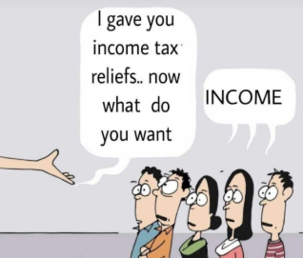
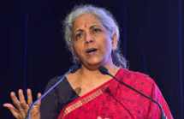
THANK YOU
I gave you tax reliefs!…..
Now what do you want?

