Slide 1
Startup Funding
ICAI, Bengaluru
CA. Rahul Saria
[FCA; CS; PGDBA; DISA, Valuation, IFRS, Blockchain, PMLA (ICAI), M&A (IIM-B); Modelling & Val. (EY); Ph.D. Research Scholar]
March 4, 2020
Notes:
Speaker Notes:

Slide 2
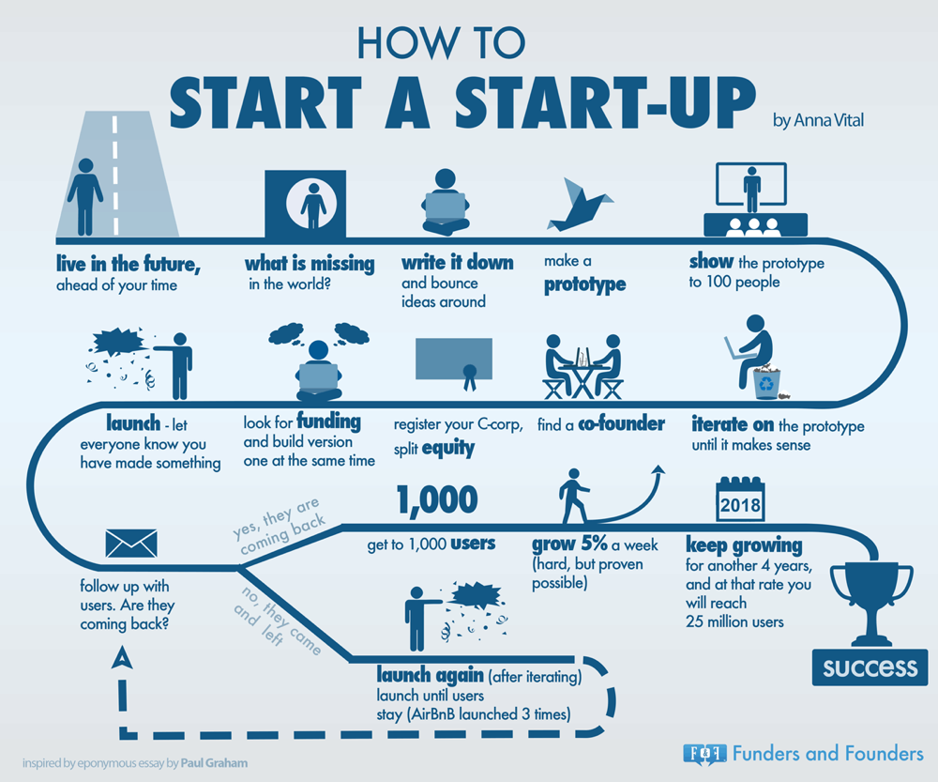

Slide 3
Forms of Organisation
Proprietorship Concern
Partnership Firm (Unlimited / LLP)
Company (Private / Public / OPC)
Trusts / Society / Non-Profit

Slide 4
Commercial Law – Practical aspects
Organisation formation
PAN / TAN – Income Tax Act, 1961
Trade License – Municipal Corporation
Shops & Establishment
Professional Tax
Current Bank Account

Slide 5
Commercial Law – Practical aspects
PF / ESI - EPF Act, 1952 / ESI Act, 1948
Goods & Service Tax (GST) – CGST Act, 2017, SGST, IGST
Import Export Code (IEC) – Indian Customs Act, 1962 / DGFT
FEMA / RBI Regulations / SEBI Regulations
Environmental Clearance / Pollution – The Environment Protection Act, 1986
Licenses – FSSAI, Medical etc.

Slide 6
Jargons..
B2C
B2B
Cap Table – CCPS
Cash Burn
Cohort
CAC
Fully Diluted Cap Table
LTV
MVP
PMF
Traction
Unit Economics
Valuation – Pre Money and Post Money
Term Sheet
Angel, PE, VC

Slide 7
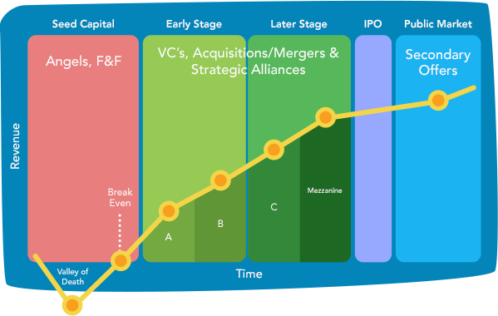
Startup Funding..
Funding Stages..

Slide 8
Fund Raise
Initial / Followup Meeting(s)
Investment Bankers
Term Sheet & Due Diligence
Funding
Business Deck
Business Model
Prototype / MVP
Business Metrics
Traction / Revenue
End Use of funds
Data Book
Business understanding / Analysis
Q&As
Data book
Financial Projections
Information Memorandum
Valuation
Funding amount
Macro terms
Financial; Legal & Commercial DD
Agreements – SHA; SSA; Founders agreement; ESOPs
Cap structure
Negotiation - Drag Along; Tag Along; Anti-Dilution; Board Seats; Pre-emptive;
Notes:
Speaker Notes:

Slide 9
Definitive agreements
SSA
CP, CS
Reps & Warranties
Disclosure Letter
Cap table
DOA
SHA
Board Seat / Observer
Voting Rights, DVR
ROFO
ROFR
Anti-Dilution
Tag Along
Drag Along
Transfer restrictions
Liq. Pref
Exit Rights

Slide 10
Unit Economics
Particulars | Amount Per Unit
Revenue | 100
Variable Costs | -50
Contribution Margin 1 | 50
CM % | 50%
CAC | -60
Contribution Margin 2 | -10
CM % | -10%
Fixed Costs (Absolute Value) | -80,00,000
EBIDTA | xxx
EBIDTA % | xxx
Revenue / CM1: 100 / 50 = 2
Revenue / CAC: 100 / 60 = 1.7

Slide 11
CFO / Finance Head
Financing / Treasury
Biz Fin /
FP&A
Controllership
Legal
Debt / Equity
Structured Debt
Quasi - Instruments
Investments
AOP
Budgeting
Analysis
Reporting (MIS)
Accounting
Income Tax
GST
Company Law
FEMA
Commercial Laws
Agreements
Contract Management
Notes:
Speaker Notes:

Slide 12
“Rahul has done an excellent job of explaining a difficult concept based on his experience. This book would be very useful to entrepreneurs, startup technocrats, finance professionals and students”
- CA. Nilesh Vikamsey
Past President ICAI; Director – SBI Life, IIFL, Thomas Cook, PNB Housing, Navneet Publication etc.
“Rahul captures all the key facets of finance that an entrepreneur is likely to need during the early life of their start up. This book will be a good addition to their list of reads ! ”
- Sharat Khurana
Founder – ZenEquity; Ex-CFO – InMobi, FreeCharge, Belong
“This book has been carved out of practical experiences in the startup world by the author and provides insight to the upcoming entrepreneurs / consultants to deal with the dynamics of start-up finance environment. The examples narrated in the book are quite imminent and one can relate the same to the practical situation which a start-up may undergo.”
- CA. Santosh Maheshwari
Partner – BDO India LLP; Ex-EY, KMPG
Notes:
Speaker Notes:

Slide 13
Questions ??
CA. Rahul Saria
E: rahulsariaca@gmail.com; M: +91 99016 20353

