Slide 1


GST: New Returns,
e Invoicing, Refunds
Good, Simple ,Tax
Dr. B. V. Murali Krishna,
Addl CCT(e Governance), Karnataka
e-mail: mkprakruthi@yahoo.co.in
Mobile: +9198440 41308
11.12.2019

Slide 2
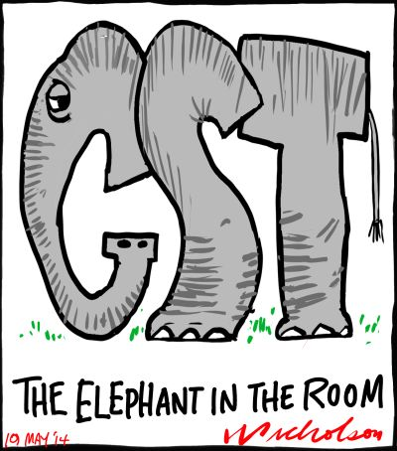
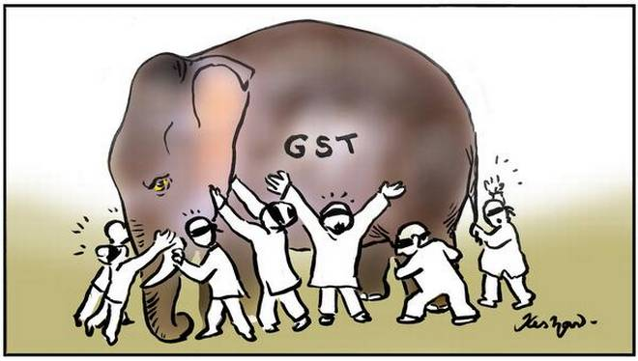
Picture: Thousand Words

Slide 3
Famous Quote!
“If you fail, never give up because F.A.I.L means “First Attempt In Learning”. End is not the END, infact E.N.D means “Efforts Never Dies”, if you get No as an answer, remember N.O means “Next Opportunity”.
Dr APJ Abdul Kalam

Slide 4
“Those who don’t know history are destined to repeat it”
….....Edmond Burke.

Slide 5
New Returns….01.04.2020...
ANX 1 and ANX 2 Statements
Matching Tool

Slide 6
Info
Background
New Type of returns
  Initial technical difficulties in implementing the GST Return Filing mechanism – GSTR2 and GST3 kept in abeyance;
  Majority of Tax payers (TPs) are small and medium enterprises – need of simple GST return and more visibility;
  27th meeting of GST council approved basic principles of GST return design;
  28th meeting held on 21st July, 2018, GST Council approved – convenient and simplified new format of the GST returns.
  As of now – GSTR1 and GSTR3B prescribed till March 2020 (NT-44/2019-CT, NT-45/2019-CT and NT-46/2019-CT);
Large TP
Tax Payer
Small TP
Turnover more than 5 Crore;
Normal Return (RET-1);
to be filed Monthly;
Payment of tax - Monthly;
Turnover – B2B, B2C, Export, SEZ, Deemed Export, sales through e-commerce operator;
Offline utility – ANX1 and ANX 2
Turnover less than 5 Crore;
2 Options – Sahaj (RET-2) and Sugam (RET-3);
Option to file Quarterly Return;
Payment of tax – Monthly;
Turnover – Sahaj – Only B2C;
Turnover – Sugam – Only B2B and B2C;

Slide 7
Key Features
NORMAL RETURNS (RET-1)
NIL Return :
  No purchase, No output tax liability – File NIL Return by sending SMS;
Continuous UPLOADING of invoices - Possible:
  upload invoices anytime during month;
  Liability will be auto populated;
  Invoices shall be visible to Recipient in “viewing facility”;
  Recipient can see filing status of supplier return – can view if liability is not discharged;
  Invoices uploaded up to 10th of succeeding month available as credit to Recipient – Recent insertion of Rule 36(4) in CGST Rules, 2017,Notification 49/ Dated 9.10.2019 – Benefit to Recipient Circular No 123/42/2019-GST Dated11.11.2019;
  Self admitted liability for invoices uploaded – if return not filed;
ACTION by Recipient :
  Realtime view of ITC on portal – Recipient will be benefited;
  Recipient to TAKE ACTION - Accept, Reject or Pending;
Unidirectional FLOW of document :
  Only invoices/DN uploaded by supplier shall be valid document for ITC;
  ITC availed on invoice/DN not uploaded shall be called “Missing Invoices”;

Slide 8
Key Features
NORMAL RETURNS (RET-1)
Offline TOOL :
  Offline Tool – with limited functionality released for testing;
  Easy to use tool - bridges the TP’s Accounting Software with GSTN portal;
  Tool - Uploads invoices/DN/CN data as well as reconcile/match ITC;
LOCKING of Invoices:
  HANDSHAKE between the recipient and supplier – indicates acceptance of transaction;
  Invoices “accepted” by recipient shall be locked;
  Deemed Locking – presumed for invoices not rejected or not kept pending;
  Locked invoices can’t be amended by supplier – CN/DN will be mandatory;
UNLOCKING of Invoice :
  Wrongly locked invoice can be unlocked only by Recipient – calls for reversal of ITC;
REJECTING invoices:
  Recipient can reject invoices not pertaining to his GSTIN;
PENDING Invoices :
  Supply not received OR need of amendment in Invoice OR not able to decide for time being, the recipient can keep the invoice as pending on the portal;
  Pending invoices shall flow to Recipient for acceptance / rejection in future tax period;

Slide 9
Key Features
NORMAL RETURNS (RET-1)
AMENDMENT of Invoices:
  Invoices not locked by Recipient – Amendment possible;
  IT facility to link Invoice and CN – so that Excess ITC is not availed by Recipient;
  CN - Change in liability of Supplier will mandate reversal of ITC to Recipient;
HSN:
  Inbuilt logic in system to report error in HSN;
  Multiple HSN and various rate of tax in single invoice – can be uploaded using tool;
  Tool has functionality to suggest HSN based on discerption of supply;
PAYMENT of Liability
  Invoices reported in subsequent tax period return – liability shall be summarised period wise;
    April invoice reported in September – Liability of April and Sept will be shown separately – single payment can be made;
    Interest computation under section 50 – automatic;
    After filing of return – invoice of April month shall be clubbed with information pertaining to April;
Amendment Return – Amendment of missing invoice
  Facility to file two amendment returns – within period specified u/s 39(9);
  Reporting of missing invoices in subsequent tax period is amendment return – TP to be careful in reporting invoices – completeness and correctness check is advised;

Slide 10
Key Features
NORMAL RETURNS (RET-1)
Payment DUE TO amended liability –
  Payment through amended return;
  ITC can be availed, if available, to pay amended liability;
  “Negative liability” – No refund – but carry forward to subsequent tax period;
  Higher late fee for change in liability of more than 10%- to ensure correct regular return;
EXPORTS – Data transmission to ICEGATE –
  Export of goods – facility to file details of Shipping bill;
  Shipping bill details can be uploaded at later date – not an amendment to return;
  Data shall be transmitted to ICEGATE;
  Till data starts flowing from ICEGATE or SEZ Online to report ITC, TP can claim ITC on self declaration basis;
CHECKS on defaulters –
  Newly register person or a TP who has defaulted in payment – uploading invoices upto threshold only will be allowed;
  On clearing default – TP can upload invoices – only then recipient can view invoices;
  Suspension or cancellation of registration – uploading invoice will be blocked for the period beyond suspension or cancellation;

Slide 11
Key Features
NEW- QUARTERLY RETURNS – SAHAJ (RET-2) OR SUGAM (RET-3)
Filing and Payment –
  Filing of Return – Option to file is quarterly;
  Payment of tax – monthly;
  Avail input on self-declaration basis (monthly);
Option to file Monthly or Quarterly –
  TP can exercise option of filing monthly or quarterly at the beginning of the year;
  Changing from monthly to quarterly or vice versa allowed once in a year – at the beginning of any quarter;
Compliance cost –
  Simplification in return would reduce compliance cost for small TPs;
Sahaj and Sugam –
  93% of TPs - Turnover less than 5 Crore (CBIC press release dt 21-07-2018);
  Uploading invoices on continuous basis allowed;
  Sahaj – Only B2C outward supplies – can opt for it;
  Sugam – B2B and B2C outward supplies – can opt for it;
  TPs having exports, supplies to SEZs, Deemed Exports – can not opt for Sahaj or Sugam;

Slide 12
Compare
Existing Forms
New Forms
GSTR-1;
GSTR-2 (in abeyance);
GSTR-3 (in abeyance);
GSTR-3B
GSTR-4
GST RET-1 (Normal Return);
GST RET-2 (Sahaj);
GST RET-3 (Sugam)
PMT-08 (Payment of tax)
Common offline utility - ANX-1& ANX2
New Return Offline Utility
Tool to facilitate preparation of the Form GST ANX-1 and Form GST ANX-2 by the taxpayers (Trial Version available);
With limited functionalities ONLY for testing purpose;
Taxpayers may use the offline Tool to furnish various details regarding
  outward supplies,
  Import of services and goods;
  inward supplies attracting reverse charge; and
  view/ take action on the documents as imported in the offline tool.
Once Form GST ANX-1 is prepared using offline Tool, it is to be uploaded on GST Portal by creating a JSON file. The data uploaded by the taxpayer will be available on the GST Portal, however, data will be purged before roll out of the new returns.

Slide 13
Process
Process
ANX- 1 - Data can be uploaded/entered to the offline tool in three ways:
1. Importing the entire excel workbook to the New return offline tool where data in all sections (worksheets) of the excel file will be imported in the tool in one go.
2. Document wise data entry by annexure preparer on the New return offline tool. (Manual entry line item-wise)
3. Table by Table of a particular return - using a .CSV file as per the format given along with the New return offline tool. Many accounting software packages generate .CSV file in the specified format and the same can be imported into the tool.
System requirement
  Windows OS 7.0 and above.
  System should be of 32bit or 64 bit.
  Microsoft Office Excel 2007 or above, if you plan to use Excel to enter data first and then import the same in the Tool.
  If you can import data in csv format from another accounting software, as given along with Tool in the Zip file of Tool, you do not need Excel.
  User should have admin rights of the system.
Steps to install
  After Downloading and extracting the OfflineTool.zip from GST Portal run the offline-utility.exe.
  Click Next to Continue the setup installation.
  Check the "Create Desktop Icon" Checkbox and click "Next".
  Click the "Install" button to start the installation.
  Keep both checkboxes checked and click on "Finish" to finish the installation.;
Key Features
  HSN Code validation;
  Facility to delete – earlier uploaded in ANX-1;
  Calculates Tax based on HSN and Rate applicable;
  Amendment / missing invoices can be uploaded (Table 3L next version);
  Facility to Match Purchase register with invoices uploaded by suppliers;
  Take Action – Accept/Pending/Reject supplier invoices;
Size of generated JSON file should not be greater than 5 MB. Maximum number of items which can be uploaded one time is 19,000.

Slide 14
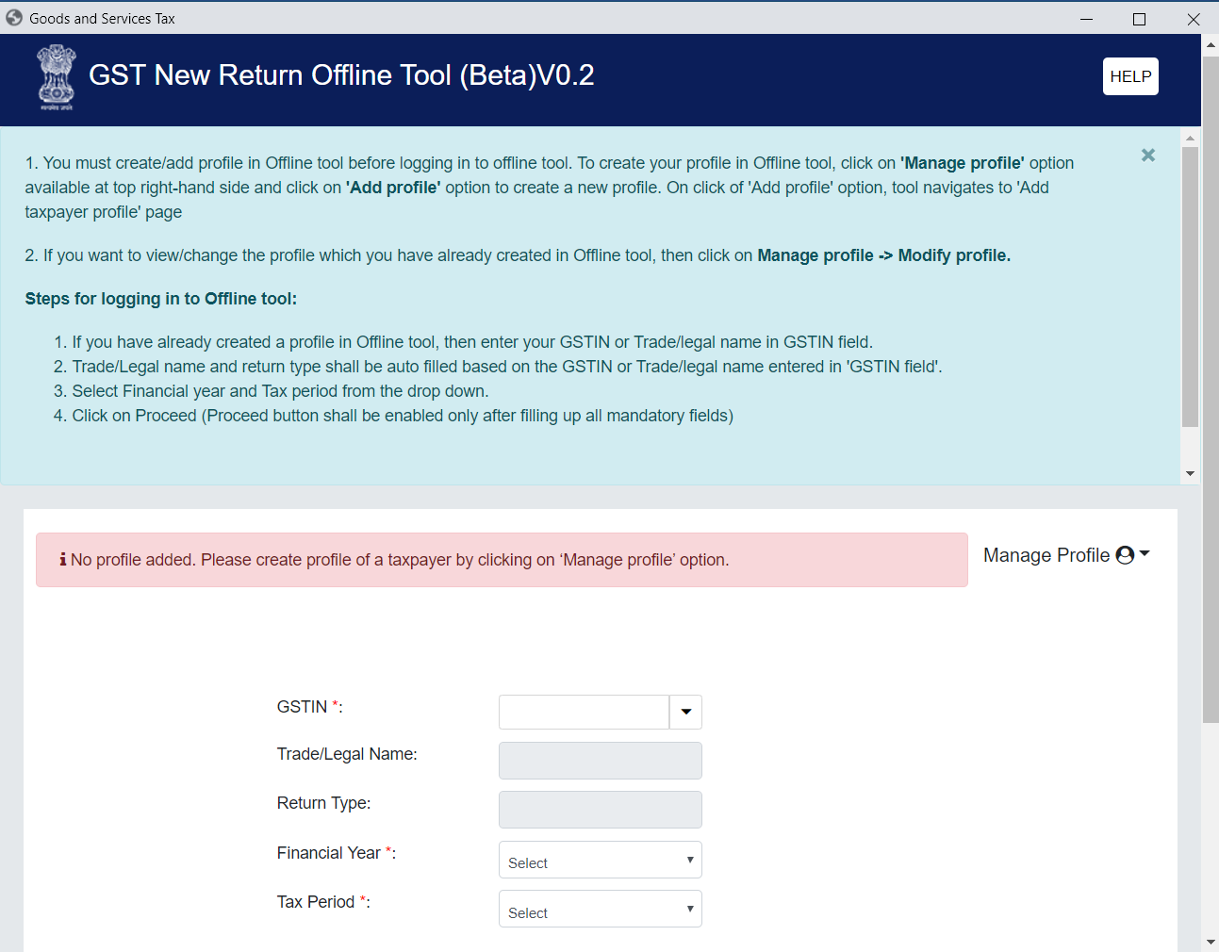
Prepare
Post installation - Profile of Tax Payer to be created

Slide 15
Well begun is half done.
….....Aristotle.

Slide 16
Brief History of e Way Bill
Delivery Note in Form 39 under KST Regime
Delivery Note VAT FORM 505 under VAT Regime
e- SUGAM( Simple Uploading of Goods Arrival and Movement )
E Sugam in Karnataka wef 01.06.2010,
E Sugam Expanded during 01.04.2014
M Sugam
E Sugam Refurbished: 13.02.2015
E Sugam to e way Bill under GST In Karnataka wef Sept 2017
E way Bill: Pilot Project All India wef 01.02.2018
E Way Bill Introduction wef 01.04.2018

Slide 17
One Year of e-Way Bill Journey
01.04.2018 to 31.03.2019
No. of e-way bills generated | 5577 Lakhs
No. of inter-state e-way bills generated | 2487 Lakhs
No. of intra-state e-way bills generated | 3090 Lakhs
No. of Tax Payers Registered in EWB | 28.89 Lakhs
No. of Transporters enrolled in EWB | 0.41 Lakhs

Slide 18
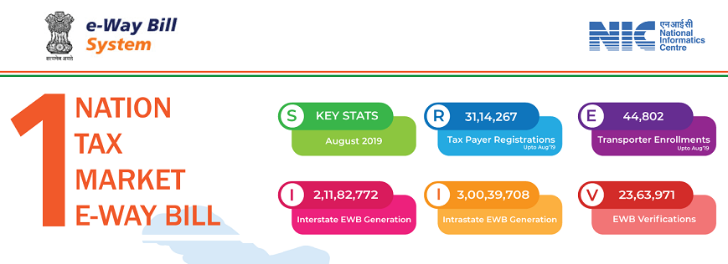
E Way Bill Update _August 2019

Slide 19
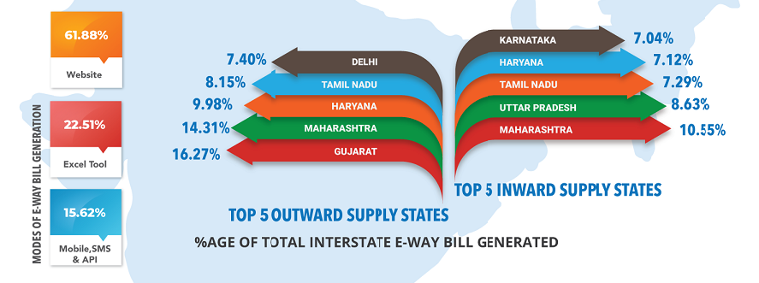
E Way Bill Update _August 2019

Slide 20
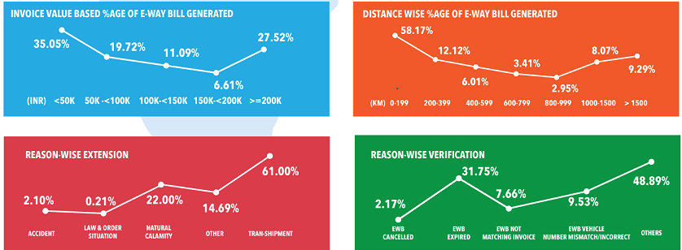
E Way Bill Update _August 2019

Slide 21

E Way Bill Update _August 2019

Slide 22
Analytics with e Way Bill
Trend Analysis- New Registered/ Between New Registered/PAN Based etc..
Outward/Inward Supply Analysis- To find out Carousal Fraud
Risk based Analysis
Parameter Based Analysis
Comparison Between- GSTR 3B, GSRT1, GSTR7
Tax Evasion Commodities
Watch List of Tax Payers/Transporters
E Vahan Analysis ?
E way Bill Officer Module- Blocking/Unblocking of Generation of e way bill

Slide 23
e-Invoicing…..

Slide 24
Comments on Invoice Matching
“India is the only country that is doing it (invoice to invoice matching).This is unique….people will have to comply or they will fall out of the GST Chain”.
David Raistrick,
Deloitte Global leader, for Indirect Tax.. ET, 25.10.2016

Slide 25

Relay Image: Input Tax Credit

Slide 26
No.of B2B Trans. in EWB for March 2019
Invoice Value Range | Number (Lakhs) | Percentage
Less than 50 K | 139.16 | 32%
50 K- 1L | 89.04 | 20%
1L-2L | 80.90 | 19%
2L-5L | 65.34 | 15%
5L-10L | 32.93 | 8%
10L-20L | 18.70 | 4%
20L-50L | 7.81 | 2%
50L-100L | 0.98 | 0%
More than 100L | 0.49 | 0%
Total | 435.39

Slide 27
Objectives of e Invoice
Better tax Payer Services- One Time Reporting, Reconciliation
Reduction In Tax Evasion
Efficiency in Tax Administration

Slide 28
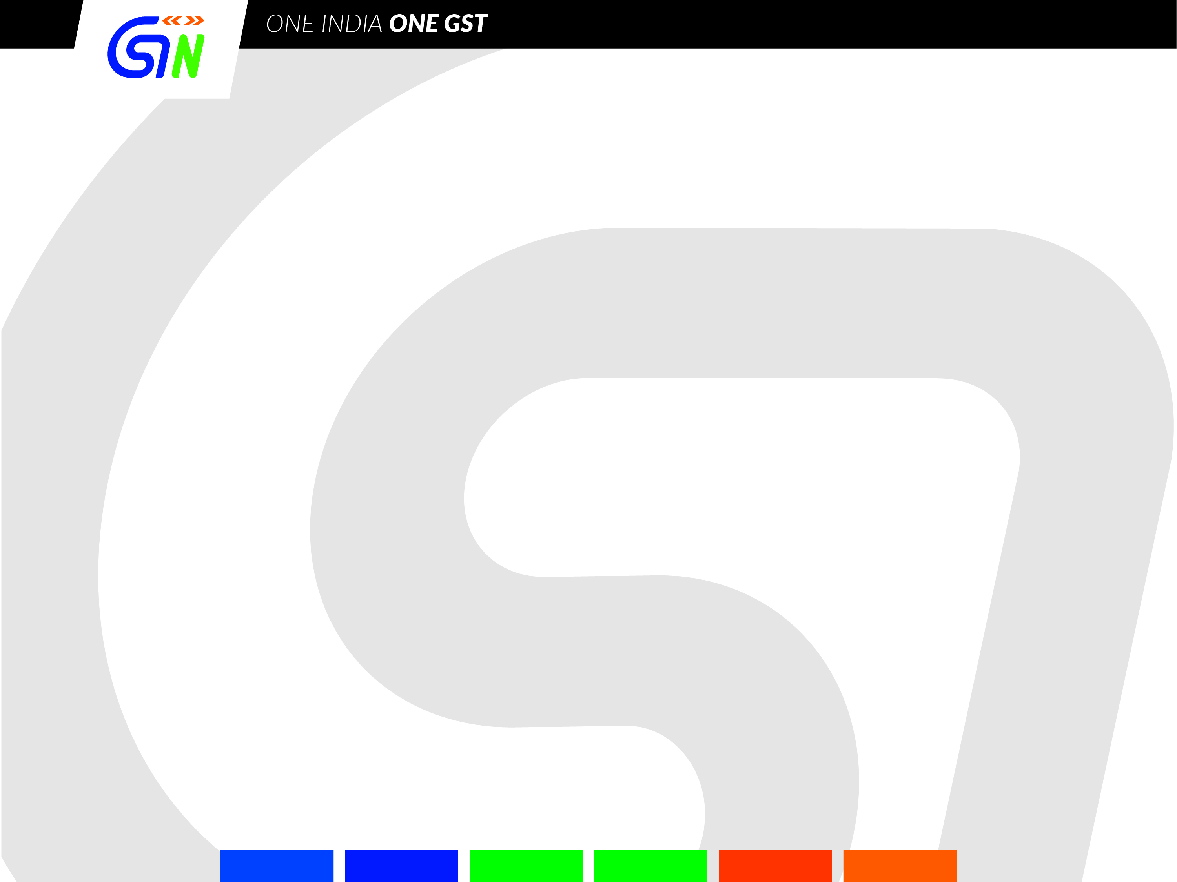
Benefits of Proposed IRN System
For Taxpayers | For Tax Authorities
Does not have to report separately to GST system and e-way bill system | Reporting of invoice data will happen on daily basis (last day load can be avoided)
It will become part of his business process | Rogue elements can be disabled from issuing invoices. Those who have not filed N number of returns New ones who have reached threshold decided at time of registration Where there is discrepancy in purchase and sales etc.
As buyer, he will get the data of inward supplies on daily basis | Same data in GSTR-1 and GSTR-3B
On receipt of info thru GST System as buyer can do reconciliation with his Purchase Order and accept/reject in time. | Tax department can prepare draft Return for the taxpayer

Slide 29
Features of e Invoice
Unique Invoice Reference Number (IRN)
(GSTN, Invoice Number of Tax Payer & Year)
(Hash Generation algorithm)
From Invoice Registration Portal(IRP), through JSON file
QR Code [ GSTIN of Seller and Buyer, Invoice Number, Invoice Date, Invoice Value, Number of line items, HSN of Major Commodity as per value, Unique IRN(hash)]
Digitally Signed by e Invoice Registration Portal
GST System- Update the ANX 1 of the Seller and ANX 2 of the Buyer- leads to preparation of Return and determine liability and ITC
E way Bill also can be generated, by adding Vehicle Number
Note: Only One IRN for each Invoice of the Seller.

Slide 30
Creation of e Invoice
Through GST System- Invoice Registration Portal
Small Tax Payers- through eight freely accounting software
Web based, API Based, SMS Based, Mobile app based, offline tool(JSON file) and GSP based

Slide 31
No. of Invoices Reported in GSTR-1
Invoice Value in Rage
 | 18-Jul | 18-Aug | 18-Sep | % of total (Sep)
Less than Re. 1/- | 144522 | 91303 | 73944 | 0.04%
Rs. 1 to 5000 | 70659111 | 67050677 | 84562050 | 40.77%
Rs. 5K to 10K | 18721798 | 18618066 | 25376274 | 12.23%
Rs. 10K to 20 K | 18412303 | 18691949 | 25240434 | 12.17%
Rs. 20K to 50 K | 23763639 | 24782813 | 33330404 | 16.07%
Rs. 50 K to 70 K | 6420343 | 6740614 | 8225155 | 3.97%
Rs. 70 K to 1 Lakh | 6124660 | 6328925 | 7751131 | 3.74%
Rs. 1 Lakh to 2 Lakh | 8111953 | 8428748 | 9561009 | 4.61%
Rs. 2 Lakh to Rs. 5 Lakh | 6685842 | 7058084 | 7567706 | 3.65%
Rs. 5 Lakh to 10 Lakh | 2934701 | 3153725 | 3214941 | 1.55%
Rs. 10 Lakh to 50 Lakh | 2120413 | 2344974 | 2324978 | 1.12%
Rs. 50 Lakh to Rs. 1 Crore | 115510 | 126537 | 120112 | 0.06%
Above Rs. 1 Crore | 77440 | 86014 | 85435 | 0.04%
TOTAL | 164292235 | 163502429 | 207433573 | 100.00%

Slide 32
Schematic Flow-IRN
IRN Request
Prepare Tax Invoice and issue
Receiver Accept/Reject
Taxpayer System/visibility
IRN System
IRN Generated for all Invoices
GST/E-Way Bill System
Invoice Persisted (with IRN)
Invoice Status Updated
IRN request received
…..
Generate GSTR-1/GReT-01
Invoice Persisted (BI Purpose)
Generate e-Way Bill

Slide 33
Issuing ETI through ERP or ASP and through E-Sero (S Korea)

Slide 34
Challenges In Digitization
Uniformity of Data
Infrastructure Support
Behavioral Changes of Tax Payers
Outreach Activities
IEC Measures
Relation Ship with Stake Holders

Slide 35
Online Refunds.

Slide 36
Online Refunds-Status-11.12.2019
Applications Received : 2349
RFD 03 Issued: 715
RFD 05 Issued: 312

Slide 37
Online Refunds
The system of end to end online refund integrated with GSTN portal has been made live on 26.09.2019
The Single Disbursement Process through PFMS (Public Financial Management System) of GOI has been successfully put in place.
This module is aimed at preventing PHYSICAL INTERFACE between tax authorities and taxpayers.
NO MORE REFUNDS FROM KHAJANE 2 OR KHAJANE 1 OF GoK.

Slide 38
Online Refunds
Making the refund procedure fully electronic, in which all steps of submission and processing shall be undertaken electronically, have been deployed on the common portal with effect from 26.09.2019.
A master Refund Circular No. 125/44/2019 has been issued in supersession of the earlier Circulars viz. Circular No. 17/17/2017-GST dated 15.11.2017, 24/24/2017-GST dated 21.12.2017, 37/11/2018-GST dated 15.03.2018, 45/19/2018-GST dated 30.05.2018 (including corrigendum dated 18.07.2019), 59/33/2018-GST dated 04.09.2018, 70/44/2018-GST dated 26.10.2018, 79/53/2018-GST dated 31.12.2018 and 94/13/2019-GST dated 28.03.2019

Slide 39
Forms
GST RFD-01 – Refund Application with various statement and declarations
GST RFD-02 – Acknowledgement post acceptance of application by Refund Processing Officer
GST RFD-03 – Deficiency Memo
GST RFD-04 – Provisional Refund Order
GST RFD-05 – Payment Order for disbursing the amount of refund sanctioned
GST RFD-06 – Refund Sanction/ Rejection Order
Part A of GST RFD-07 – Order for Complete Adjustment of sanctioned Refund (now a part of RFD06)
Part B of GST RFD-07 – Order for withholding the Refund
Part C of GST RFD-07 – Release order of RFD 07B (manual), [Under Development]
GST RFD-08 – Notice for rejection of application for refund
GST RFD-09 – Reply to show cause notice issued under RFD-08
GST PMT-03- Provision to re-credit cash/credit in case of inadmissible refund as per RFD06

Slide 40
REFUND WORKFLOW -RFD-01

Slide 41

“Success is no accident.it is hard work, perseverance, learning, studying, sacrifice and most of all, love of what you are doing or learning to do”.
………Pele
Final Thought
Thank You

