Slide 1
GST 80:20 computation for Real Estate sector BANGALORE BRANCH of ICAI
CA Rahul R Gandhi 17th July, 2024

Slide 2
Synopsis
Background - Different transactions in real estate sector
Old rate Vs New Rate Regime (NRR)
Practical overview of transaction
Conditions for NRR
Practical approach for 80:20 computation
FAQ’s
Practical issues in complying with 80:20 Rule
QnA & Thankyou

Slide 3
Background (Transactions)
Sale of Land
Sale of Land & building
Self Construction
Works Contract
Plotted Development
Joint Development Agreement
Illegal Construction
Redevelopment
Approved Resolution Plan

Slide 4
Old rates – with ITC – before 1/4/2019
GST Rates for Builder
PMAY – 8%
12% * 2/3
1/3rd Land Deduction
Other Real Estate 12%
18% * 2/3
1/3rd Land Deduction

Slide 5
New rate REGIME (NRR) – W.e.f 1/4/2019
GST Rate NRR
Affordable
1% - No ITC
Residential
5% - No ITC
Pure Commercial Projects
12% with ITC
1/3rd Land Deduction
1/3rd Land Deduction
7.5% * 2/3
1/3rd Land Deduction
18% * 2/3
1.5% * 2/3

Slide 6
Practical overview of TransAction
Developmental Rights
Land Owner
Builder
Construction services
60 Flats
40 Flats
Before Construction
After OC
Before Construction +LO 40 share
After OC
25 Sold
12 Sold
3 remaining unsold
45 Sold
10 Sold
5 remaining unsold
Remit GST with ITC
Reversal of ITC basis - carpet area sold/unsold
Remit GST w/o ITC
No GST - Sch III: Development right RCM

Slide 7
Conditions for the New Rates without ITC
Composition Scheme
Applicability
ITC:
No ITC on the future purchases
Report ITC not availed as ineligible credit in GSTR-3B [No. 4 (D)(2)]
Reversal/availment of Excess ITC as on 31st March 2019 as per (Annexure I in the case of REP other than RREP and in Annexure II in the case of RREP)
JDA TAX :
Paying of GST is only in cash
ITC not permitted
Residential Real Estate Projects
Tax on Development Rights to be paid by Builder on RCM basis.

Slide 8
Conditions for the New Rates without ITC
‘Excess URP Tax’ - RCM u/s 9(4) for Purchases from Unregistered Persons
1) Procure 80% inputs and input services from registered vendors other than TDR, long term lease premium, salami, FSI , electricity, high speed diesel, motor spirit, natural gas
3) RCM Payments - 9(3) deemed as Registered Purchase classified under 80% bucket
4) Purchases >20% from URP to be paid tax at 18%,
5) CEMENT / CAPITAL GOODS Purchased from URP to be paid under RCM irrespective of % threshold on monthly basis at the applicable rates.(Currently 28% for cement)
2) Shortfall beyond 20% to be assessed and paid projectwise by JUNE of next Financial YEAR

Slide 9
RCM U/s 9(4)
NN 7/2019 CT(R)-Sec 9(4)
S.No | Category of supply of goods and services | Recipient of goods & services
1 | Supply of such goods and services or both [other than TDR & upfront premium] which constitute the shortfall of 80% | Promoter
2 | Cement falling in chapter heading 2523 | Promoter
3 | Capital goods falling under any chapter in the first schedule to the Customs Tariff Act, 1975 | Promoter

Slide 10
RCM U/s 9(4)
NN 8/2019 CT(R) - Goods
Sl No | Chapter | Description | Rate of Tax
452Q | Any chapter | Supply of any goods other than capital goods and cement, by an unregistered person to a promoter for construction of the project on which tax is payable by the promoter U/s 9(4) | 9%
Overrides the any specific chapter or heading which is covered
NN 3/2019 CT(R) - Services
Sl No | Chapter | Description | Rate of Tax
39 | 99 | Supply of Input services other than TDR, FSI, Upfront Premium- to the extent of 80%. | 9%
Overrides the any specific chapter or heading which is covered

Slide 11
6 steps practical approach for 80:20 computation
1
3
4
5
2
Identification of ‘I & IS’
Identification of ‘Supplier’ of I & IS
Whether ‘used for supplying the services’
Apply 80:20 rule – Calculate ‘Excess URP Tax’
Discharge tax on excess URP beyond 20%
Have the above details on Project wise - FY wise - GSTIN wise
6

Slide 12
Step 1: Identification of ‘I & IS’
Inputs
Capital goods?
Excluded from calculation & applicable to RCM irrespective of quantum on monthly basis
Cement
Included in calculation & applicable to RCM irrespective of quantum on monthly basis
Other inputs
Other goods - included in calculation & computation and discharge tax yearly
Inputs service
Service - whether capitalised or not - included
What about salaries paid? Is it I or IS?
These are neither G/S therefore excluded from computation (FAQ)
Take away: Sch III transactions are all excluded from computation
Segregation of total cost into CG, Cement, Other than Cement, IS, Sch III & others
Exclude Development Rights, Lease Payments, FSI, Electricity, HSD, Motor spirit, gas

Slide 13
Step 2: Identification of ‘Supplier’ of I & IS
Registered or Unregistered?
Unregistered
Turnover below the threshold
Not engaged in any supply/business activity
Exclusively exempt supply
Exclusively RCM supplies
Retrospective cancellation? Whether RP or URP?
Approach 1: Treat as URP
Approach 2: Treat as RP
Already tax has been discharged
No provision for True-up as in Rule 42 (based on change in registration status)

Slide 14
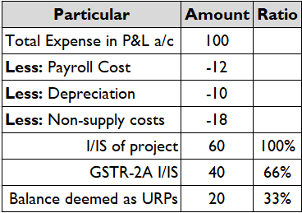
Step 2: Identification of ‘Supplier’ of I & IS
Departments perspective : Summary approach
Limitation: Incorrect reporting errors from supplier not captured (like B2C, incorrect GSTIN, incorrect value etc)
Proactive approach to mitigate: RE Promoter to have expense register with corresponding GSTIN, general practices on reconciliation & followup.

Slide 15
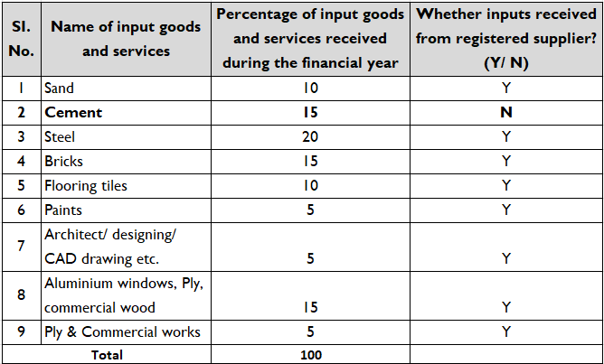
Step 1 & Step 2
Example 1
URP: 15%
Is it Cement?
Yes, pay RCM on 15 @28%

Slide 16
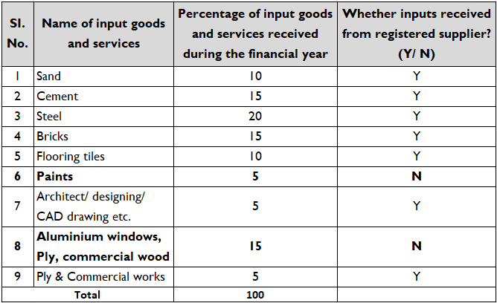
Step 1 & Step 2
Example 2
URP: 20%
Is it Cement? – No

Slide 17
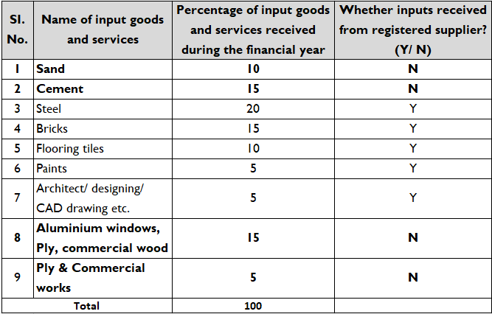
Step 1 & Step 2
Example 3
URP: 20%
Is it Cement ?
Yes, pay RCM on 15 @28%
Other than Cement?
Yes, pay RCM on 10 @18%

Slide 18
Step 3: Whether ‘used for supplying the services’
Most critical & important step
i) I/IS related to business activity or used in construction service?
Used for supplying the service = Construction service
Supplier engaged in Multiple activities like plotted development, other taxable/Non-taxable ..etc.
Supporting provision: maintain projectwise accounts & discharge yearly

Slide 19
Step 3: Whether ‘used for supplying the services’
Should it be directly or indirectly related to construction ?
Rate/Exemption notification: ‘construction service’
RCM notification: Excess procurement for the purpose of ‘construction of project’
Therefore 2 conditions i.e., I/IS should be
Used for supplying the construction service AND
Used for construction of project = Construction cost
Directly
(Part of construction service)
Included
Eg: Civil construction cost,
Common amenities cost
Related to Construction cost?
Included
Eg: Marketing cost, Government related cost
Indirectly

Slide 20
Step 3: Whether ‘used for supplying the services’
Total Cost = 10 Crore
Business activity related – 2 crore
Construction related – 8 crore
Excluded
Included
Head Office Expense
Direct expense of construction services of residential flats
Indirect expense related to particular RREP

Slide 21
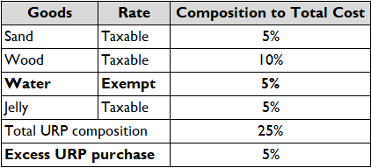
Step 5: Discharge tax on excess URP beyond 20%
i) Whether exempt supplies form part of 80:20?
Illustration
Issue:
Increase in RCM liability for the RE Promoter
Same transaction viewed differently from suppliers angle (exempt) & recipient angle (Taxable under RCM)

Slide 22
Step 5: Discharge tax on excess URP beyond 20%
Rate notification vis-a-vis Exemption Notification
Aggressive approach
Legal reference
i) ‘Overriding this notification’ - Implies only rate noticition i.e., 1/2017 (Goods) & 11/2017(Services)
ii) Absence of mechanism to claim tax on exemption
Conservative approach
To include the said supplies under 80:20 and pay tax on the same
“Explanation. – This entry is to be taken to apply to all services which satisfy the conditions prescribed herein, even though they may be covered by a more specific chapter, section or heading elsewhere in this notification.”

Slide 23
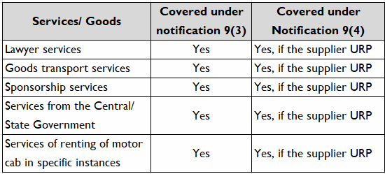
Step 5: Discharge tax on excess URP beyond 20%
ii) Interplay of 9(3) & 9(4) provisions?
Illustration

Slide 24
Step 5: Discharge tax on excess URP beyond 20%
RE Promoter (Builder)
Excess URP
No Excess URP
Should you pay tax for supplies u/s 9(3)?
Conservative Approach
Yes
Aggressive Approach
No
9(3) being specific entry
RCM notification not intended to grant exemption to previously existing RCM liability
Harmonious Interpretation
Both notification operate together
9(4) specific to RE promoters
Further this is new entry post the entry in 9(3)

Slide 25
Step 6: details on Project - FY - GSTIN wise
Year 1
Year 2
Year 3
Year 4
Project Launch
10% flats booked
Under construction
40% booked
Upto OC
80% booked
Post OC
80:20 Rule – Not Applicable
80:20 applicable to expenses of Year 1
80:20 applicable to expenses of Year 2
80:20 applicable to expenses of Year 3
Non-applicability ‘Post Occupancy’ certificate
Calculation of threshold independent for each year and no carry forward of expenses during lifecycle of project
Note: Computation - Projectwise Yearwise & NOT Year to Date wise

Slide 26
FAQ’s issued by CBIC
1. | If value of purchases as prescribed above from registered supplier is less than 80%, what would be the applicable GST rate on such purchases? | Promoter has to pay GST @ 18% on reverse charge basis on all such inward supplies (to the extent short of 80% of inward supplies from registered supplier) except cement on which tax has to be paid (by the promoter on reverse charge basis) at the applicable rate, which at present is 28% (CGST 14% + SGST 14%)

Slide 27
FAQ’s issued by CBIC
2. | In case of new rate of 5% / 1%, whether the conditions of payment of tax through Cash Ledger, payment of tax under RCM subject to 80% limit, nonavailing of Input Tax Credit, reversal of credit, maintenance of project wise account, reporting of ITC not availed in corresponding GSTR-3B etc. are required to be complied mandatorily by the Developer ? | Yes. All the specified conditions against clause (i) to (id) of Sl. No 3 of Notification No. 11/2017CTR are mandatory.

Slide 28
FAQ’s issued by CBIC
4 | The condition in Notification No. 3/2019 specifies that 80% of inputs and input services should be procured from registered person. What about expenditure such as salaries, wages, etc. These are not supplies under GST [Sl. 1 of Schedule III]. Now, my question is, whether such services will be included under input services for considering 80% criteria? | Services by an employee to the employer in the course of or in relation to his employment are neither a goods nor a service as per clause 1 of the Schedule III of CGST Act, 2017. Therefore, salaries and wages paid by promoter to his employees will not be relevant for the minimum purchase requirement of 80% .

Slide 29
FAQ’s issued by CBIC
4 | The condition in Notification No. 3/2019 specifies that 80% of inputs and input services should be procured from registered person. What about expenditure such as salaries, wages, etc. These are not supplies under GST [Sl. 1 of Schedule III]. Now, my question is, whether such services will be included under input services for considering 80% criteria? | Services by an employee to the employer in the course of or in relation to his employment are neither a goods nor a service as per clause 1 of the Schedule III of CGST Act, 2017. Therefore, salaries and wages paid by promoter to his employees will not be relevant for the minimum purchase requirement of 80% .

Slide 30
FAQ’s issued by CBIC
4 | In case of a Real Estate Project, comprising of Residential as well as Commercial portion (more than 15%), how is the minimum procurement limit of 80% to be tested, evaluated and complied with where the Project has single RERA Registration and a single GST Registration and it is not practically feasible to get separate registrations due to peculiar nature of building(s)? | The promoter shall apportion and account for the procurements for residential and commercial portion on the basis of the ratio of the carpet area of the residential and commercial apartments in the project.

Slide 31
FAQ’s issued by CBIC
4 | Whether the condition of receiving 80% of inputs and input services from the registered person shall be applicable if the developer opts to continue to pay tax at the old rates of 12%/8% in respect of an ongoing project? | No, if the developer opts to continue to pay tax at the old rates of 12%/8% in respect of an ongoing project, the condition of receiving 80% of inputs and input services from the registered person doesn’t apply.

Slide 32
FAQ’s issued by CBIC
4 | Whether the condition of receiving 80% of inputs and input services from the registered person shall be applicable if the developer opts to continue to pay tax at the old rates of 12%/8% in respect of an ongoing project? | No, if the developer opts to continue to pay tax at the old rates of 12%/8% in respect of an ongoing project, the condition of receiving 80% of inputs and input services from the registered person doesn’t apply.

Slide 33
FAQ’s issued by CBIC
4 | Whether the inward supplies of exempted goods / services shall be included in the value of supplies from unregistered persons while calculating 80% threshold? | Yes. Inward supplies of exempted goods / services shall be included in the value of supplies from unregistered persons while calculating 80% threshold.

Slide 34
FAQ’s issued by CBIC
4 | Whether the purchase of Land from an unregistered person shall be required to be included in the value of Input and Input Services for the purpose of calculation of 80% threshold? | No. As per Schedule III, Entry No 5, of CGST Act, sale of land is not a supply. In addition, as per 5th proviso to entries at Sl. No. (i), (ia), (ib), (ic) and (id) against Serial No 3 in the Notification No.11 / 2017-CTR dated 28.06.2017 as amended by Notification No. 3 / 2019-CTR dated 30/03/2019, transactions by way of grant of development rights, long term lease, FSI etc. are not required to be included in the value of Input and Input Services for evaluation of criteria of 80% from registered persons.

Slide 35
FAQ’s issued by CBIC
4 | Whether the amended rule 42 shall apply to all RREPs including ongoing projects? | In case of an ongoing RREP, in respect of which promoter opts for the new rates of 1% / 5% and which underwent transition of ITC consequent to change of rates of tax on 01.04.2019, ITC determined under sub- rule (1) of rule 42 shall not be required to be calculated finally on the completion or first occupation of the RREP.

Slide 36
Practical issue in complying with 80% Rule
Where goods are purchased from registered dealer but they did not get uploaded in 2A or 2B , Recipient GST Number is also not there in the invoice.
Interest on Loan taken from friends and family who are not registered would it come in 80% category
TDR certificate purchased
Tax other wise payable under 9(3) not paid
Project is over 3 years - first year no shortfall - ⁠year 2 short fall of 80%- ⁠year 3 no shortfall - ⁠over all project no shortfall
Does 80% include Headoffice expenses , if yes how to allocate - isd or cross charge not done- ⁠parallel projects
Excess Material lying on site 1 used in site 2,3 etc how to include in 80% computation

Slide 37
Practical issue in complying with 80% Rule
What does expenditure means, should it be booked in books or incurred. Does it differ from person maintaining cash basis to accrual basis?
Transitioned to GST from old regime to 5% regime, any special attention to past purchases % ?
Treatment of - year and end provisions- ⁠amortisations- ⁠Ind AS adjustments for lease equalisation etc
In case of redevelopment of halted project by the allottee association should this compliance be checked
Applicability of this clause of old projected continued under with ITC regime
Does land owner needs to be concerned of this clause
What happens to commercial apartments?
REP project 70% residential and 30% commercial
Wages paid to daily labourers who are not on rolls

Slide 38
Quick Reference Guide
Reference | Description
NN 03/2019 | Changes in GST Rates - real estate
NN 04/2019 | Exemption to TDR, FSI and Premium - Long Term lease
NN 05/2019 | RCM for TDR, FSI and Premium - Long Term lease
NN 06/2019 | Time of Supply for JDA
NN 07/2019 | RCM rate for services + 80% criteria 9(4) purchases
NN 08/2019 | New rate 18% for unregistered purchase of goods
NN 10/2019 | Extention for filing Annex IV to opt to old scheme for on-going projects
NN 16/2019-CT | Changes in GST Rules - Rule 42 / 43
ROD 04/2019 | Credit attributable to be determined based on carpet area
Gear up for upcoming litigations…!

Slide 39
Stay Connected
Thankyou
CA Rahul R Gandhi
rgandhi@rrgca.com

