Slide 1
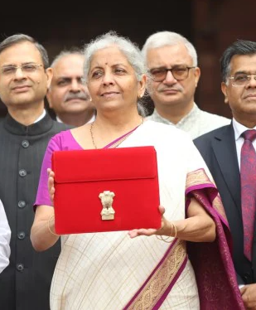
Analysis of Union Budget 2024-25
31st Awareness Program
F.M. Nirmala Sitharaman presented 7th consecutive budget surpassing former PM Morarji Desai’s record, who delivered 5 full budgets & one interim budget between 1959-64.
SIRC of ICAI

Slide 2
Analysis of Union Budget 2024-25

Slide 3
Analysis of Union Budget 2024-25
Contributors:
Krishnan S, Mayank M, Ravi S, Sivaram R, Shweta D, Hari D, Janvi V
SIRC of ICAI

Slide 4
India - A glance
Estimates
Population | 1.395 bn | July 2024
Population Growth Rate | 0.8% | July 2024
Life Expectancy: Male | 70.5 yrs | 2023
Life Expectancy: Female | 73.6 yrs | 2023
Literacy | 78% | 2022
GDP (at current prices) | US$ 3,600 bn | ES 2024
Real GDP growth | 8.2% | ES 2024
GDP (in PPP) 3rd Largest | US $14,600 bn | 2024
Per capita Income | US $2,600 | ES 2024
Exports (goods and services) | US $ 778 bn | Chart 4 ES
Imports (goods and services) | US $ 854 bn | Chart 4 ES
Foreign Exchange Reserves | US $ 654 bn | (ES) June 2024
Government External Borrowings | US $ 149 bn | (RBI) March 2024
External Debt (Govt & Non-Govt) | US $ 664 bn | (ES) March 2024
Interest to Gross Revenue | 24% | 2024 RE (Budget)

Slide 5
India – Key Economic Indicators 2024 vs. 1991 ….. 33 years’ snapshot post liberalisation
 | 2024 | 1991 | CAGR
Population (Bn) | 1.395 | 0.89 | 1.4%
Life expectancy (Years) | 72 | 59 | 0.6%
Literacy rate | 78% | 52% | 1.2%
GDP Growth Rate | 8.2% | 5.3%
GDP (at current prices) – Rs. cr | 295 | 5 | 12.9%
GDP (at current prices) - US$ Bn | 3,600 | 275 | 8.1%
Per capita income - US$ | 2,600 | 310 | 6.5%
Exports (G+S) - US$ Bn | 778 | 18 | 12.1%
Imports (G+S) - US$ Bn | 854 | 24 | 11.4%
Share in world trade (exports + imports) | 3% | 1%
Foreign Currency Reserves - US$ Bn | 654 | 6 | 15.4%
Exchange Rate (US $) | 83 | 18 | 4.8%
Savings Rate (May 2024) | 29.7% | 22.9%
Investment Rate (May 2024) | 32.2% | 22.5%
Investments | 1 Tr$

Slide 6
India’s GDP Growth % - Last 10 Years
Real GDP & Nominal GDP expected to grow approximately @ 6.5%-7% & 10.5% respectively in 2024-25 (ES & Budget)

Slide 7
India – GDP Projection
We are where China was in 2008
India could achieve a projected GDP of $8 Trillion and per capita income of $5,625 by 2030 on account of India’s demographic dividend and a sharp rise in working population. – CBRE
If India wants to build a $10 Trillion economy by 2030, it needs to grow at 18.6% CAGR
To reach the same by 2033, it needs to grow at 12% CAGR

Slide 8
India per-capita income
 | GDP- Lakh Cr | % | Population- Cr | % | Per capita
India | 295 |  | 139.2 |  | 211,875
U.P. | 25 | 9% | 23.6 | 17% | 107,745
Bihar | 8 | 3% | 12.7 | 9% | 58,963
Others | 262 | 88% | 102.8 | 74% | 254,755
Two poor states namely U.P. & Bihar with 36.3 crore combined population have a very low per-capita income and need substantial financial resources. Excluding these 2 states, India’s per-capita income rises to Rs. 255,000 from Rs. 212,000

Slide 9
Sectors
Per-capita Gross Value Added (GVA) analysis
Sector | GVA (cr) FY’24 | Workforce distribution | Per-capita GVA FY’24* | Ratio | Per-capita GVA FY’20* | Ratio | 4-year CAGR*
Agriculture | 47,25,223 | 45.80% | 73,436 | 1 | 55,594 | 1 | 7.2%
Industry | 73,92,965 | 25.20% | 2,08,820 | 2.8 | 1,55,450 | 2.8 | 7.7%
Services | 1,46,43,960 | 29.00% | 3,59,431 | 4.9 | 2,21,391 | 4.0 | 12.9%
Total | 2,67,62,148 | 100.00% | 1,90,491 | – | 1,34,902 | – | 9.0%
Sectoral Per capita GVA of Agriculture increased by ₹ 17,482, for industry it has increased by ₹ 53,370 and service industry by ₹ 1,38,040 and the gap is expanding and creating discontent among people in agriculture.

Slide 10
GDP Growth Forecast
IMF GDP Growth Forecast (WEO April 2024 Update)
 | 2024 | 2025 | 2026
World | 3.2% | 3.2% | 3.2%
Advanced Economies | 1.7% | 1.8% | 1.8%
United States | 2.7% | 1.9% | 2%
Euro Area | 0.8% | 1.5% | 1.4%
India* | 6.8% | 6.5% | 6.5%
UK | 0.5% | 1.5% | 1.7%
Japan | 0.9% | 1% | 0.8%
Emerging Market Economies | 4.2% | 4.2% | 4.1%
China | 4.6% | 4.1% | 3.8%

Slide 11
The World is Changing …
GDP in $ trillion
Regions | 2024 | 2025 | 2033 | CAGR (2024-2033)
US | 28.8 | 29.8 | 35.9 | 2.5%
EU22 | 17.9 | 18.5 | 20.5 | 1.5%
Japan | 4.1 | 4.3 | 5.1 | 2.5%
Others | 16.1 | 16.8 | 20.1 | 2.5%
Total OECD | 66.9 | 69.5 | 81.7 | 2.2%
China | 18.5 | 19.8 | 26.4 | 4.0%
India | 3.6 | 3.9 | 7.1 | 8.0%
Others | 19.7 | 20.6 | 33.3 | 6.0%
Total: RoW | 42.0 | 44.4 | 66.8 | 5.3%
Total Global | 108.7 | 113.9 | 148.5 | 3.5%
Source: IMF, WEO Database & projections

Slide 12
India & China – at a glance ……………..China has grown faster
 | Estimates as of | India | China
Population | 2023 (E) | 1.395 bn | 1.454 bn
Population Growth Rate | 2023 (E) | 0.8% | -0.14%
Life Expectancy: Male | 2021 (E) | 68.71 yrs | 75 yrs
Life Expectancy: Female | 2021 (E) | 71.49 yrs | 80.88 yrs
Literacy | 2022 (E) | 78% | 96.8%
GDP (current) | 2023-24 | US $ 3.60 Tn | US $ 18.53 Tn
GDP growth (Real) | 2023-24 | 8.2% | 4.6%
GDP (in PPP) | 2023 (E) | US $ 14.59 Tn | US $ 35,29 Tn
Per capita Income (current) | 2023-24 (E) | US $ 2,600 | US $ 13,140
Exports (Goods & Services) | 2023-24 (E) | US $ 776.68 bn | US $ 3.82 Tn
Imports (Goods & Services) | 2023-24 (E) | US $ 854.80 bn | US $ 2.72 Tn
Foreign Currency Reserves | Dec 2023(E) | US $ 654.6 bn | US $3.11 Tn
External Debt | Dec 2023(E) | US $ 648.2 bn | US $2.45 Tn
Debt / GDP ratio | Q1 2023 | 83% | 287.8%

Slide 13
Video 1
FM Speech – Para 2 & 3
Global context
The global economy, while performing better than expected, is still in the grip of policy uncertainties. Elevated asset prices, political uncertainties and shipping disruptions continue to pose significant downside risks for growth and upside risks to inflation.
In this context, India’s economic growth continues to be the shining exception and will remain so in the years ahead. India’s inflation continues to be low, stable and moving towards the 4 per cent target. Core inflation (non- food, non-fuel) currently is 3.1 per cent. Steps are being taken to ensure supplies of perishable goods reach market adequately.

Slide 14
Global Context
SIRC of ICAI
India has grown well while ROW is in stress. During covid, GoI followed prudent policies and invested in growth-oriented areas which provided good results.
Please comment on COVID & post COVID economic strategies of the OECD and India

Slide 15
Video 2
FM Speech – Para 7
Budget priorities
The people have given a unique opportunity to our government to take the country on the path of strong development and all-round prosperity.
In the interim budget, we promised to present a detailed roadmap for our pursuit of ‘Viksit Bharat’. In line with the strategy set out in the interim budget, this budget envisages sustained efforts on the following 9 priorities for generating ample opportunities for all.
1) Productivity and resilience in Agriculture
2) Employment & Skilling
3) Inclusive Human Resource Development and Social Justice
4) Manufacturing & Services
5) Urban Development
6) Energy Security
7) Infrastructure
8) Innovation, Research & Development and
9) Next Generation Reforms

Slide 16
Budget priorities
SIRC of ICAI
1) Productivity and resilience in Agriculture
2) Employment & Skilling
3) Inclusive Human Resource Development and Social Justice
4) Manufacturing & Services
5) Urban Development
6) Energy Security
7) Infrastructure
8) Innovation, Research & Development and
9) Next Generation Reforms
Are these priorities appropriate for India to become the third largest economy in three years?

Slide 17
Video 3
FM Speech – Para 11 & 12
Productivity and Resilience in Agriculture
New 109 high-yielding and climate-resilient varieties of 32 field and horticulture crops will be released for cultivation by farmers.
Natural Farming
In the next two years, 1 crore farmers across the country will be initiated into natural farming supported by certification and branding. Implementation will be through scientific institutions and willing gram panchayats. 10,000 need-based bio-input resource centres will be established.

Slide 18
Strong Agricultural Base
Food Grains
Milk
Cotton
Horticulture
Sugar
Spices
Cropland
Livestock
Production (Mn tonnes)
Production (Mn tonnes)
Exports
(in USD Bn)
(Mn hectares)
Production (Mn tonnes)
Production (Mn bales)
Production (Mn tonnes)
Population (Mn)
329.68
(2nd largest)
236.35
(Largest)
31.6
(Largest)
355.48
(2nd largest)
32
(Largest)
4.25
(Largest)
200.2
(Largest)
536.78
(Largest)
INDIA
Major producer of agrochemicals, tea, cashew, jute, oilseeds, etc.
Largest exporter of cereal products, cotton, bovine meat, sugar, etc.
All 15 major climates in the world; 46 of the 60 soil types in the world
Largest manufacturers of farm equipment
Proximity to food importing nations
Source: PIB, IBEF, Economic Survey 2021-22, Government of India reports

Slide 19
Productivity and resilience in Agriculture
SIRC of ICAI
To review agriculture research setup to focus on raising productivity and developing climate resilient varieties
New 109 high-yielding and climate-resilient varieties of 32 field and horticulture crops will be released for cultivation by farmers
1 crore farmers to be initiated into natural farming
To set up 10,000 need-based bio-input resource centres
Large scale clusters for vegetable production to be developed closer to major consumption centers
To set up Digital Public Infrastructure (DPI) in agriculture to cover farmers and their lands in 3 years
To bring out a National Cooperation Policy to develop co-operative sector
Provision of Rs. 1.52 lakh crore for agriculture and allied sector

Slide 20
Productivity and resilience in Agriculture
SIRC of ICAI
Is the budgetary strategy adequate to improve agriculture productivity?
How can India increase farmer’s income from non-MSP agriculture products?
How can India become a global export power-house in agriculture?

Slide 21
Video 4
FM Speech – Para 19
Employment Linked Incentive
Our government will implement following 3 schemes for ‘Employment Linked Incentive’, as part of the Prime Minister’s package. These will be based on enrolment in the EPFO, and focus on recognition of first-time employees, and support to employees and employers.

Slide 22
Formal jobs are growing
 | Net new EPF subscribers |  | Net new ESI subscribers
 | Ages 18-25 | Women | Ages 18-25 | Women
2018-19 | 61,12,223 |  | 1,49,65,972
 | 67.31% | 21.35% | 48.20% | 16.60%
2019-20 | 78,58,394 |  | 1,51,45,261
 | 60.27% | 20.28% | 48.60% | 17.90%
2020-21 | 77,08,375 |  | 1,15,05,302
 | 55.12% | 18.14% | 48.40% | 16.30%
2021-22 | 1,22,34,625 |  | 1,49,12,698
 | 52.09% | 21.40% | 48.20% | 18.50%
2022-23 | 1,38,51,689 |  | 1,67,73,023
 | 49.46% | 20.72% | 47.52% | 19.62%
2023-24 | 1,53,38,421 |  | 1,86,39,065
 | 48.68% | 19.70% | 47.00% | 19.24%
Source: EPF, MOSPI

Slide 23
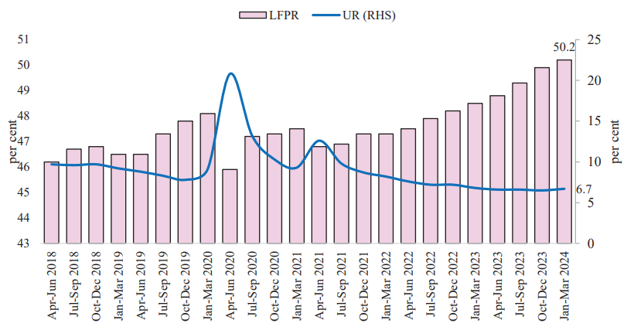
Declining quarterly urban unemployment rate
LFPR - Labour Force Participation Rate
WPR - Worker Population Ratio
UR – Unemployment Rate

Slide 24
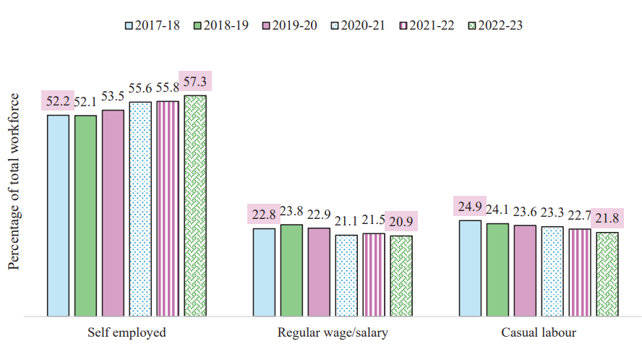
Trend in broad category wise employment status
Source : ES

Slide 25
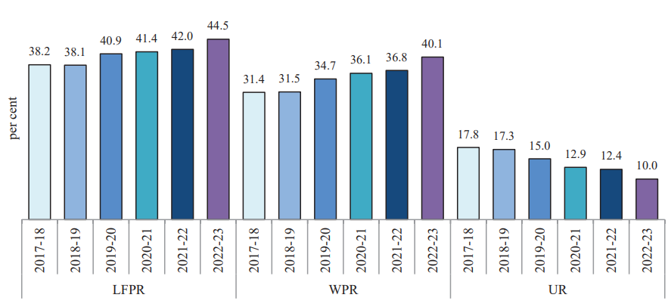
Youth employment indicators
Source : ES
LFPR - Labour Force Participation Rate
WPR - Worker Population Ratio
UR – Unemployment Rate

Slide 26
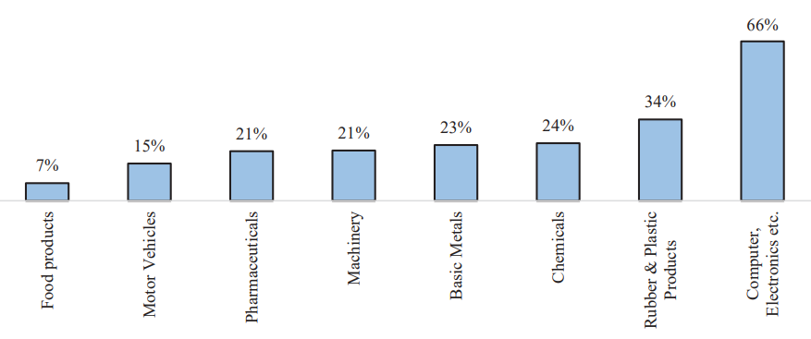
Total growth in employment in 5 years: FY18 to FY22
Source : ES

Slide 27
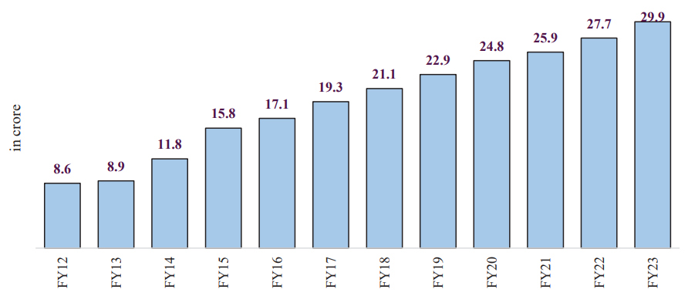
Rising EPFO membership
Source : ES

Slide 28
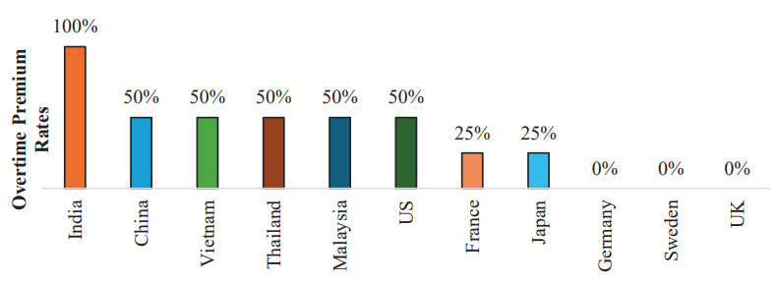
India has a higher overtime wage premium
Source : ES

Slide 29
Employment & Skilling
SIRC of ICAI
To implement following 3 schemes for ‘Employment Linked Incentive’
First scheme to provide one month’s wage as subsidy (maximum Rs. 15,000) to all persons newly entering the workforce (EPFO) with wage/ salary less than Rs. 1 lakh per month
Subsidy to assist employees and employers in hiring of first timers
Expected to cover approximately one crore persons per annum
Second scheme to incentivize additional employment in the manufacturing sector, linked to the employment of first-time employees
Under third scheme, govt to reimburse employers up to Rs. 3,000 p.m. for 2 years towards their EPFO contribution for each additional employee
Under Skilling programme, 1,000 ITIs to be upgraded in hub and spoke arrangements in five years for total outlay of Rs. 60,000 crs
Model Skill Loan Scheme to be revised to facilitate loans up to Rs. 7.5 lakh with a guarantee from a government promoted Fund

Slide 30
Employment & Skilling
SIRC of ICAI
Is the government doing enough to develop human capital in the country?
Are we adequately investing in higher education to meet our future needs?
Will India reap demographic dividend?
Are these measures sufficient to generate well paying jobs in our country?

Slide 31
Inclusive HRD and Social Justice
SIRC of ICAI
To formulate Purvodaya for the all-round development of the eastern India
To set up more than 100 branches of India Post Payment Bank up in the North-East region to expand the banking services.
To develop an industrial node at Gaya
To set up new 2400 MW power plant at Pirpainti at a cost of Rs. 21,400 crs.
New airports, medical colleges and sports infra to be created in Bihar
Three crore additional houses under the PM Awas Yojana
Allocation of more than Rs. 3 lakh cr for schemes benefitting women and
girls
Rs. 2.66 lakh crs provided for rural development including rural infra
Are any other measures required to improve the rural sector?

Slide 32
Video 5
FM Speech – Para 42
Support for promotion of MSMEs
This budget provides special attention to MSMEs and manufacturing, particularly labour-intensive manufacturing. We have formulated a package covering financing, regulatory changes and technology support for MSMEs to help them grow and also compete globally, as mentioned in the interim budget

Slide 33
Support to promote MSMEs
SIRC of ICAI
Credit Guarantee Scheme for MSMEs in the manufacturing sector for purchase of machinery and equipment without collateral or third-party guarantee to be introduced
New assessment model for MSME credit based on the scoring of digital footprints of MSMEs in the economy. To benefit MSMEs without formal accounting system
To enable MSMEs to unlock their working capital by converting their trade receivables into cash, turnover threshold of buyers for mandatory onboarding on the TReDS platform reduced to Rs. 250 crore
Credit Support to MSMEs during Stress Period
Mudra loans to be enhanced to Rs. 20 lakh for those entrepreneurs who have successfully repaid previous loans under the ‘Tarun’ category
SIDBI to open new branches in all major MSME clusters within 3 years
E-Commerce Export Hubs to be set up in PPP mode

Slide 34
Support to promote MSMEs
SIRC of ICAI
Will this outlay for MSME make it more resilient, competitive and efficient?
Do these measures ensure adequate lending to MSMEs which are starved to credit?
What more needs to be done to make MSMEs grow?

Slide 35
Video 6
FM Speech – Para 52 to 54
Industrial parks
Our government will facilitate development of investment-ready “plug and play” industrial parks with complete infrastructure in or near 100 cities, in partnership with the states and private sector, by better using town planning schemes.
Twelve industrial parks under the National Industrial Corridor Development Programme also will be sanctioned.
Rental Housing
Rental housing with dormitory type accommodation for industrial workers will be facilitated in PPP mode with VGF support and commitment from anchor industries.

Slide 36
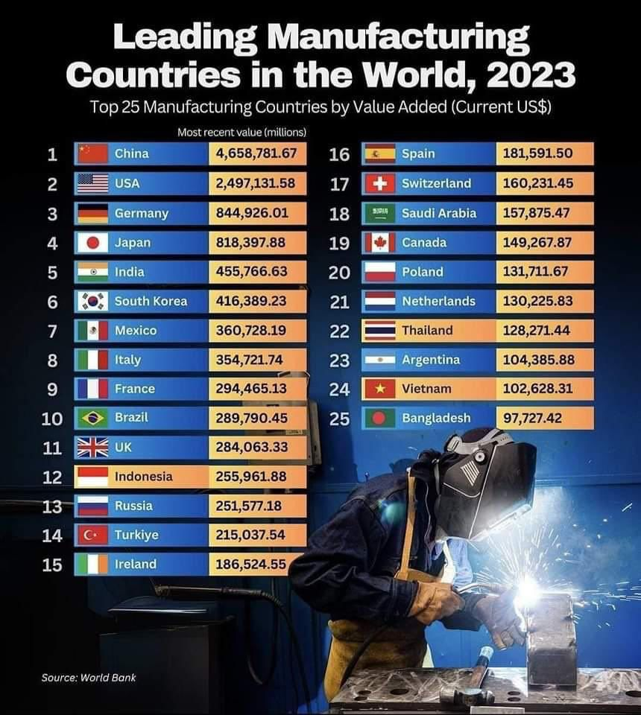
Manufacturing and Services
SIRC of ICAI

Slide 37
Manufacturing and Services
SIRC of ICAI
One crore youth to be skilled by India’s 500 top companies in five years. GoI to pay internship allowance of Rs. 5,000 p.m. along with a one-time assistance of Rs. 6,000. Companies to bear the training cost and 10% of the internship cost from their CSR funds
To develop investment-ready “plug and play” industrial parks with complete infra in or near 100 cities, jointly with states and private sector
12 industrial parks to be sanctioned under National Industrial Corridor Development Programme
Ownership, leasing and flagging reforms to be implemented to improve the share of the Indian shipping industry and generate more jobs
An Integrated Technology Platform will be set up for improving the outcomes under the Insolvency and Bankruptcy Code (IBC)
Appropriate changes to the IBC and strengthening of the tribunals to be initiated to speed up insolvency resolution. Debt recovery tribunals to be strengthened

Slide 38
Manufacturing and Services
SIRC of ICAI
Do these proposals help in promoting India as a manufacturing destination to the world?
Should the PLI scheme be extended to manufacturing and services to make India manufacturing sector more competitive?

Slide 39
Video 7
FM Speech – Para 64 to 65
Cities as Growth Hubs
Working with states, our government will facilitate development of ‘Cities as Growth Hubs’. This will be achieved through economic and transit planning, and orderly development of peri-urban areas utilizing town planning schemes.
Creative redevelopment of cities
For creative brownfield redevelopment of existing cities with a transformative impact, our government will formulate a framework for enabling policies, market-based mechanisms and regulation.

Slide 40
Urban Development
SIRC of ICAI
To facilitate development of ‘Cities as Growth Hubs’
PM Awas Yojana Urban 2.0 to provide housing to 1 cr urban poor and middle-class families with an investment of Rs. 10 lakh crs
Enable policies and regulations for efficient and transparent rental housing
To formulate Transit Oriented Development plans for 14 large cities with a population above 30 lakh along with implementation/ financing strategy
Are we finally focusing on urban centers as engines of growth?

Slide 41
Video 8
FM Speech – Para 79
Infrastructure investment by Central Government
Significant investment the Central Government has made over the years in building and improving infrastructure has had a strong multiplier effect on the economy. We will endeavor to maintain strong fiscal support for infrastructure over the next 5 years, in conjunction with imperatives of other priorities and fiscal consolidation. This year, I have provided ` 11,11,111 crore for capital expenditure. This would be 3.4 per cent of our GDP.

Slide 42
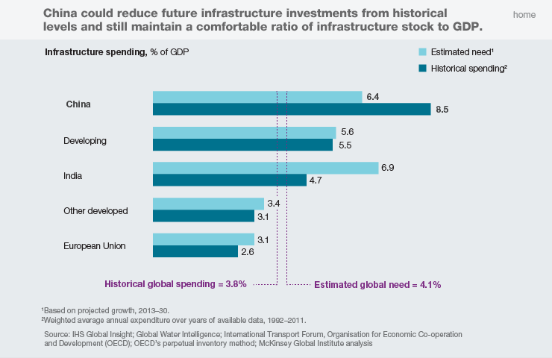
Infrastructure Investment … India is spending much below its need and China, way above

Slide 43
Strong Industrial & Infrastructural Base
Coal
Iron Ore
Aviation
Railway
Roadway
Ports
Renewable Energy
Textile
Production (MT)
Production (Mn tonnes)
Passenger Traffic (Mn)
Network (‘000 Kms)
Network
(Mn Kms)
Cargo Traffic
(million tonnes)
Capacity
(GW)
Production
(Bn Sq. Mt.)
997.25
(2nd largest)
277
(3rd largest)
327.28
(4th largest)
68.43
(4th largest)
6.7
(2nd largest)
819.3
144
(4th largest)
70.89
(2nd largest)
INDIA
Exports stood at USD 777 billion in 2023-24
Ranked 38th in Logistics Performance Index (LPI) 2023
Produces 95 minerals - 4 fuel-related, 10 metallic, 23 non-metallic, 3 atomic, and 55 others
Source: PIB, Airports Authority of India, Government of India reports, IBEF

Slide 44
Infrastructure
SIRC of ICAI
To provide Rs. 11,11,111 cr for capital expenditure, 3.4% of GDP
To provide Rs. 1.5 lakh cr as long-term interest free loans for infra investment by state govts
Viability gap funding to promote Infra investment by private sector
Financial assistance to various states for irrigation and flood mitigation
To transform Vishnupad Temple Corridor and Mahabodhi Temple Corridor into world class pilgrim and tourist destinations
To support the development of Nalanda as a tourist centre besides reviving Nalanda University to its glorious stature
Is the budgetary allocation adequate to meet India’s infrastructure requirements?
How do we access long-term low-cost capital to fund infrastructure?

Slide 45
Video 9
FM Speech – Para 95 & 96
Priority 9: Next Generation Reforms
Economic Policy Framework
We will formulate an Economic Policy Framework to delineate the overarching approach to economic development and set the scope of the next generation of reforms for facilitating employment opportunities and sustaining high growth.
Our government will initiate and incentivize reforms for (1) improving productivity of factors of production, and (2) facilitating markets and sectors to become more efficient. These reforms will cover all factors of production, namely land, labour, capital and entrepreneurship, and technology as an enabler of improving total factor productivity and bridging inequality.

Slide 46
Next Generation reforms
SIRC of ICAI
FDI and ODI rules and regulations to be simplified to (1) facilitate foreign direct investments, (2) nudge prioritization, and (3) promote opportunities for using Indian Rupee as a currency for overseas investments.
To formulate an Economic Policy Framework to enhance employment opportunities and sustain high growth
To initiate and incentivize reforms to (1) improve productivity and (2) facilitate markets and sectors to become more efficient
To allocate a significant part of the 50-year interest-free loan to promote competitive federalism and incentivize states to implement quicker reforms
To incentivize land-related reforms by State govts within the next 3 years through appropriate fiscal support
Shram Suvidha and Samadhan portals to be revamped to enhance ease of compliance for industry and trade

Slide 47
Next Generation reforms
SIRC of ICAI
To seek required legislative approval for providing an efficient and flexible mode for financing leasing of aircrafts and ships, and pooled funds of private equity through a ‘variable company structure’
Does this Budget accelerate the pace of growth?
In your opinion what are the next generation reforms required?

Slide 48
Video 10
FM Speech – Para 112 to 114
Budget Estimates 2024-25
For the year 2024-25, the total receipts other than borrowings and the total expenditure are estimated at Rs. 32.07 lakh crore and Rs.48.21 lakh crore respectively. The net tax receipts are estimated at ` 25.83 lakh crore. The fiscal deficit is estimated at 4.9 per cent of GDP.
The gross and net market borrowings through dated securities during 2024-25 are estimated at Rs. 14.01 lakh crore and Rs. 11.63 lakh crore respectively. Both will be less than that in 2023-24.
The fiscal consolidation path announced by me in 2021 has served our economy very well, and we aim to reach a deficit below 4.5 per cent next year. The Government is committed to staying the course. From 2026-27 onwards, our endeavour will be to keep the fiscal deficit each year such thatthe Central Government debt will be on a declining path as percentage of GDP.

Slide 49
Trends in Fiscal Deficit – 7 years
(Rs. cr)
Source: ES & Budget

Slide 50
Trends in Revenue and Fiscal Deficit – 7 years
(% of GDP)
Source: ES & Budget

Slide 51
Trends in Inflation (CPI) -10 years
(Source: ES)

Slide 52
Revenues for the past four years
Rs. cr
 | 2021-2022 | 2022-2023 | 2023-2024 | 2024-2025
 | Actual | Actual | Prov. Actuals | BE
Gross Tax revenue | 27,09,315 | 30,54,192 | 34,64,792 | 38,40,170
Growth in gross tax revenue (%) | 33.65% | 12.73% | 13.44% | 10.83%
Revenue Receipts – A | 21,69,905 | 23,83,207 | 27,28,412 | 31,29,200
Tax Revenue (net to Centre) | 18,04,793 | 20,97,786 | 23,26,524 | 25,83,499
Non-tax revenue | 3,65,112 | 2,85,421 | 4,01,888 | 5,45,701
Capital Receipts - B | 16,23,896 | 18,09,951 | 17,14,130 | 16,91,312
Recoveries of Loans | 24,737 | 26,161 | 27,338 | 28,000
Other Receipts | 14,638 | 46,035 | 33,122 | 50,000
Borrowing and other Liabilities * | 15,84,521 | 17,37,755 | 16,53,670 | 16,13,312
Total Receipts (A + B) | 37,93,801 | 41,93,158 | 44,42,542 | 48,20,512
Gross tax revenue growth for 2023-24 BE was 10.4% but stood at 13.4% on revised estimates!
Gross tax revenue growth for 2024-25 BE is estimated to be 10.8%
Source: Budget 2024-25
*Includes draw-down of cash balance

Slide 53
Is the Budget Credible?
Rs ‘000 cr
 | 2019-20 |  | 2020-21 |  | 2021-22 |  | 2022-23 |  | 2023-24 |  | 2024-25
 | BE | Actuals | BE | Actuals | BE | Actuals | BE | Actuals | BE | PE | BE
Receipts | 2,735 | 2,681 | 3,095 | 3,517 | 3,412 | 3,791 | 3,944 | 4,195 | 4,515 | 4,615 | 4,680
Actuals vs BE |  | 98% |  | 114% |  | 111% |  | 106% |  | 102%
Tax Receipt | 2,461 | 2,010 | 2,423 | 2,027 | 2,217 | 2,709 | 2,758 | 3,054 | 3,361 | 3,465 | 3,840
Actuals vs BE |  | 82% |  | 84% |  | 122% |  | 111% |  | 103%
Subsidies | 302 | 228 | 228 | 708 | 336 | 243 | 318 | 306 | 370 | 304 | 391
Actuals vs BE |  | 76% |  | 311% |  | 72% |  | 96% |  | 82%
Receipts growth%
CY Actuals on LY BE |  |  |  | 29% |  | 22% |  | 23% |  | 17%
CY Actuals on LY Actuals |  |  |  | 31% |  | 8% |  | 11% |  | 10%
CY BE on LY actuals |  |  | 15% |  | -3% |  | 4% |  | 8% |  | 1%
CY BE on LY BE |  |  | 13% |  | 10% |  | 16% |  | 14% |  | 4%

Slide 54
Budget estimates
SIRC of ICAI
Tax collection growth @ 13.5% is higher than nominal GDP growth @ 10.5% during 2023-24
Budget estimates have been conservative and fiscal prudence has been followed
Is India on the right path to accelerate growth with low inflation?

Slide 55
Video 11
FM Speech – Para 137 & 138
Direct Taxes
Comprehensive Review of the Income-tax Act, 1961
I am now announcing a comprehensive review of the Income-tax Act, 1961. The purpose is to make the Act concise, lucid, easy to read and understand. This will reduce disputes and litigation, thereby providing tax certainty to the taxpayers. It will also bring down the demand embroiled in litigation. It is proposed to be completed in six months.
A beginning is being made in the Finance Bill by simplifying the tax regime for charities, TDS rate structure, provisions for reassessment and search provisions and capital gains taxation.

Slide 56
Tax revenue
Rs. cr
TAX REVENUE RECEIPTS | 2022-23 | 2023-24 | 2023-24 | 2024-25
 | Actuals | (BE) | (PA) | (BE)
Gross Tax Revenue | 30,54,192 | 33,60,858 | 34,64,792 | 38,40,170
Corporation tax | 8,25,834 | 9,22,675 | 9,11,055 | 10,20,000
Income tax | 8,33,251 | 9,00,575 | 10,44,726 | 11,87,000
Customs | 2,13,372 | 2,33,100 | 2,33,067 | 2,37,745
Excise | 3,19,000 | 3,39,000 | 3,05,330 | 3,19,000
Service tax | 431 | 500 | 424 | 100
GST | 8,49,133 | 9,56,600 | 9,57,032 | 10,61,899
Taxes on Union Territories | 8,711 | 8,408 | - | 9,426
Other Taxes | 4,460 | - | 13,158 | 5,000
Direct Tax | 16,59,085 | 18,23,250 | 19,55,781 | 22,07,000
Indirect Tax | 13,95,107 | 15,37,608 | 15,09,011 | 16,33,170
Direct tax to GDP ratio | 6.1% | 6.0% | 6.6% | 6.8%
Indirect tax to GDP ratio | 5.1% | 5.1% | 5.1% | 5.0%
Total tax to GDP ratio | 11.2% | 11.1% | 11.7% | 11.8%

Slide 57
Direct Taxes
SIRC of ICAI
Comprehensive Review of the Income-tax Act, 1961 in 6 months
To make the Act concise, lucid, easy to read and understand. This will reduce disputes and litigation, thereby providing tax certainty to taxpayers. It will also bring down the demand embroiled in litigation.
Taxation of buy-back of shares
Buy-back tax to be paid by companies abolished
Amount paid on buy-back of shares by companies to be treated as dividend income by investors. Cost of such shares shall be treated as a capital loss to the investor.
Angel taxation to be abolished from FY 2024-25 for all classes of investors
Tax on share premium u/s 56(2)(viib) shall not apply from FY 2024-25.
Equalisation Levy abolished
Equalisation Levy at the rate of 2% of consideration received for e-commerce supply of goods or services abolished from 1st August 2024

Slide 58
Direct Taxes
SIRC of ICAI
Simplification and rationalization of Capital Gains taxation
STCG on specified financial assets to be taxed at 20% instead of 15%
STCG on all other financial assets and all non-financial assets continue to be taxed at applicable tax rate
LTCG on all financial and non-financial assets to be taxed at 12.50%
Indexation benefits removed
LTCG taxation abolished for unlisted bonds and debentures, debt mutual funds and market linked debentures. All CGs to be taxed at applicable rates
LTCG exemption on certain listed financial assets raised to Rs. 1.25 lakh p.a.
For LTCG classification, listed financial assets to held for more than a year and unlisted financial assets and all non-financial assets to be held for at least 2 years
These proposals are proposed to be given effect with immediate force
To reduce the corporate tax rate on foreign companies from 40% to 35%

Slide 59
Direct Taxes
SIRC of ICAI
Simplification of Reassessment to reduce tax-uncertainty and disputes
Time limit for reassessment to be reduced from 10 years to 5 years.
An assessment to be reopened beyond 3 years from the end of the assessment year only if the escaped income is Rs. 50 lakh or more, up to a maximum period of 5 years from the end of the assessment year
In search cases, time limit reduced to 6 years before the year of search from the existing time limit of 10 years
Simplification for Charities and of TDS
Two tax exemption regimes for charities to be merged into one.
5% TDS rate on many payments to be merged into the 2% TDS rate
20% TDS rate on repurchase of units by mutual funds or UTI withdrawn.
TDS rate on e-commerce operators to be reduced from 1% to 0.1%.
TCS credit to be given in the TDS to be deducted on salary
To decriminalize delay for TDS payment up to the due date of filing returns

Slide 60
Direct Taxes
SIRC of ICAI
Litigation and Appeals
Vivad Se Vishwas Scheme, 2024 introduced to resolve certain income tax disputes pending in appeal
To deploy more officers to hear and decide appeals with large tax impact
To increase monetary limits for filing appeals related to direct taxes, excise and service tax in the Tax Tribunals, High Courts and Supreme Court to Rs. 60 lakhs, Rs. 2 crs and Rs. 5 crs respectively.
Personal Income Tax
In the new tax regime, the 5% first tax slab raised to Rs. 7 lakhs
Standard deduction for salaried employees increased to Rs. 75,000.
Deduction on family pension for pensioners to be enhanced to Rs. 25,000.
This will provide relief to about 4 crore salaried individuals and pensioners
Security Transactions Tax on futures and options of securities to be increased to 0.02% and 0.1% respectively

Slide 61
Direct Taxes
SIRC of ICAI
Is the simplification and rationalization of capital gains taxation appropriate?
Will simplification of reassessment procedure reduce tax-uncertainty and disputes?
Is the shifting of taxation of buy-back of shares to investors as dividend income appropriate?

Slide 62
Video 12
FM Speech – Para 115
Indirect Taxes
I start with GST. It has decreased tax incidence on the common man; reduced compliance burden and logistics cost for trade and industry; and enhanced revenues of the central and state governments. It is a success of vast proportions. To multiply the benefits of GST, we will strive to further simplify and rationalize the tax structure and endeavor to expand it to the remaining sectors. Entrepreneurship is vital

Slide 63
Indirect Taxes
SIRC of ICAI
To multiply the benefits of GST, govt to further simplify and rationalise the tax structure and endeavor to expand it to the remaining sectors
A comprehensive review of the customs duty rate structure to be done over the next 6 months, to rationalize and simplify it for ease of trade, removal of duty inversion and reduction of disputes
To provide relief to cancer patients, three more medicines to be fully exempt from customs duties
Basic customs duty on X-ray tubes & flat panel detectors for use in manufacture of medical X-ray machines under the Phased Manufacturing Programme to be reduced from 15% to 5%/7.5%/10%
Basic customs duty on mobile phones, mobile Printed Circuit Board Assembly and mobile charger reduced to 15% from 20%
To expand the list of exempted capital goods for use in the manufacture of solar cells and panels in the country

Slide 64
Indirect Taxes
SIRC of ICAI
To enhance domestic value addition in gold and precious metal jewellery, customs duties on gold and silver to be reduced to 6% from 15% and that on platinum to 6.4% from 15.4%
Basic Customs Duty on ferro nickel and blister copper to be removed
To incentivize domestic manufacturing, BCD on Printed Circuit Board Assembly of specified telecom equipment increased from 10 to 15%
To support existing and new capacities in the pipeline, BCD on ammonium nitrate increased from 7.5 to 10%
Increase in customs duty of laboratory chemicals under heading 9802 from 10% to 150%

Slide 65
Indirect Taxes
SIRC of ICAI
Do these indirect tax proposals help in promoting exports, boost domestic manufacturing and increase tax collection?
Do these indirect tax proposals help in reducing compliance burden and improving tax administration?

Slide 66
Conclusion
SIRC of ICAI
Does the budget put us on a high growth path to meet the 5 trillion $ mark by 2026 & the 10 trillion $ mark by 2033*?
*India needs to grow at a nominal rate of 12% (@ Rs. 82.5 to USD) to meet this target

Slide 67
THANK YOU

