Slide 1
SA 220 – Quality Control in an Audit of Financial Statements
Seminar on Standards on Auditing
12 June 2024
ICAI – Bengaluru Branch
CA Shristi Sarayan

Slide 2
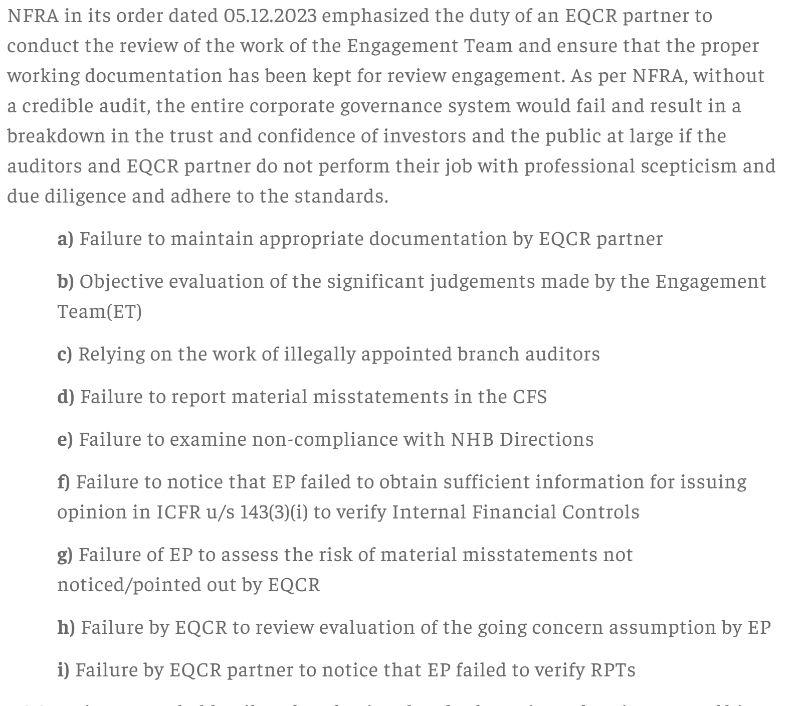
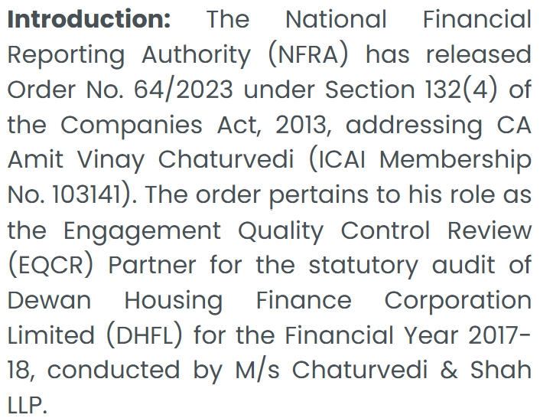

Slide 3
Focus on Audit Quality
There has been a significant focus on audit firms to build and maintain higher levels of audit quality:
The various orders from NFRA appear to indicate lapses in application of professional judgment or skepticism
There is responsibility placed equally on the EQCR Partner as on the Engagement Partner with both penalties and debarment being the consequent impact on audit lapses

Slide 4
SA 220 - Quality Control in an Audit of Financial Statements
Quality
Client/ Engagement Acceptance
Engagement Partner & Team
EQCR
Performance
Monitoring
SQC

Slide 5
Objective of SA 220
To implement quality control procedures at the engagement level that provide the auditor with reasonable assurance that:
The audit complies with professional standards and regulatory and legal requirements; and
The auditor’s report issued is appropriate in the circumstances.
Implementation of Quality Control Procedures – requires a Firm /Auditor to have established appropriate SQC policies which are available for reference to all personnel and there is a process to ensure compliance of such policies. This is also required under the ICAI - AQMM
For an Audit to comply: Availability of a Standard Audit Practice Manual provided to all personnel within the audit function to ensure consistent compliance with professional standards and compliance with applicable laws and regulations (through checklists etc.). This is also required under the ICAI - AQMM

Slide 6
Objective of SA 220
To implement quality control procedures at the engagement level that provide the auditor with reasonable assurance that:
The audit complies with professional standards and regulatory and legal requirements; and
The auditor’s report issued is appropriate in the circumstances.
Implementation of Quality Control Procedures – requires a Firm /Auditor to have established appropriate SQC policies which are available for reference to all personnel and there is a process to ensure compliance of such policies. This is also required under the ICAI - AQMM
For an Audit to comply: Availability of a Standard Audit Practice Manual provided to all personnel within the audit function to ensure consistent compliance with professional standards and compliance with applicable laws and regulations (through checklists etc.). This is also required under the ICAI - AQMM

Slide 7
Objective of SA 220
To implement quality control procedures at the engagement level that provide the auditor with reasonable assurance that:
The audit complies with professional standards and regulatory and legal requirements; and
The auditor’s report issued is appropriate in the circumstances.
Implementation of Quality Control Procedures – requires a Firm /Auditor to have established appropriate SQC policies which are available for reference to all personnel and there is a process to ensure compliance of such policies. This is also required under the ICAI - AQMM
For an Audit to comply: Availability of a Standard Audit Practice Manual provided to all personnel within the audit function to ensure consistent compliance with professional standards and compliance with applicable laws and regulations (through checklists etc.). This is also required under the ICAI - AQMM
Audit Report : The basis of conclusions reached by the Engagement Partner are free from any bias, and the conclusions are clearly drafted in the Report. i.e. : qualification not hidden as an EoM

Slide 8
Objective of SA 220
Implementation of Quality Control Procedures – requires a Firm /Auditor to have established appropriate SQC policies which are available for reference to all personnel and there is a process to ensure compliance of such policies. This is also required under the ICAI - AQMM
To implement quality control procedures at the engagement level that provide the auditor with reasonable assurance that:
The audit complies with professional standards and regulatory and legal requirements; and
The auditor’s report issued is appropriate in the circumstances.
For an Audit to comply: Availability of a Standard Audit Practice Manual provided to all personnel within the audit function to ensure consistent compliance with professional standards and compliance with applicable laws and regulations (through checklists etc.). This is also required under the ICAI - AQMM
Audit Report : The basis of conclusions reached by the Engagement Partner are free from any bias, and the conclusions are clearly drafted in the Report. i.e. : qualification not hidden as an EoM

Slide 9
Requirements
Leadership Responsibilities for Quality on Audits
Relevant Ethical Requirements
Engagement Performance
Acceptance & Continuance of Client Relationships and Audit Engagements
Monitoring
Premised on basis of SQC1 being applicable to the Firm
Notes:
SQC 1 deals with the firm’s responsibilities to establish and maintain its system of quality control for audit engagements. The system of quality control includes policies and procedures that address same elements as listed above and an additional element relating to human resources. When considering compliance with this standard, the engagement team needs to also consider the reliance on the firm’s system of quality control, unless information provided by the firm or other parties suggest otherwise, in relation to for example:
- Competence of personnel through their recruitment and formal training.
Independence through the accumulation and communication of relevant independence information.
Maintenance of client relationships through acceptance and continuance systems.
Adherence to regulatory and legal requirements through the monitoring process.

Slide 10
Common Pitfalls
Need for compliance

Slide 11
Leadership Responsibilities for Quality on Audits
Responsibility of the engagement partner in an audit engagement and the actions to be undertaken by him/her to deliver his/her responsibility or appropriate messages to the other members of the engagement team, to include emphasis on:
The importance to audit quality of
Performing work that complies with professional standards and regulatory and legal requirements;
Complying with the firm’s quality control policies and procedures as applicable;
Issuing auditor’s reports that are appropriate in the circumstances; and
The engagement team’s ability to raise concerns without fear of reprisals; and
The fact that quality is essential in performing audit engagements.
There should be clear demarcation in the role and responsibilities of the engagement partner and other partners (if any) on the engagement
Engagement Quality Control Reviewer (EQCR) should be appointed on a timely basis for audits of financial statements of listed entities, and those other audit engagements, if any, for which the firm has determined that an engagement quality control review is required. EQCR is not part of Engagement Team
Engagement partner has to independently carry out his responsibility and must not rely purely on the review carried out by the EQCR
Notes:
Engagement Partner is the partner or other person in the firm who is a member of the ICAI and is in full time practice and is responsible for the engagement and its performance, and for the report that is issued on behalf of the firm, and who, where required, has the appropriate authority from a professional, legal or regulatory body. Any other partner assigned to the audit engagement, who is not an EQCR or Specialist and is involved in assisting the engagement partner in the audit engagement is to be considered as a Support Partner.
Roles and responsibilities of the engagement partner and support partner should be agreed upon upfront before start of the audit engagement and documented.
Engagement partner is responsible for the overall quality on each audit engagement to which such partner is assigned
In order to take responsibility for the overall audit quality on the audit engagement, the actions of the engagement partner and appropriate messages to the other members of the engagement team, is to emphasis:
The importance to audit quality of:
(i) Performing work that complies with professional standards and regulatory and legal requirements;
(ii) Complying with the firm’s quality control policies and procedures as applicable;
(iii) Issuing auditor’s reports that are appropriate in the circumstances; and
(iv) The engagement team’s ability to raise concerns without fear of reprisals; and
The fact that quality is essential in performing audit engagements.

Slide 12
Relevant Ethical Requirements
Sufficient inquiries should be carried out by the engagement partner with the engagement team for any non-compliance with relevant ethical requirements
Compliance with all the components of Code of Ethics (i.e. Integrity, Objectivity, Professional competence and due care, confidentiality and professional behavior) to be ensured in the engagements
While evaluating compliance with the ethical and independence requirements, all relevant details of firm/ network/ network firms to be considered
Information on identified breaches to the firm’s independence policies and procedures, if any, to be evaluated for the audit engagement’s threat to independence
Actions taken for eliminating independence threats (identified if any) in an audit engagement to be communicated within the firm as per firm’s independence policies and procedures
Engagement partner’s conclusion on compliance with relevant ethical and independence requirements by the engagement team to be documented in the audit file

Slide 13
Acceptance & Continuance of Client Relationships and Audit Engagements
Appropriate procedures as per SQC 1 to be carried out before accepting
an engagement with a new client
continuance of an existing engagement
a new engagement with an existing client
All the relevant information should be considered when evaluating the acceptance and continuance of client relationship and audit engagement
In case of an engagement with a new client, communication with predecessor auditor to be carried out in written form by providing adequate time to respond
Audit work should not be performed before communicating with predecessor auditor in case of initial audit engagements
Observations/ reports of predecessor auditor should be considered while accepting and continuing the client relationships and audit engagements
Information obtained that could have caused the firm to decline the engagement should be communicated to the firm by the engagement partner

Slide 14
Acceptance & Continuance of Client Relationships and Audit Engagements contd.
Reasons for non-continuance / non-appointment of the previous firm should be considered when evaluating acceptance and continuance decision
Client’s aggressiveness with maintaining firm’s fee as low as possible to be evaluated when considering acceptance and continuance decision
Engagement partner’s satisfaction of whether the appropriate procedures were followed, and appropriate conclusions reached regarding the acceptance and continuance of client relationships and audit engagement should be documented
Competence and capabilities required for the audit engagement whether available with the engagement team to be evaluated before acceptance/ continuance
Involvement of auditor’s experts should be considered in audit engagements, which may require such expertise which may not be available with the engagement team
Engagement partner’s satisfaction of the competence and capability of the engagement team and auditor’s experts to perform the audit engagement in accordance with professional standards and regulatory and legal requirements and enable an auditor’s report that is appropriate in the circumstances to be issued, should be documented

Slide 15
Engagement Performance
Direction, supervision and performance
Reviews
Consultation
Engagement Quality Control Review
Differences of Opinion

Slide 16
Engagement Performance Direction, supervision and performance
Engagement team should be informed of their roles and responsibilities, including the need to comply with the ethical requirements
Engagement team must be informed/ stressed upon to plan and perform the audit with professional skepticism
Culture to be developed or environment to be provided for the less experienced engagement team member to have appropriate communication/ discussions with more experienced team members
Appropriate guidance and training to be provided to the engagement team to clearly understand the objectives of the assigned work
Engagement team to be made aware of the nature of entity’s business/ risks related issues or the problems that may arise
Engagement team to be informed of the detailed audit approach to the performance of the engagement

Slide 17
Engagement Performance Direction, supervision and performance contd.
Audit Engagement’s progress is to be tracked
Competence and capabilities of individual members of the engagement team to be considered when evaluating whether they have sufficient time to carry out their work
Appropriate supervision should be there to confirm whether the engagement team has understood the instructions and whether the work is being carried out in accordance with the planned approach to the audit engagement
Significant matters arising during the audit engagement should be considered for modification of the planned audit approach
Matters for consultation or consideration to be identified by more experienced engagement team members

Slide 18
Engagement Performance Reviews
Engagement team’s work should be reviewed in accordance with firm policies and procedures
Work of less experienced engagement team members should be reviewed by more experienced team members as required as per SQC1
Work should be reviewed at appropriate stages of audit or on a timely basis
Work should be performed in accordance with professional standards and regulatory and legal requirements
Significant matters to be raised for further consideration
Appropriate consultations to be undertaken by the engagement team
Resulting conclusions of consultations undertaken should be documented and implemented
Revision to be done to the nature, timing and extent of work performed

Slide 19
Engagement Performance Reviews contd.
Work performed should support the conclusions reached
Evidence obtained by the engagement team to be sufficient and appropriate to support the auditor’s report
Objectives of the engagement procedures must be achieved
Engagement partner to be involved in review of at appropriate stages of audit and significant matters to be resolved on a timely basis such as:
Critical areas of judgment, especially those relating to difficult or contentious matters identified during the course of the engagement;
Significant risks; and
Other areas the engagement partner considers important
Review comments/observations to be resolved and actioned upon and appropriately documented

Slide 20
Engagement Performance Consultation
Engagement team shall undertake appropriate consultation on difficult or contentious matters
Such consultations shall be done with appropriate parties/ levels- i.e. either they have appropriate knowledge, seniority and/or experience (within the engagement team, and between the engagement team and others within or outside the firm)
Where firm lacks appropriate resources, consultations to be done outside the firm, if the requirement exists
All the relevant facts must be provided for consultation
Nature and scope of, and conclusions resulting from, such consultations to be agreed by the engagement partner with the party consulted
Implementation of the conclusions resulting from such consultations to be ensured by the engagement partner

Slide 21
Engagement Performance Engagement Quality Control Reviews
Engagement quality control review should be conducted in a timely manner at appropriate stages so that it does not result in unresolved significant matters to the EQCR’s satisfaction on or before the auditor’s report date
EQCR to be involved in
review of consultations undertaken by the engagement team
determining the use of experts and specialists
review of audit documentation relating to the significant judgments the engagement team made and the conclusions reached
EQCR to carry out an objective evaluation of the significant judgments made by the engagement team and the conclusions reached in formulating the auditor’s report (including identification, communication and reporting of Key Audit matters, where applicable, matters for communicating to TCWG, etc.)
Significant matters arising during the audit engagement, including those identified during the engagement quality control review should be discussed by the engagement partner with the EQCR
Auditor’s report must not be dated prior to completion of the engagement quality control review

Slide 22
Engagement Performance Engagement Quality Control Reviews contd.
In case of listed entity audit engagement, below items to be reviewed by EQCR in specific:
Engagement team’s evaluation of the firm’s independence in relation to the audit engagement
Whether appropriate consultation has taken place on matters involving differences of opinion or other difficult or contentious matters
conclusions arising from those consultations
Significant judgements used by the engagement team to identify significant risks as per SA 315, and the responses to those risks in accordance with SA 330
Significant judgements used by the engagement team to identify and response to fraud risks in accordance with SA 240
Judgements made by the engagement team to determine materiality
Significance and disposition of corrected and uncorrected misstatements identified during the audit.
Matters to be communicated to management and those charged with governance and, where applicable, other parties such as regulatory bodies.
The above items shall be considered for review by EQCR, when circumstances exist in audit of financial statements of other entities.

Slide 23
Engagement Performance Differences of Opinion
Differences of opinion within the engagement team, with those consulted or, where applicable, between the engagement partner and the engagement quality control reviewer must not remain unresolved or undealt.
Differences of opinion within the engagement team, with those consulted or, where applicable, between the engagement partner and the engagement quality control reviewer are to be dealt and resolved as per the firm’s policies and procedures for dealing with and resolving differences of opinion.

Slide 24
Monitoring
Monitoring – a process comprising an ongoing consideration and evaluation of the firm’s system of quality control, including a periodic inspection of a selection of completed engagements, designed to enable the firm to obtain reasonable assurance that its system of quality control is operating effectively.
Results of the firm’s monitoring process (as per SQC 1) as evidenced in the latest information circulated by the firm and, if applicable, other network firms and the deficiencies noted therein which may affect the audit engagements should be evaluated and considered by the engagement partner in the audit engagement.
The above shall be considered for both the observations wherein the deficiencies were noted for the audit engagements where the engagement partner was the same individual and also for the deficiencies noted at the firm level, which if circulated by the firm

Slide 25
Common Pitfalls
Documentation

Slide 26
Documentation Requirements
At the Individual Engagement Level
At the Overall Firm Level

Slide 27
Documentation Engagement team
Issues identified and its resolution with regard to compliance with relevant ethical requirements
Conclusions on independence compliance requirements and any discussions with the firm to support such conclusions
Conclusions reached with regard to acceptance and continuance of client relationships and audit engagements
Nature and scope of, and conclusions resulting from, consultations undertaken during the course of audit engagement
Work not documented is work not done!

Slide 28
Documentation Engagement quality control reviewer
Whether procedures as required by the firm’s policies on EQCR has been performed
Whether the EQCR has been completed on or before the date of the auditor’s report
If the reviewer is aware of any unresolved matters that would cause the reviewer to believe that the significant judgements the engagement team made and the conclusions they reached were not appropriate
Work not documented is work not done!

Slide 29
Documentation – Firm Level
Adequate documentation is required to be maintained at the Firm level demonstrating the monitoring process, i.e.
how the Partner and Engagement files were selected for review,
the process to ensure all Partners are subject to monitoring at regular intervals
Issues noted during the monitoring process – communications with Engagement Team and conclusions on compliance by the Engagement Team
Remediation Activities initiated by the Firm for lapses noted
Process to ensure that the Engagement Team has factored the learnings in the next engagement

Slide 30
Q & A

Slide 31
THANK YOU
shristisarayan@trueandfair.pro

