Slide 2
Why?
It’s the talk of the world

Slide 3
PRIOR TO CHAT GPT
Chatbots
Predictive Text
Predictive Responses

Slide 4
What is gpt?
Generative Pre-trained transformer

Slide 5
History of chat gpt

Slide 6
HOW DOES IT WORK?
Specialised algorithms to find patterns within data sequences
Neural network machine learning model

Slide 7
WILL CA’S BE REPLACED?

Slide 8
CHAT GPT

Slide 9
CHAT GPT

Slide 10
Chat gpt

Slide 11
Where can we use it?
Calculations
Representations
Better Presentations

Slide 12
HOW CAN WE GET MAXIMUM BENEFIT?
Keep Chatting
Let the chat be sequential
Chat to it like a colleague

Slide 13
THINGS CHATGPT CANNOT DO
Sign an audit report or certificate
Generate/Revoke UDIN
Sign a valuation report
Attend a faceless assessment under Income Tax
Do a GST “settlement”

Slide 14
vERSIONS
3.5- Free
4- Subscription based

Slide 15
versions

Slide 16
versions

Slide 17
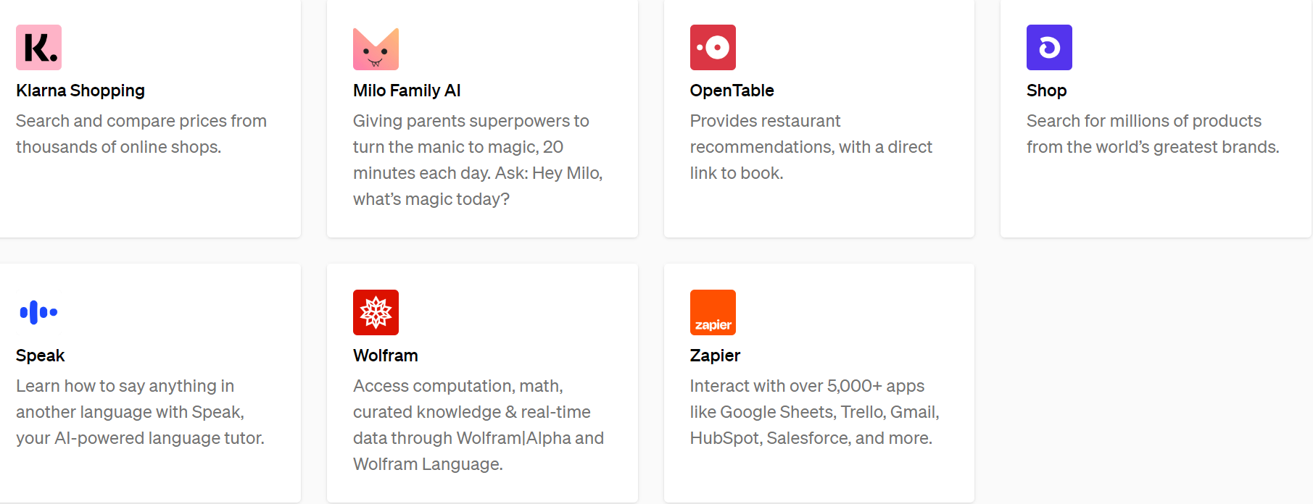
THINGS ONE CAN DO WITH CHAT GPT 4
Plug ins
Search the internet with Bing

Slide 18
CALCULATIONS- IND AS

Slide 19
PRESENT VALUE
=PV(10%, 5,,-1000000)
= Rs 620,921.41

Slide 20
Chat gpt

Slide 21
CHAT GPT
EIR
Interest

Slide 22
Accounting for interest free employee loans

Slide 23
SOLUTION

Slide 24
SFC

Slide 25
SFC

Slide 26
AUDIT REPORT

Slide 27
AUDIT REPORT

Slide 28
A BIT OF A NEGATIVE
Updated only till September 2021

Slide 29
88C

Slide 30
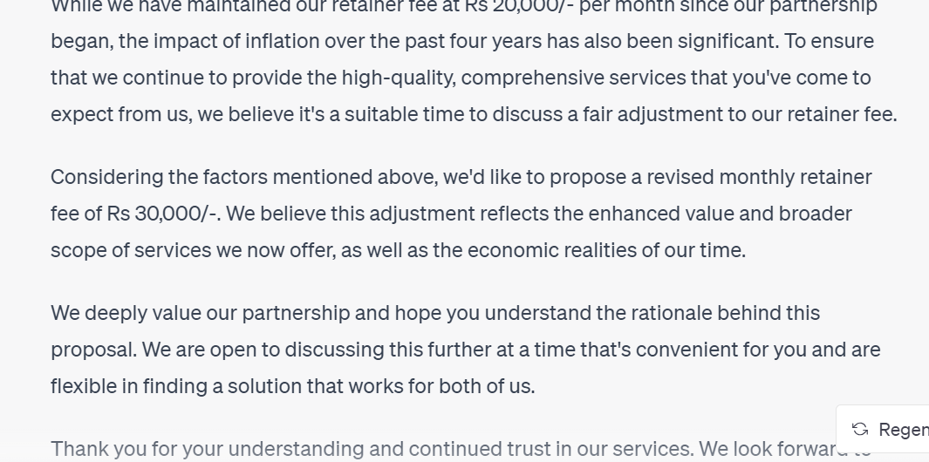
fee

Slide 31
email

Slide 32
QUESTION

Slide 33
CHAT GPT VS WINMAN?

Slide 34
names

Slide 35
Names or memes?

Slide 36
analysis

Slide 37
result

Slide 38
Practical use

Slide 39
APPEALS
We have received a demand from the GST Department in Karnataka, ACIT Audit (4), Bangalore asking us to pay GST on liquidated damages. Total amount involved is Rs 3.40 crores.
We have relied on the following cases in support of our stand that GST is not payable on liquidated damages.
South Eastern Coalfields Ltd. v. CCE&ST [2021] 124 taxmann.com 174 (New Delhi - CESTAT)
M.P. Poorva Kshetra Vidyut Vitaran Co. Ltd. v. Pr. Commissioner CGST & CE [2021] 126 taxmann.com 182 (New Delhi - CESTAT)
Commissioner of ServiceTax v. Repco Home Finance Ltd. [2020] 117 taxmann.com 755 (Chennai - CESTAT).
[2021] 128 taxmann.com 405 (Chennai – CESTAT) Neyveli Lignite Corporation Ltd. V Commissioner of Customs, Central Excise & ServiceTax, Chennai
Can you draft an appeal asking the office to drop the demands?

Slide 40
response

Slide 41
response

Slide 42
response

Slide 43
VALUATION?

Slide 44
Case laws

Slide 45
Case laws

Slide 46
VISION STATEMENT

Slide 47
VISION STATEMENT

Slide 48
CHAT GPT
Threat?
Tool?
Time-Pass?

Slide 49
The future
“ Local versions” of Chat GPT?

Slide 50
Chat gpt on chat gpt

Slide 51
FINAL WORD?
Chat GPT provides access to technology/software/plug-ins
Chartered Accountants could use this to:
Draft Appeals
Generate Newsletters
Use MS Office more effectively
Give good presentations
Improve their content

Slide 52
Thank You!
Mohan.lavi@gmail.com
+ 91 99000 22040

